Slide 1
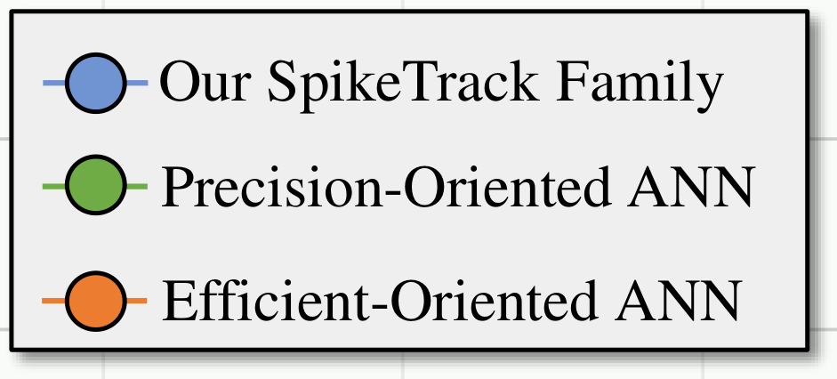
Success Rate v.s. Power on LaSOT
68.5
Our
SpikeTrack
Family
SpikeTrack
-
68
B
384
Precision
-
Oriented ANN
Efficient
-
67.5
Oriented ANN
SpikeTrack
SwinTrack
-
B
256
224
67
STARK
-
Success Rate (AUC%)
ST
50
66.5
CSWinTT
Sim
-
66
B/32
65.5
SpikeTrack
-
65
S
256
TransT
AsymTrack
-
64.5
B
HiT
-
B
64
0
10
20
30
40
50
60
70
Power (mJ)

