Slide 1
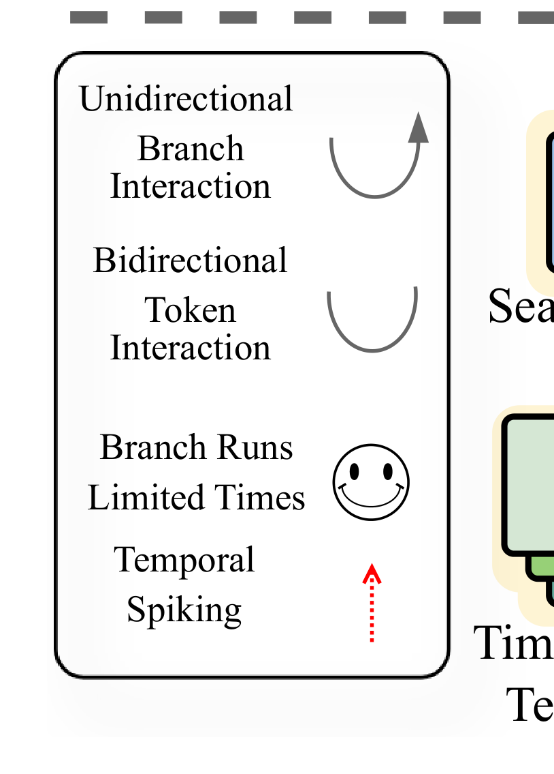
×L
Templates Concatenated
Learned Search
with Search Region
SNN Backbone
Region Feature
Unidirectional
Branch
Interaction
Bidirectional
Token
Search Region
Interaction
Branch Runs
Limited Times
Temporal
Spiking
Time-stacked
Templates

