Slide 1
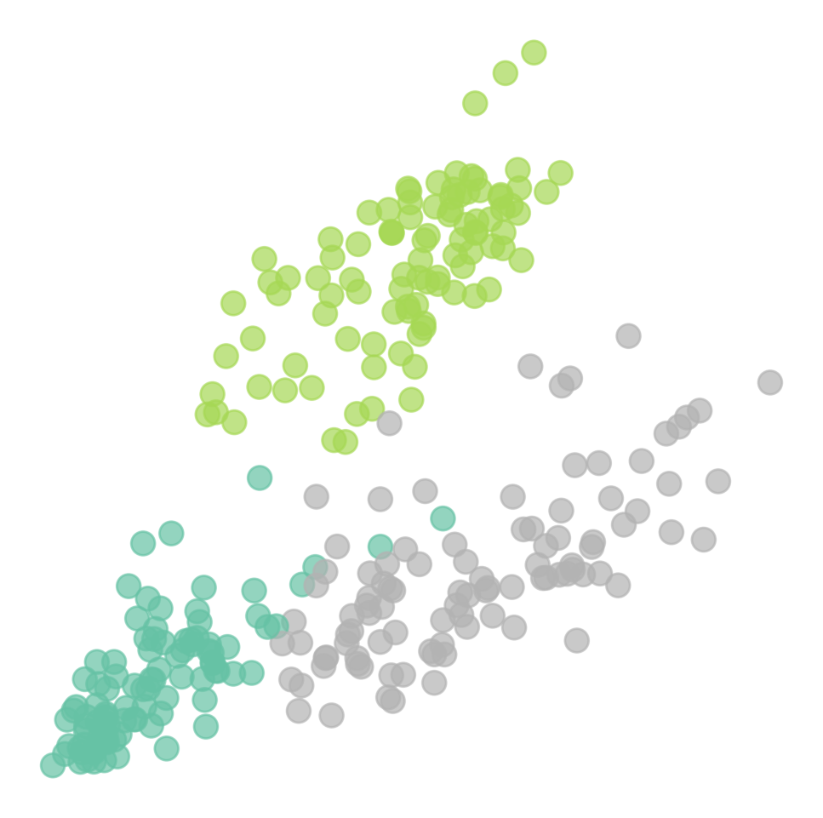
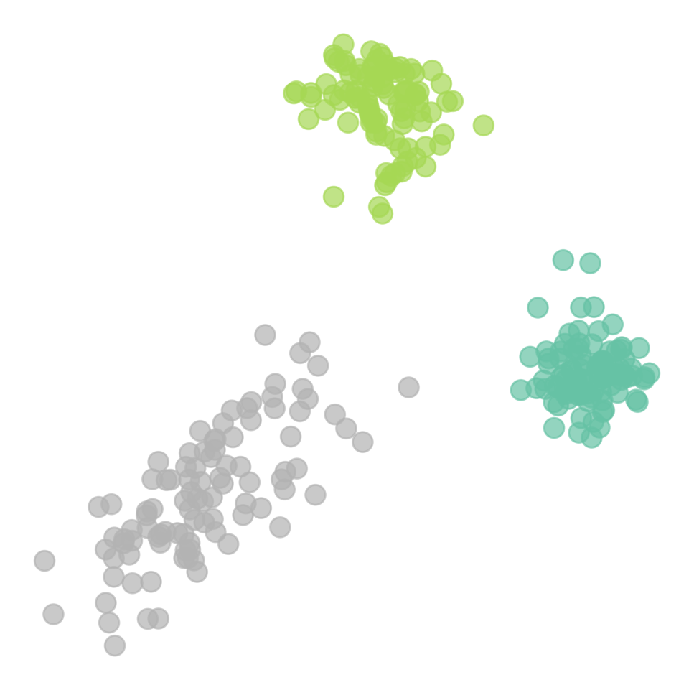
TrainingFullSpikeNeuralNetworkswithAuxiliaryAccumulationPathway
67.91
Spiking ResNet50
65.72
57.66
67
Spiking ResNet34
65.63
61.86
64.3
Spiking ResNet18
62.68
(a)FSNN(DST)
(b)DSNN
62.32
50
55
60
65
70
Figure4.
Thethet-SNE(
Maaten&Hinton
,
2008
)plotsofembed-
w/ DST + SA
w/ DST
w/o DST
dingfeaturesonDVSGesture.

