Slide 1


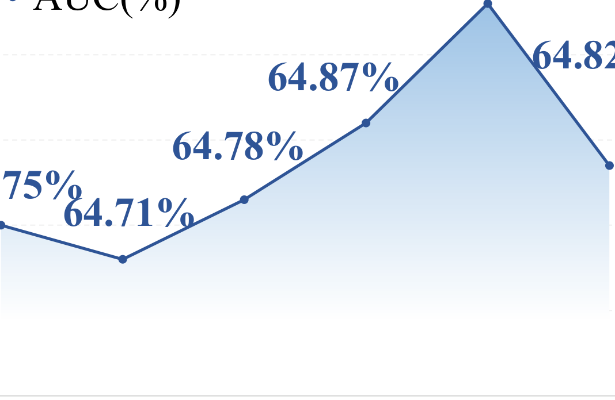


100.0%
90.0%
65.05%
65.01%
80.0%
AUC(%)
70.0%
65.0%
64.95%
64.82%
64.87%
60.0%
50.8%
50.0%
64.85%
64.78%
64.75%
40.0%
64.71%
64.75%
30.0%
20.0%
64.65%
10.0%
0.0%
64.55%
Outside MSF
Inside MSF
0
0.2
0.4
0.5
0.6
0.8

