Slide 1
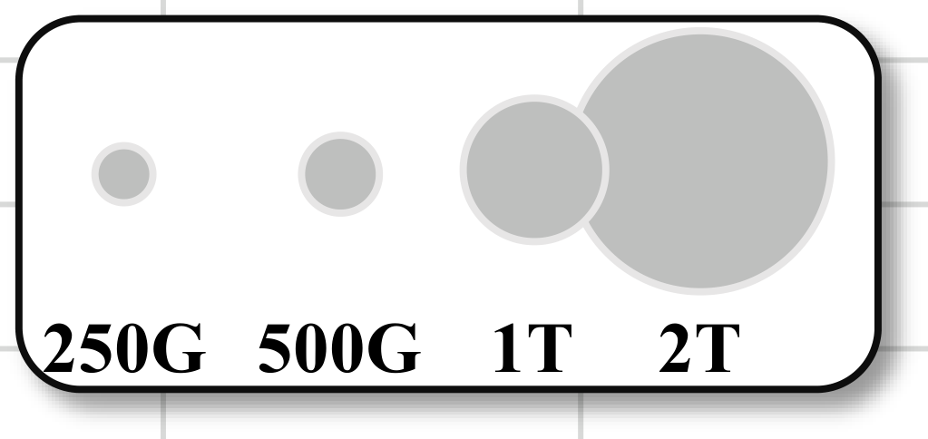
Ours
STCF
RFDA
CPGA
Ours-Light
MFQEv2.0
250G
500G
1T
2T
0
5
10
15
20
25
Runtime(FPS)

