Slide 1












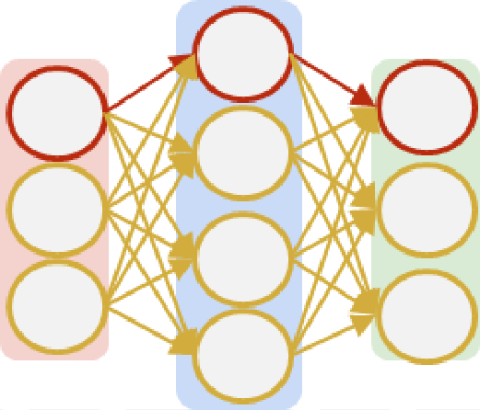




















tion
m
(
i
)=(
p
+
n
)
/
2+(
i
−
1)
,where
1
≤
i
≤
p/
2
.Thefunctionassignsatargetposition
m
(
i
Window
Merge
W
)
tothefeaturestreamatposition
i
inthefeaturesequence.Thesepairedposi-tionsformflowunits,denotedas
X
=[
G
,
G
,...,
G
]
1
2
n/
,where
2
c
G
=[
x
,x
]
and
×
h
×
p
i
i
G
∈
R
.Theseunitses-tablishdirectchannelsforlong-rangedependencieswithinthefeaturesequence.Takingflowunit
m
i
(
i
)
G
asanexample,systemicreconfigurationoccursduringtheflowprocesseswithintheunit.Acircularpermutationtakesplacebetweenthefeaturestreamsatsourceposition
i
B
acktrack
i
andtargetposi-tion
(1)
(
h
m
)
T
(
i
)
,
i.e
.,transforming
x
=[
x
,...,x
]
into
i
i
i
(
h
x
=[
x
)
,...,x
(1)
T
i
]
.Themechanismenablesspa-tiallyseparatedfeaturestoundergodirectfeatureextrac-tionthroughpatch-basedFClayers.Theflowprocessex-ecutessynchronouslyacrossallflowunits,withverticalre-constructionfollowingidenticalprinciples.AsillustratedinFig.
m
(
i
)
m
(
i
)
4
,featureflowblockexpandsthefeatureperceptionrangebymovingfeaturesfromthefourcornersintolocalredregions.Throughselectivehorizontalorverticalop-erations,weenableinteractionsbetweendifferenttargetre-gions,ultimatelyconstructingaglobalreceptivefieldacrosstheentirefeature.
F
low
W
Window Partition

