Slide 1
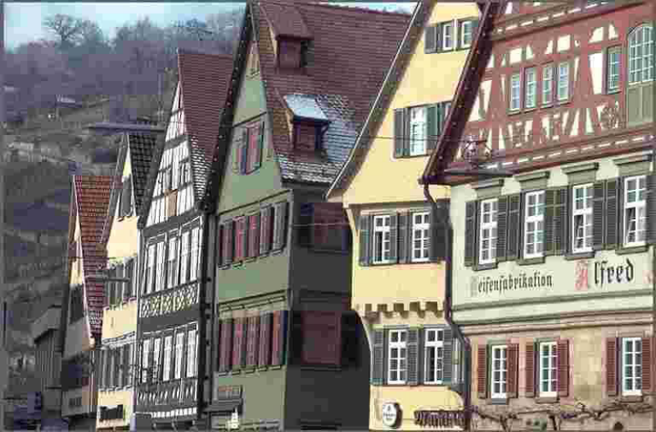


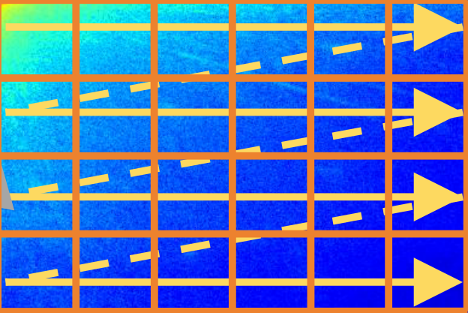
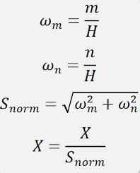
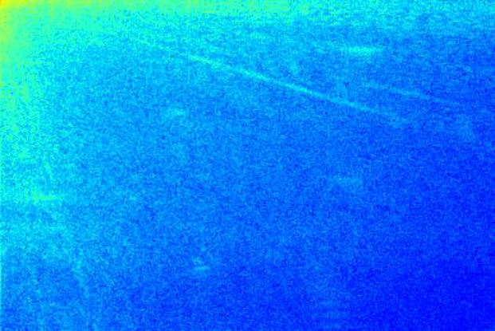
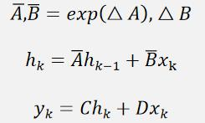
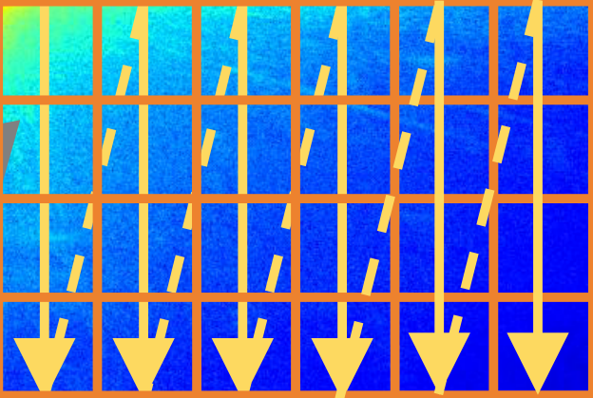
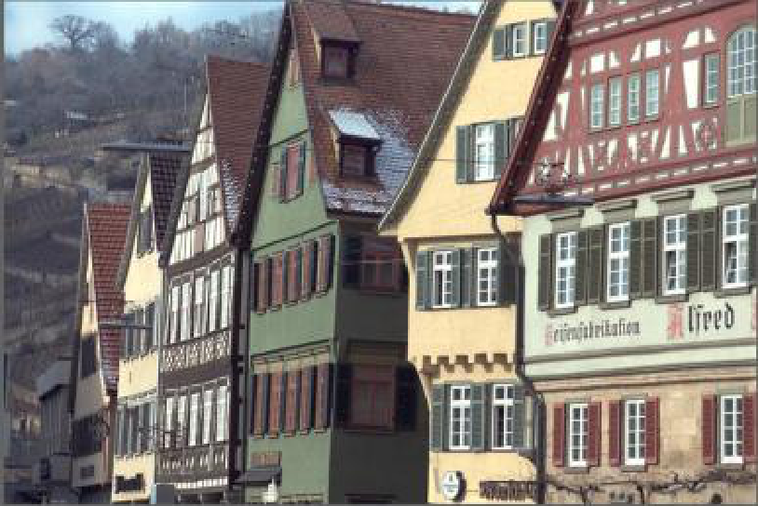
Linear
SASSB
LayerNorm
DWConv
SiLU
DWT
IDWT
Linear
GLB
Downsample
Linear
SiLU
GLB
Downsample
Coarse-to-Fine State Space BlockScale-Adaptive State Space Block
GLB
Downsample
RB
CFSSB
GLB
scale1
scale2
Upsample
GLB
Upsample
GLB
Global-to-Local Block
Upsample

