Slide 1
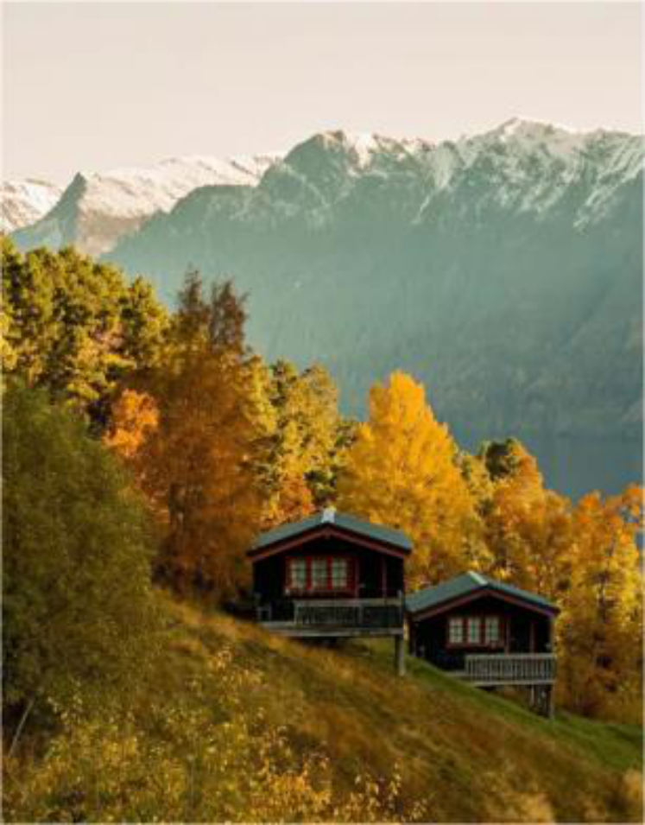


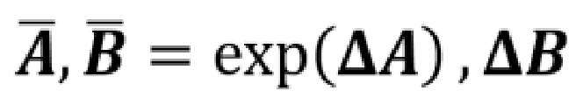

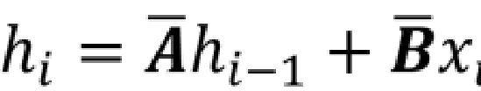




Attentive State Space Group
Attentive State Space Block
Reconstruct
Reconstruct
Window
Window
Norm
Conv 3×3
Norm
Conv 3×3
Norm
Conv 3×3
Norm
Norm
Norm
Norm
MLP
Norm
MHSA
MLP
MHSA
MLP
ASSM
MLP
ASSM
LQ Image
scale
scale
HQ Image
(b) Attentive State
-
(a) Attentive State Space Module
space Equation
(c) Semantic Guided Neighboring
T
T
0
0
0
1
0
Projection
1
Projection
LogSoftmax
LogSoftmax
Gumbel
Gumbel
1
1
1
1
1
L
1
L
0
0
0
1
0
1
5
5
5
5
5
unfold
5
unfold
ASE
1
0
1
0
0
fold
0
fold
7
7
1
7
1
0
0
0
0
7
7
Positional
Linear
7
Embedding
Linear
-
-
Selection Matrix
Selection Matrix
1
1
2
2
3
8
3
8
ASE
8
ASE
8
ASE
8
1
8
1
2
2
3
-
3
-
SGN
-
SGN
fold
-
add to
unfold
SGN
C
SGN
4
4
5
5
6
2
6
2
2
2
2
4
2
4
5
5
6
SGN
matmul
6
SGN
7
7
8
8
9
6
9
6
6
6
6
7
6
7
8
8
9
9
9
9
9
9
9
Layer
9
-
shared
3
3
3
3
3
Dynamic Prompt
3
P
4
4
4
4
4
Prompt Pool
4
Layer
-
specific

