Slide 1

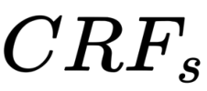





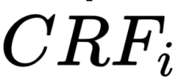
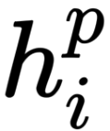
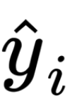
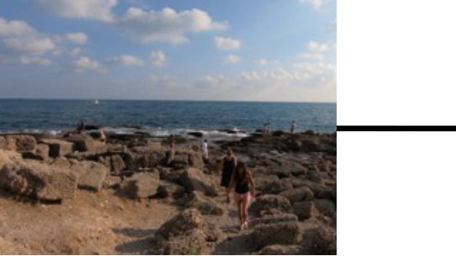

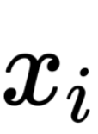

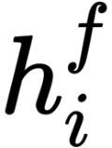

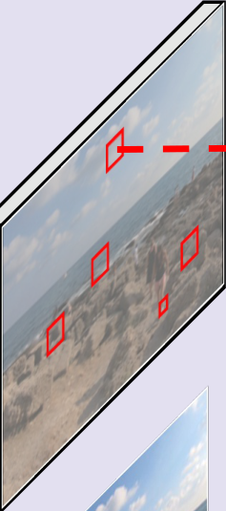
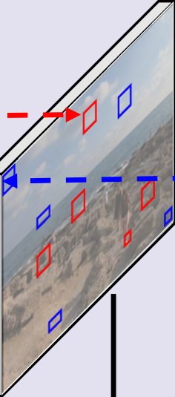
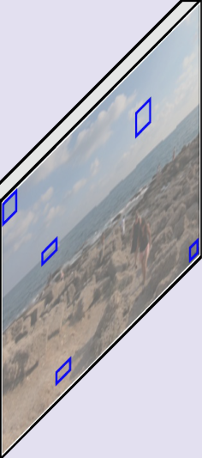




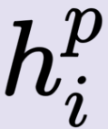
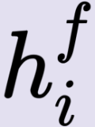
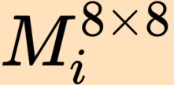

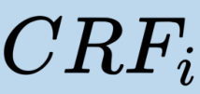

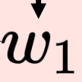
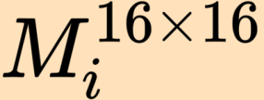

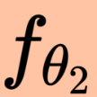
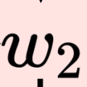


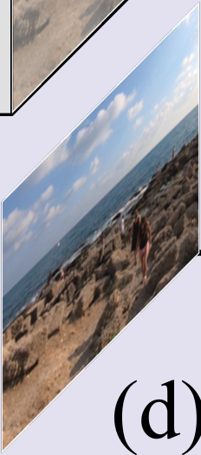



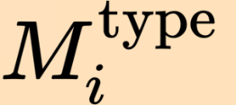


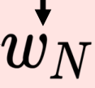
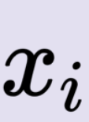



Compression
e
Aware
Adaptation
Sequence
...tppE
Network
Adaptation
Frame
Adaptation
Frame
Adaptation
Frame
Adaptation
…
Alignment
Aware
Aware
Refinement
Refinement
Conv
ReLU
e
Conv
ReLU
e
Conv
ReLU
…
Region
Region
MV
Sparse
Conv
C
Concatenation
Bitstream
e
Aware
Enhancement
...rpxE
Network
Element
e
…
wise
Addition
...⋮E
Overview
Sequence
E
wise
Weight
Generator
Frame
e
wise
Expert
Weight
Generator
…
Expert
Expert
…
…
…
Expert
Expert
Expert
C
Expert
...⋮E
Region
e
...⋮E
Aware
Refinement
Sequence
Adaptation
...⋮E
Frame
Adaptation
...⋮E
MV
Alignment

