Slide 1
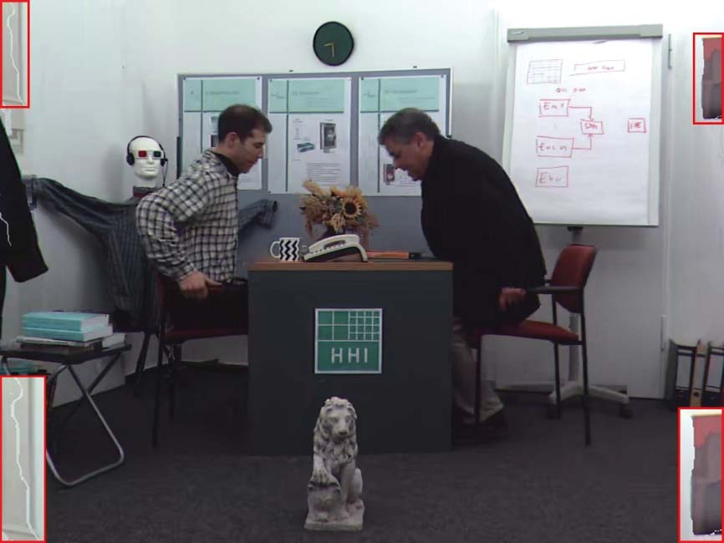
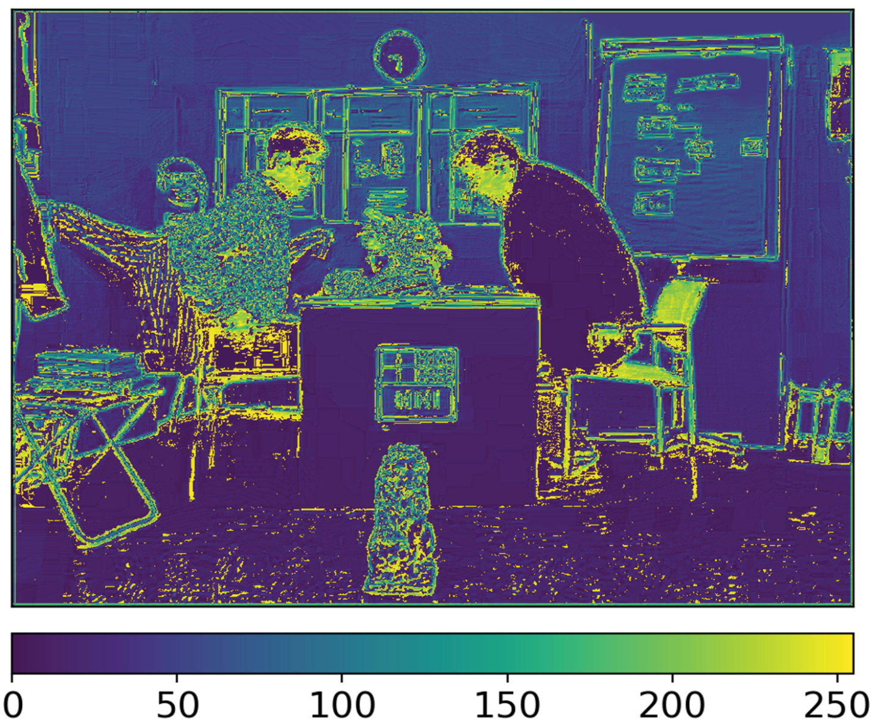
Fig.6.Featuremapvisualizationofthelocalfeatureextractor,where(a)isthe100
th
frameofthelow-qualitysynthesizedview
Bookarrival
sequenceunder
(
QP
,
QP
)
=(30,39),(b)indicatesthefeaturemapextractedbythelocalfeatureextractor.
t
d

