Slide 1
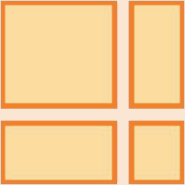
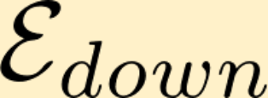

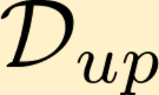




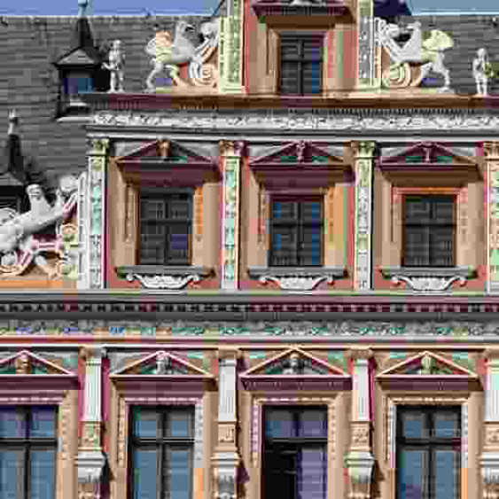
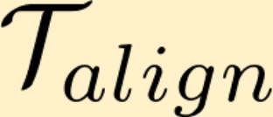

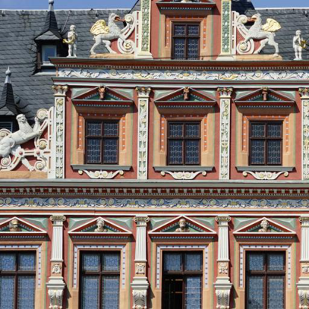


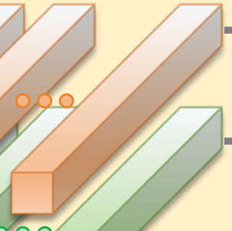
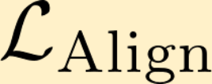
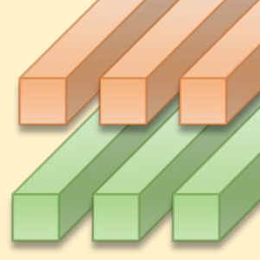
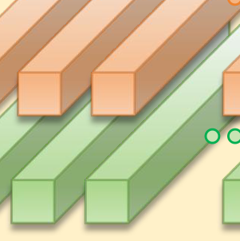
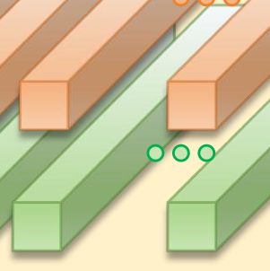
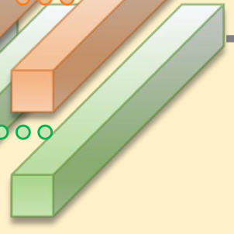



Semantic Alignment Image Prompt Extractor (SAIPE)
Image Guidance Embedder
Aligned Embeded Tokens
Residual Swin Transfomer Block
Residual Swin Transfomer Block
×
2
×
2HighDimensionalFeatures
Multi-Head Attention
ImageGuidanceEmbedderOpenCLIP ViT-H/14
LearnableQueries
Detailed Descirptions
Fusion
The image features a large, colorful building with a variety of statues and intricate designs adorning its facade. The building has a pink and yellow color scheme, and its facade is adorned with statues of people and animals......
Multi-scale Convolution
Residual
Layer-Norm
+
VLM
Feed-Forward
Performer Encoder
LLaVA 1.5 version7 Billion parameters
Attention
Mid Feature

