Slide 1


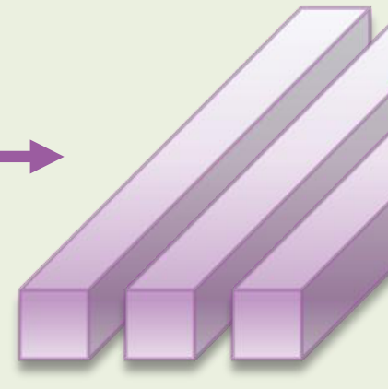





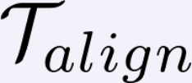


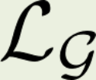











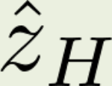

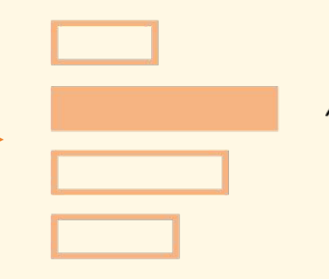



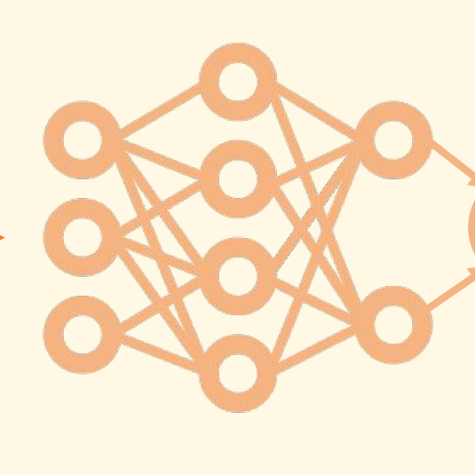
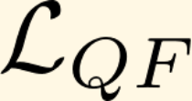





Semantic-Oriented One-Step Diffusion (SODiff)
I
H
Discriminator Network
L
ˆ(,)
II
SAIPE
MSE
HH
L
ˆ(,)
II
EA
HH
I
L
VAEDecoder
UNet
VAEEncoder
Quality Factor-Aware Time Predictor
GumbleSoftmax
Compute Loss
Conv+BN
Trainable
Prompt Track
Relu
SharedAvgPooling
Frozen
Diffusion Track
+
Res
Timestep Track

