Slide 1
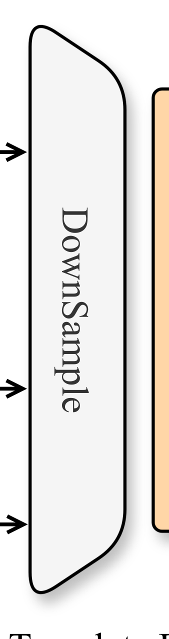
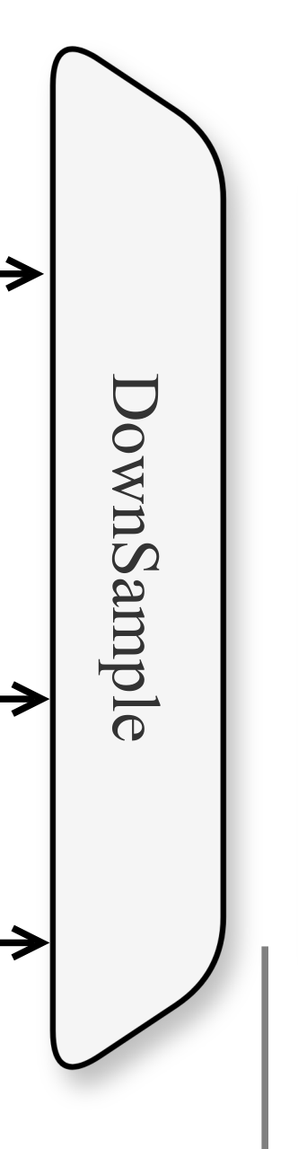
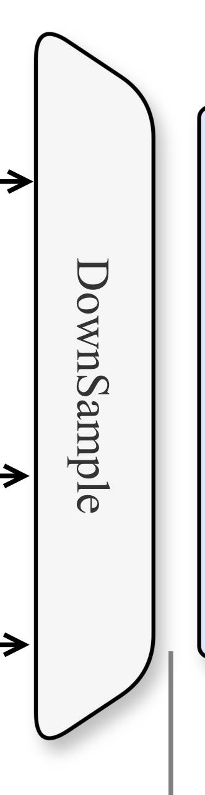
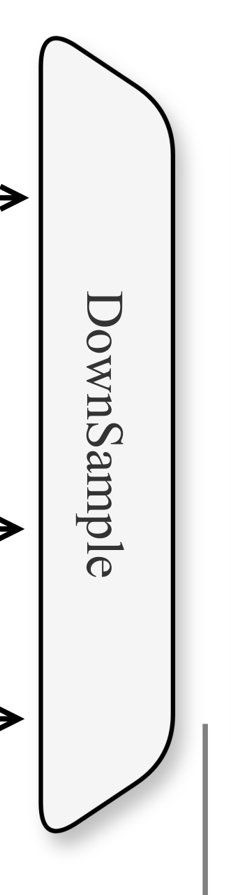


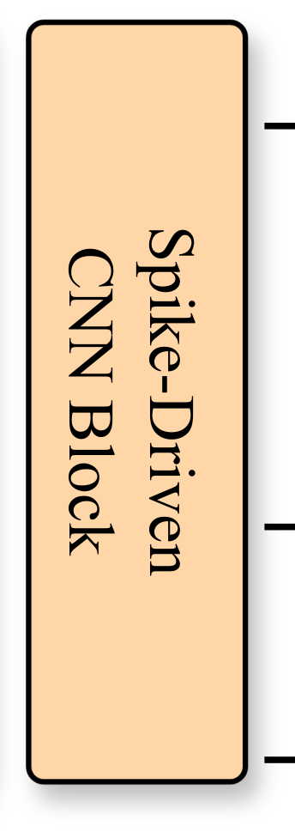

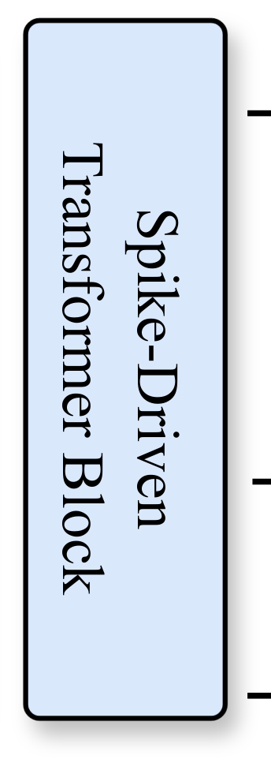

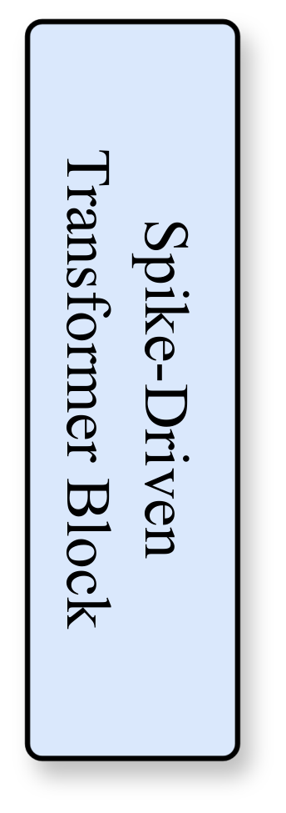



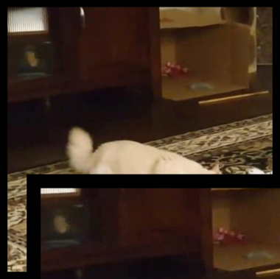











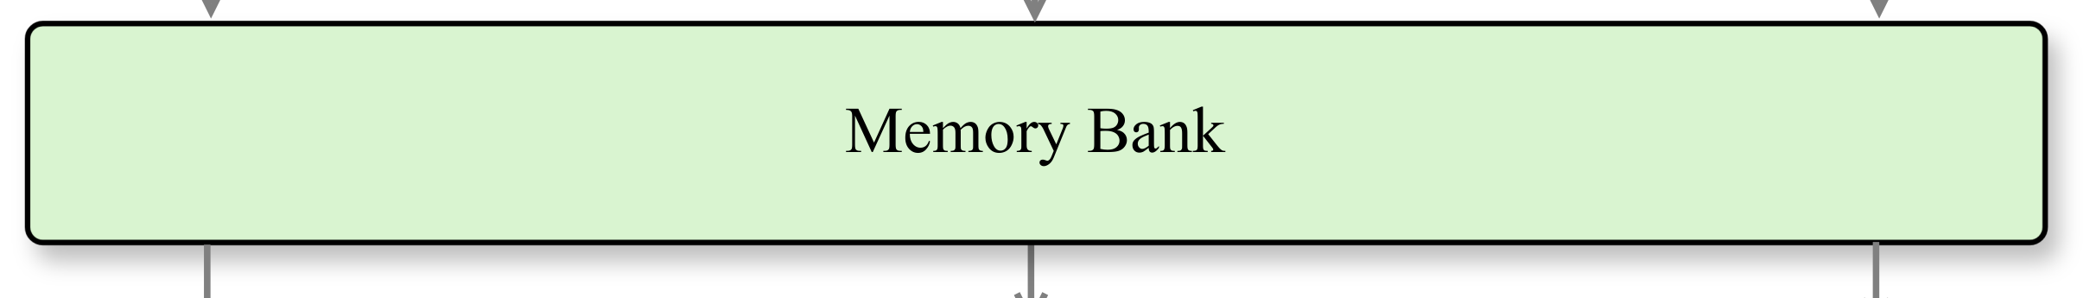
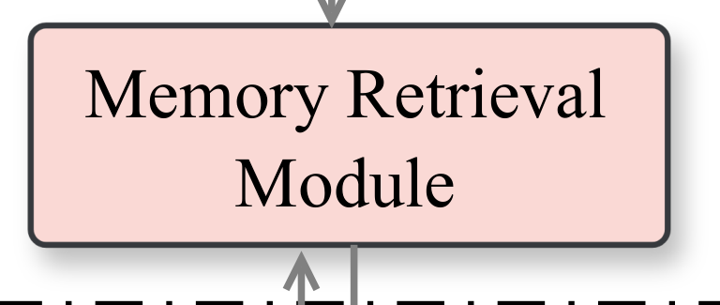
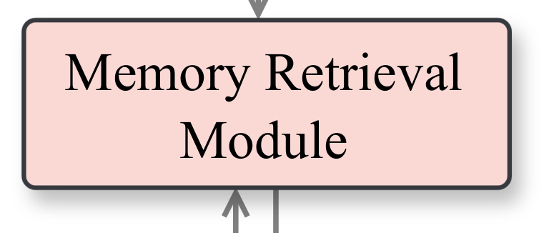
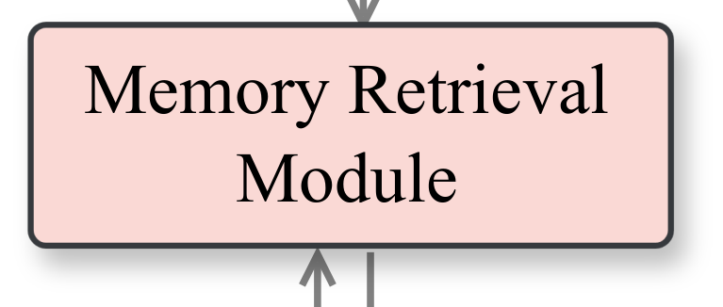

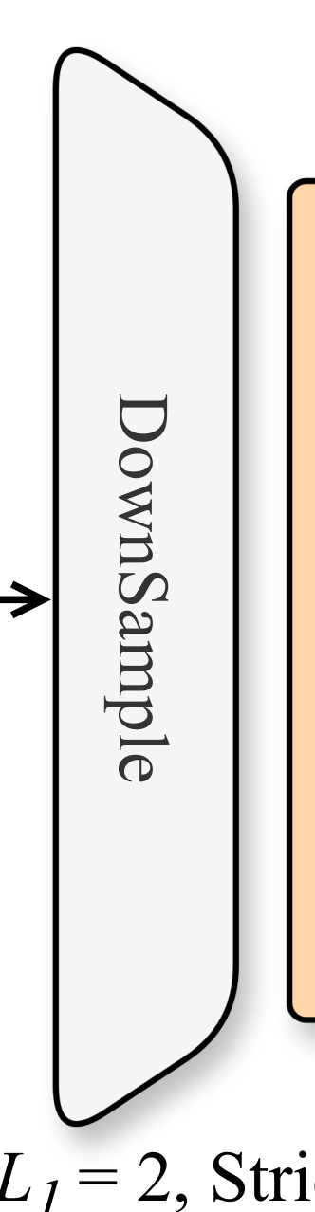
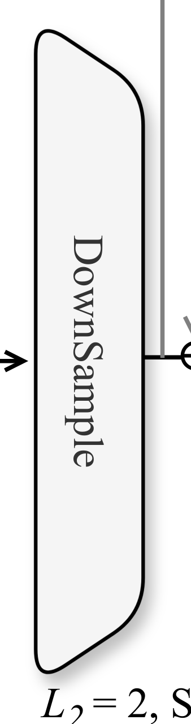
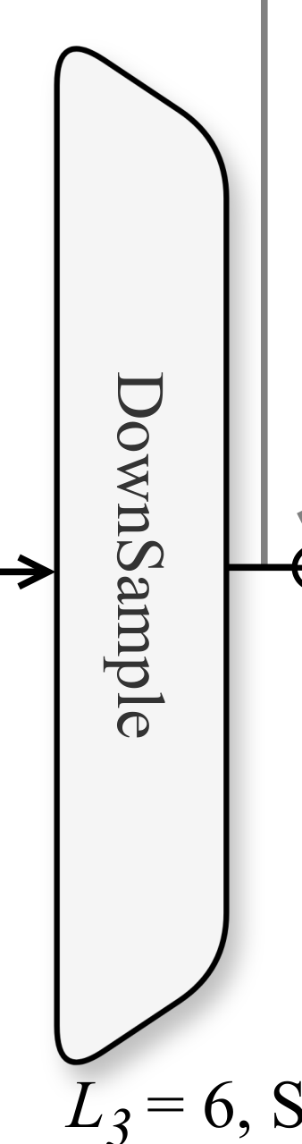
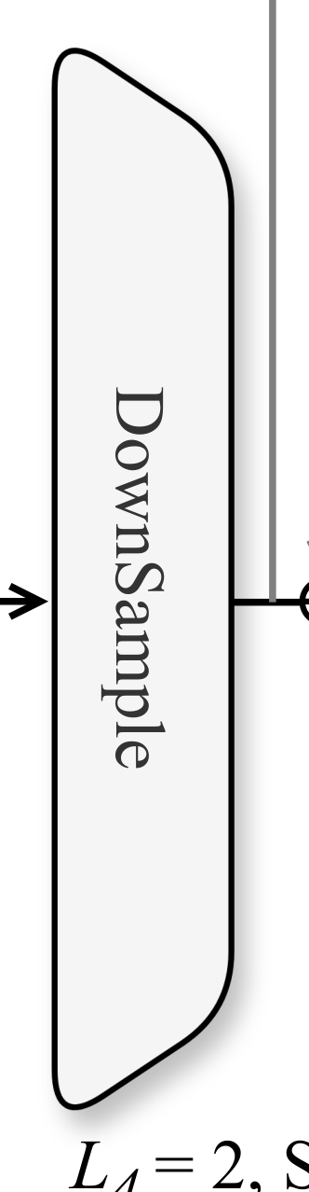

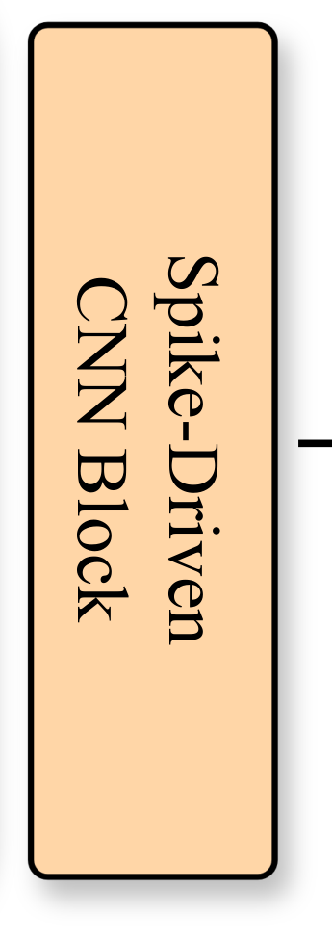
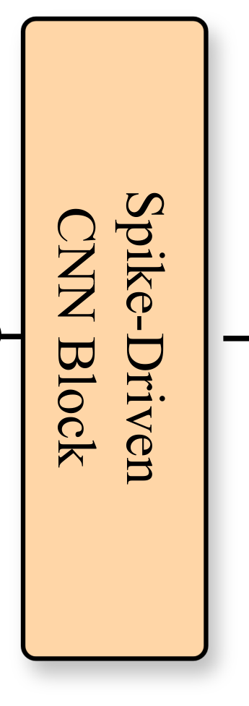
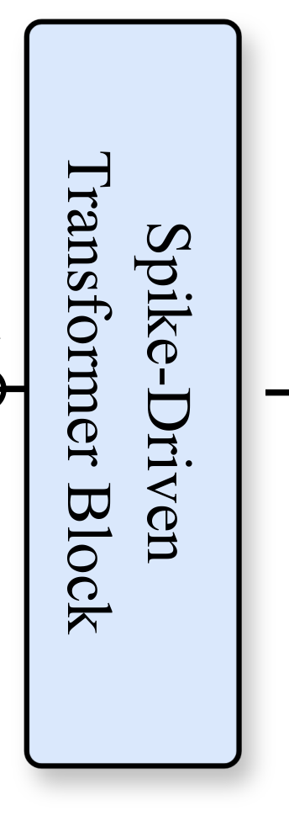
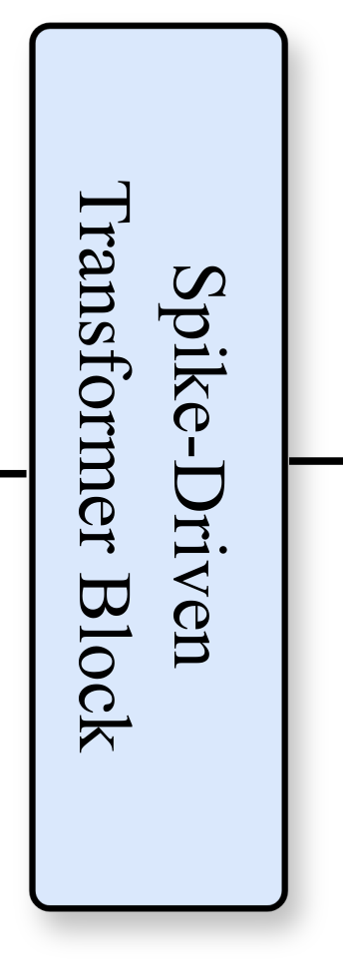






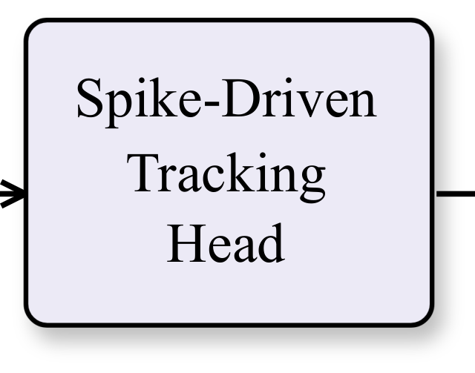
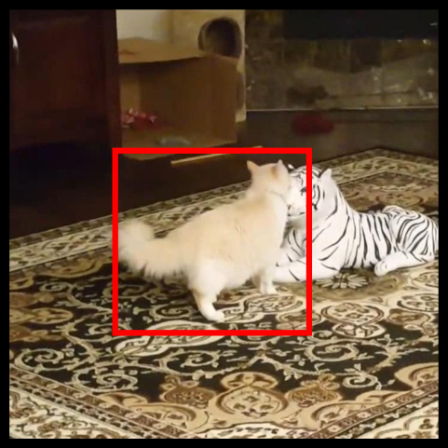
Spiking
Branch Runs
Neuron Layer
Limited Times
t=T
…
Temporal
Membrane
Spiking
Shorcut
…
…
…
…
…
Spike-Driven
Spike-Driven
CNN Block
CNN Block
CNN Block
Transformer Block
DownSample
Spike-Driven
DownSample
Spike-Driven
DownSample
Spike-Driven
DownSample
Spike-Driven
Transformer Block
Transformer Block
Channel
Channel
MLP
Conv
t=1
Templates
Template Branch
Memory Bank
Efficient
Spike-Driven
Weight-sharing
Self-Attention
Backbone
Memory Retrieval
Memory Retrieval
Memory Retrieval
Spike
Module
Module
Module
Separable
Conv
Search Branch
Spike
Separable
Conv
CNN Block
DownSample
CNN Block
DownSample
DownSample
DownSample
Spike-Driven
Spike-Driven
Spike-Driven
Spike-Driven
Spike-Driven
Transformer Block
Transformer Block
Tracking
Search Region
Head
L
= 2, Stride = 2, 4
L
= 2, Stride = 8
L
= 6, Stride = 16
L
= 2, Stride = 16
1
2
3
4

