Slide 1
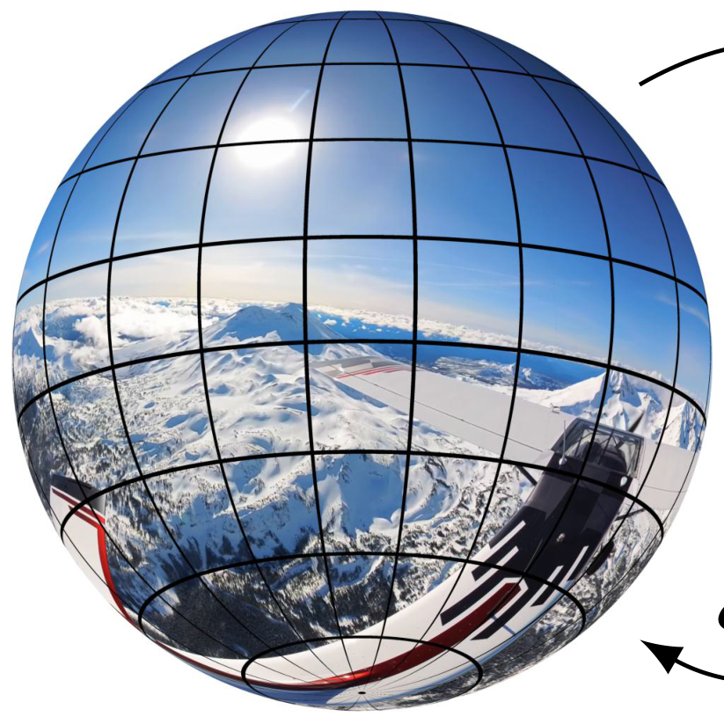
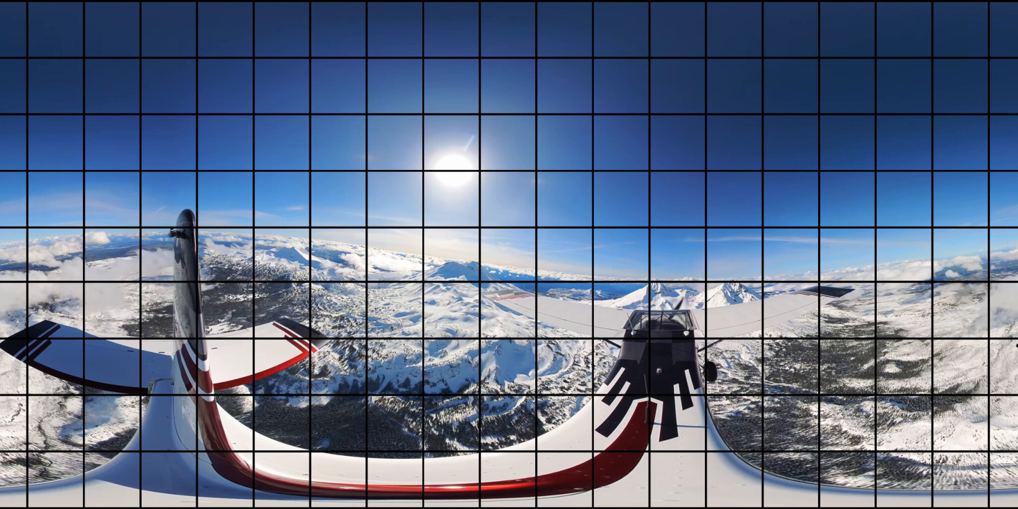
ξ
o
ξ
−
1
o
(a)Sphericaldomain
(b)Equirectangularprojection
−
8
−
6
savings
−
4
−
2
0
increase
2
4
Performancefor360-degreevideo
6
Performanceforperspectivevideo
8
Naiveoptimizationon360-degreevideo
Naiveoptimizationon360-degreeandperspectivevideo
Our360-degreeoptimizationframework
(c)Ratesavings

