Slide 1
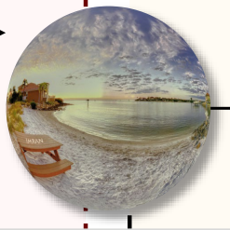


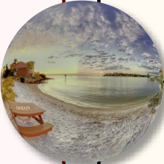


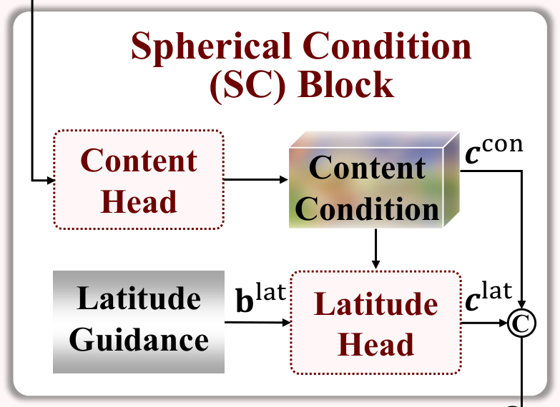

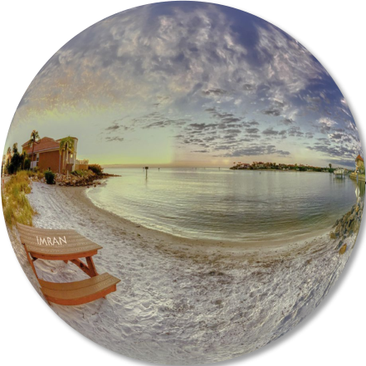

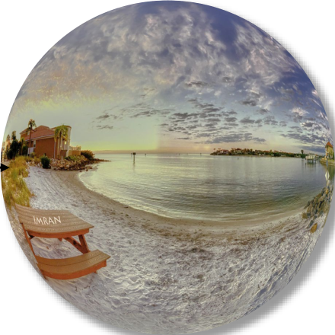
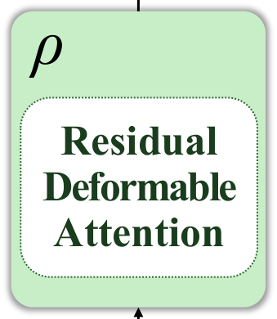
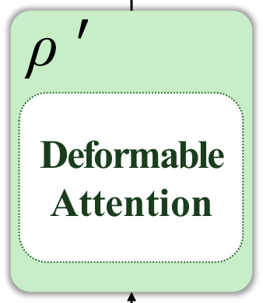



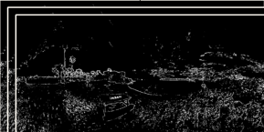
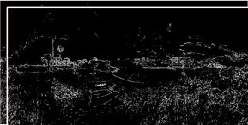
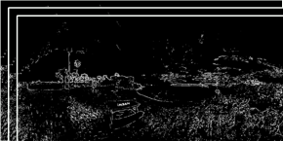
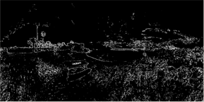
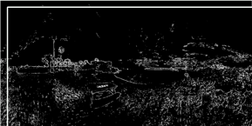
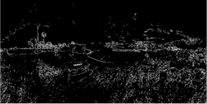

�𝐱𝐱→
(1) Deformable Downscaling
[
𝐲𝐲
;
𝐡𝐡
]
(2) Latitude-aware HF Projection
�𝐳𝐳
[
𝐲𝐲
;
𝐡𝐡
]
→𝐳𝐳
(3) Reverse Upscaling
[
𝐲𝐲
,
]
→𝐱𝐱
𝒚𝒚
Invertible Deformable (ID) Block
SC Block
Spherical Condition (SC) Block
LF
Output
ρ
ρ
′
Invertible Projection
①
:
LR Image
�𝒚𝒚
𝒚𝒚
con
(
)
ERP & Haar
Content Head
𝒄𝒄
~ Haar& ~ ERP
Content Condition
~ID Block
(IP) Block
C
~IP Block
Residual
ρ
ρ
′
DeformableAttention
Supervision
Sample
DeformableAttention
Latitude
lat
lat
𝐛𝐛
𝒄𝒄
Latitude Head
Guidance
C
Latent Space
Input:
𝒉𝒉
𝒄𝒄
Input:
Output
𝒛𝒛
②
:
C
�𝒙𝒙
Split
HR image
�𝒙𝒙
HR image
�𝒉𝒉
Recovered HR Image
Recovered HF
HF
𝒙𝒙

