Slide 1
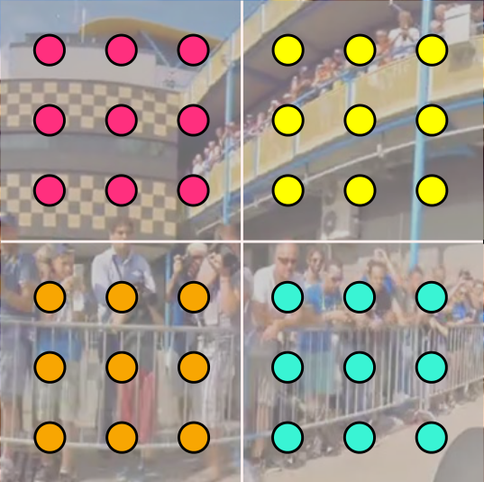
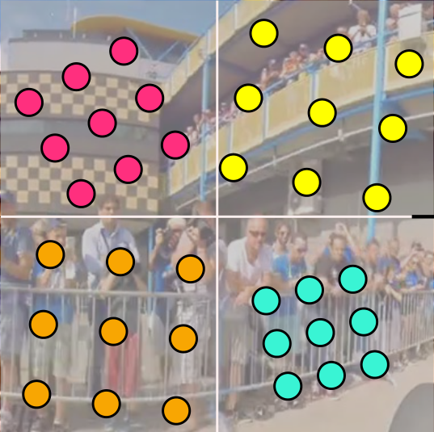
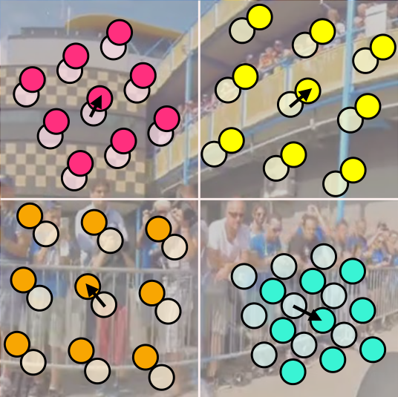
ρ
′
ρ
/
Deformable SwinTransformer (DST) Module
DST
×
2
̃
𝐟𝐟
𝐬𝐬
Scale Head
Offset Head
�
DConv
𝐬𝐬
𝐖𝐖
𝜼𝜼
𝐪𝐪
𝐪𝐪
(
�
)
θ
θ
Multi-head attention
scale
offset
LayerNorm
LayerNorm
DST
𝐟𝐟
×
2
𝐖𝐖
𝐟𝐟
𝐤𝐤
a
MLP
̂𝐟𝐟
𝐤𝐤
DConv
𝐖𝐖
𝜼𝜼
(
�
)
𝐯𝐯
𝐯𝐯
DConv
Referenced points
Scaled points
Deformed points
𝐬𝐬
Sampled features
(a) Architecture of functions
ρ
�
and
ρ′
�
in ID block
(b) Architecture of DST Module

