Slide 1
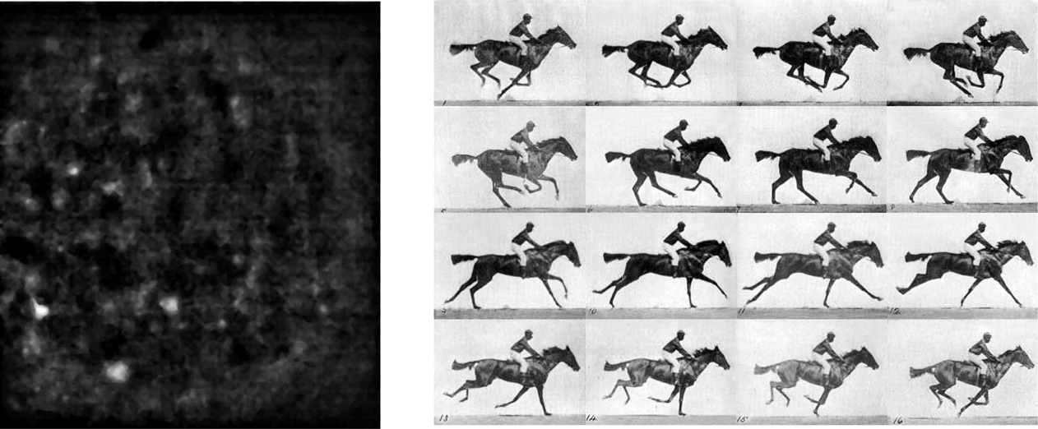
A
BCD
30um
"Time ﬂies like an arrow""Fruit ﬂies like a banana"

