Slide 1
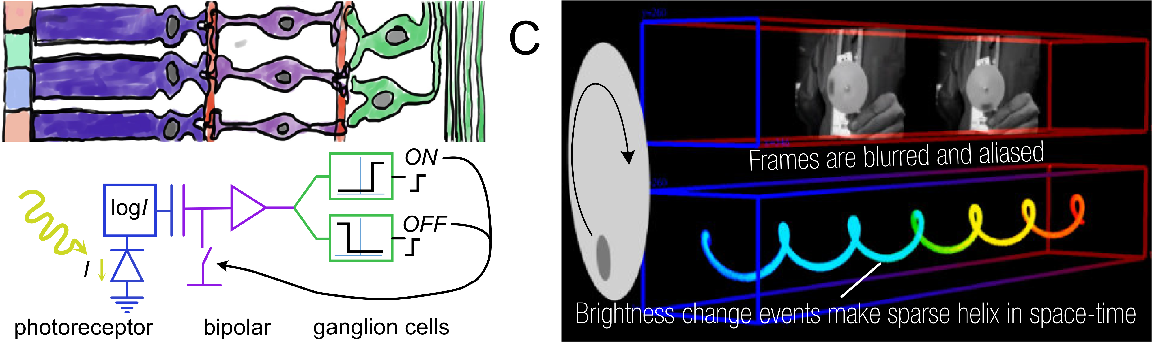














A
BC
Frames are blurred and aliased
log
IONOFF
I
Brightness change events make sparse helix in space-time
photoreceptorbipolarganglion cells

