Slide 1
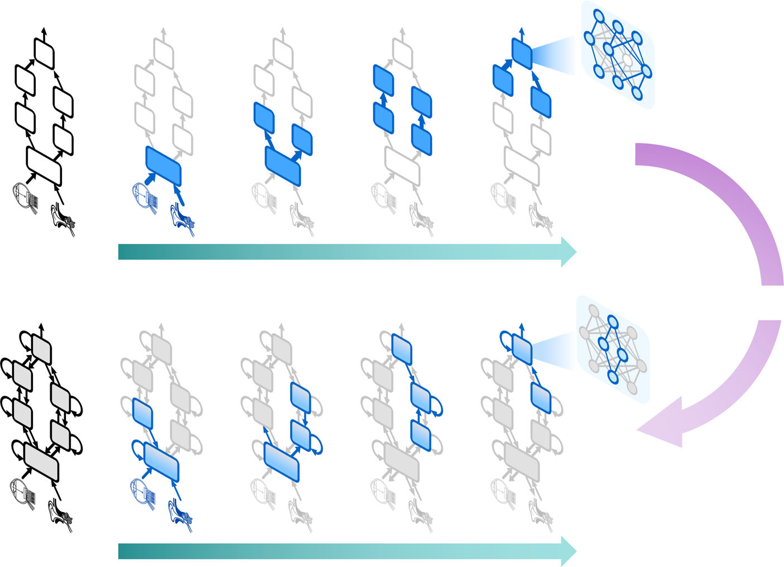
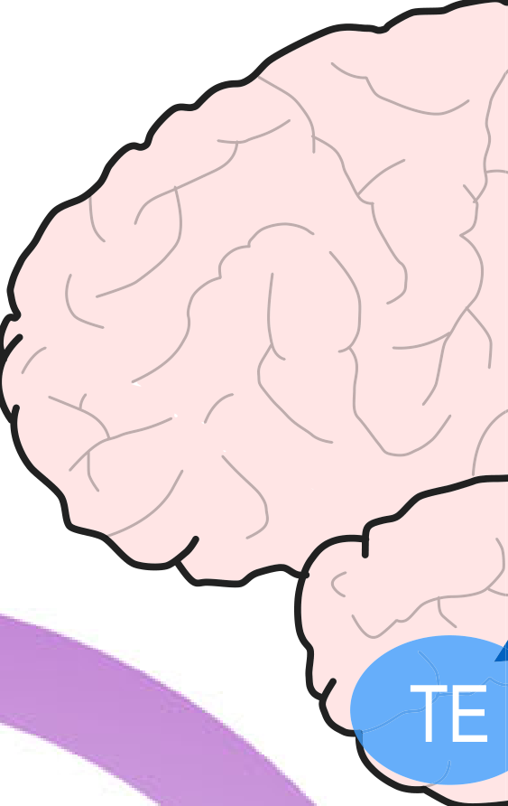















Table1|Limitationsandopportunitiesfordynamicallysparseperceptionsystems
CurrentlimitationsBio-inspiredopportunities
Signi
ﬁ
cantlyincreasingsensormodalitiesanddatavolumesischallenginginperceptionsystems,evenwhenstatelesssparsityisexploited.Statefultechniquesallowtofurtherboostsparsityduetothehighspatiotemporalcorrelationspresentinsensoryinputs.Moststate-of-the-artstatefulsparsity-awarehardwareutilizesverysimplisticnotionsofstate,suchas(alinearcombinationof)aneuron
’
spastinputs.Advancedstatescanpursuethepredictionoftheexpectedinputs,insteadofmimickingthepastinputs.Thisallowsupdatesonlyuponsurprise.Today
’
sstatefulsystemscompute,retain,andutilizestatepurelywithinonecomputationalbuildingblock(e.g.,aneuronorneurallayer),raisingthecostofitscomputation,limitingitspredictivevalue,andexploitationopportunities.Stateinformationshouldbesharedbetweendifferentsystemcomponents,andespeciallybefedbackfromhigherintelligencetolowersensorylayers,justlikethebrainfeedsexpectationvaluesbackintothelowerareasofthecortex.Statefuldynamicallysparsesystemslackaproperhierarchicalorganization,anddonotexploitstatesatandacrossmultipleabstractionlayerstowardsdynamicactivitygating.Statefuldynamicsparsityshouldbeformalizedanduni
ﬁ
edacrossabstractionlayers,toallowacoordinateddynamic(de)activationofblockswithdifferentgranularity.
A
. Statelessperceptionsystem
Low-levelprocessingHigh-levelprocessingDecisionmakingSensing
Featureextraction
TE
TEO
V3/4
V1/2
Time
B. Stateful perceptionsystem
Brain inspirationC. Visual brainareas
StatefulneuronsLocalrecurrenceTop-down feedback
Time

