Slide 1
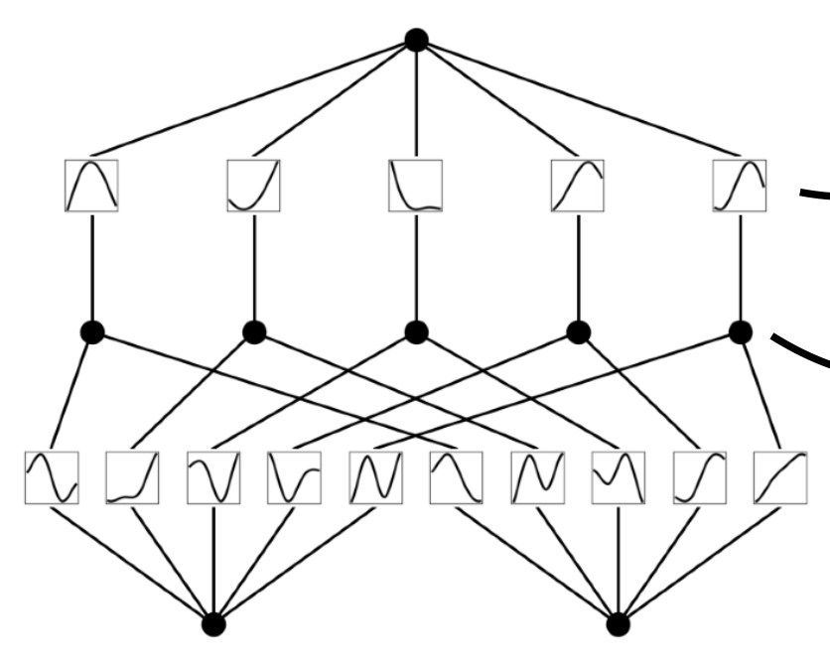
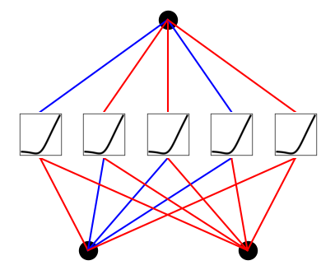
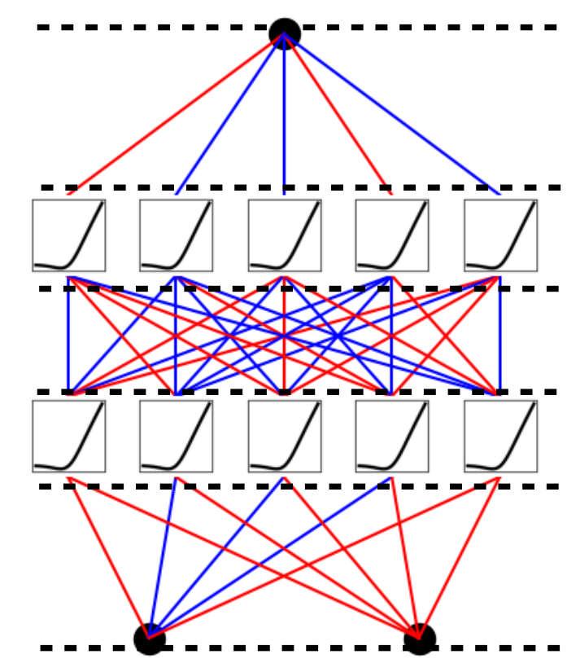
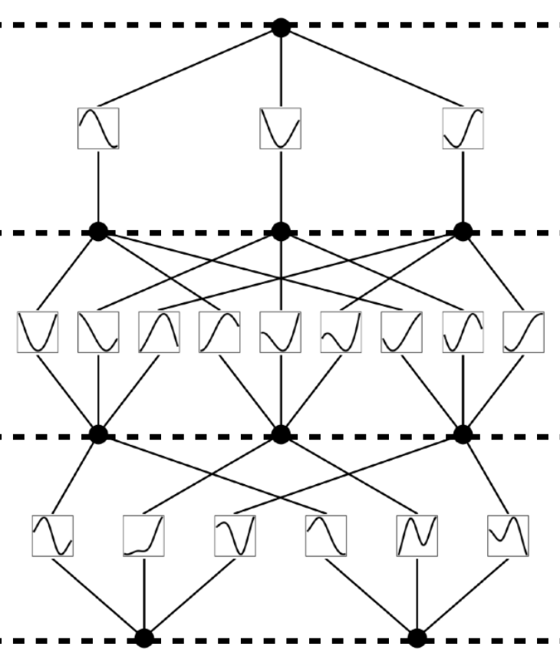
Model
Multi-Layer Perceptron (MLP)
Kolmogorov-Arnold Network (KAN)
Theorem
Universal Approximation Theorem
Kolmogorov-Arnold Representation Theorem
2
n
N
+
1
n
(
ϵ
Formula
)
f
(
x
)
=
Φ
ϕ
(
f
x
)
(
x
)
≈
a
σ
(
w
⋅
x
+
b
)
∑
q
∑
q
,
(Shallow)
∑
i
i
i
p
p
q
=
1
p
i
=
1
=
1
(a)
fixed
(b)
learnable
activation functions
activation functions
on
nodes
on
edges
Model
(Shallow)
sum operation on
nodes
learnable
weights
on
edges
Formula
MLP
(
x
)
=
(
W
∘
σ
∘
W
∘
σ
∘
W
)
(
x
)
KAN
(
x
)
=
(
Φ
∘
Φ
∘
Φ
)
(
x
3
2
2
1
1
3
2
1
)
(Deep)
KAN
(
x
MLP
)
(
x
(c)
)
(d)
W
3
Φ
3
Model
σ
nonlinear,
(Deep)
2
fixed
W
Φ
nonlinear,
2
2
learnable
σ
1
linear,
W
learnable
Φ
1
1
x
x

