Slide 1
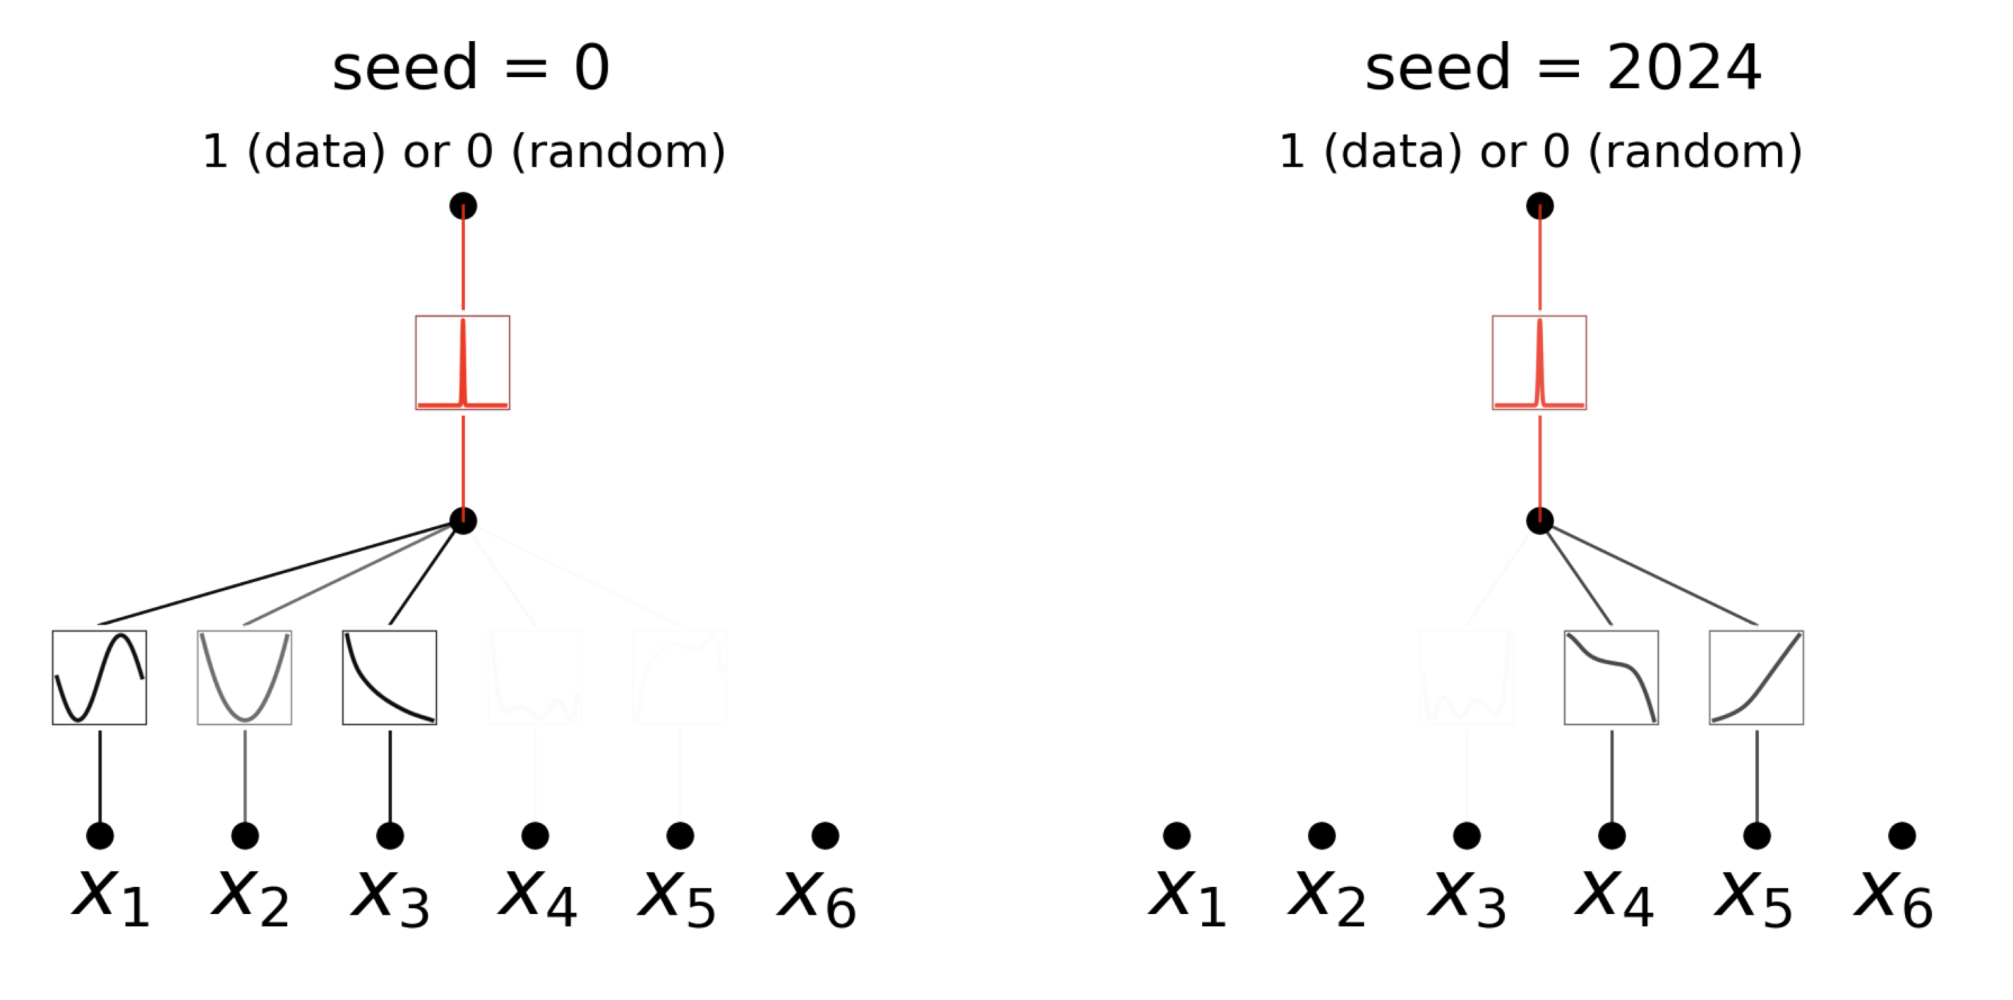
PublishedasaconferencepaperatICLR2025

