Slide 1
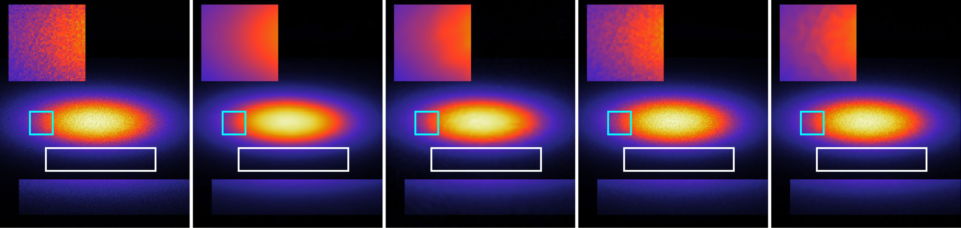
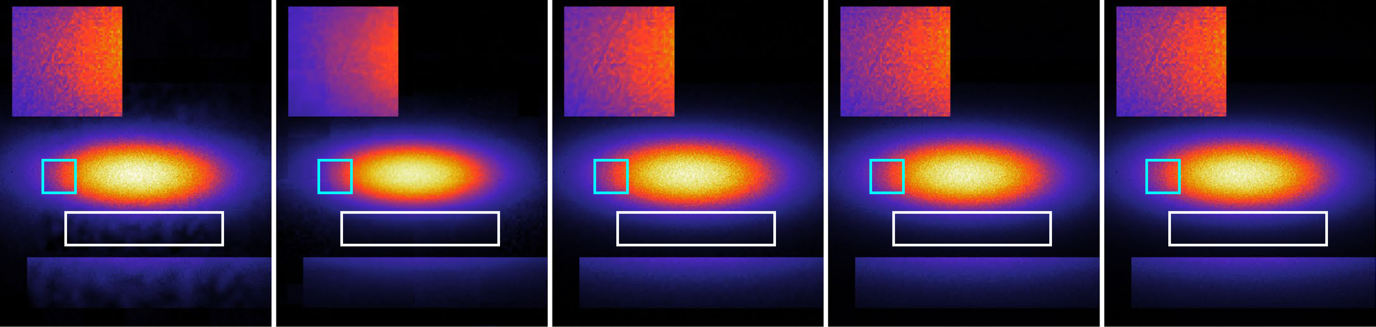
abc
Coordinates: 36 × 550 × 550, float32Raw data1.31 MB36.7 dB, 0.89Frequency encoding1.91 MB36.7 dB, 0.89Wavelet activation2.74 MB37.3 dB, 0.91Hash encoding1.91 MB37.2 dB, 0.90Sine activation2.29 MB39.1 dB, 0.95Multiscale INRs2.35 MB39.4 dB, 0.90Adaptive coordinate networks1.45 MB40.4 dB, 0.93Variable-periodic activation1.36 MB42.3 dB, 0.96This work: WAVELET-INR1.33 MB43.6 dB, 0.97This work: WIEN-INR
FE
0.020
Raw data
Multiscale INR
Wavelet activation
FE
Adaptive coordinate network
Hash
Sine activation
Hash
Multiscale INR
β
0.015
Wavelet activation
WAVELET-INR
Contrast,
Variable- periodic activation
Sine activation
WIEN-INR
Adaptive coordinatenetwork
0.010
Variable-periodicactivation
WAVELET-INR
0.005
WIEN-INR
0.99840.99790.99680.99600.99570.99570.99330.99230.9922
0.990
0.993
0.997
1.000
0
0.01
0.02
0.03
0.04
2
−1
Scattering vector,
R
∆
q
(Å
)

