Slide 1
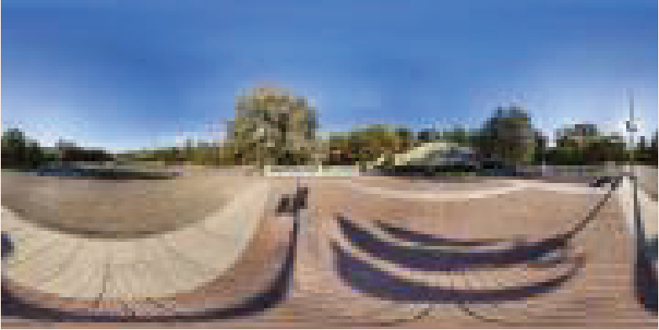
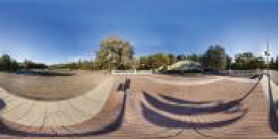
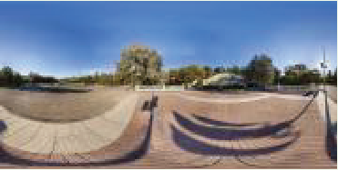
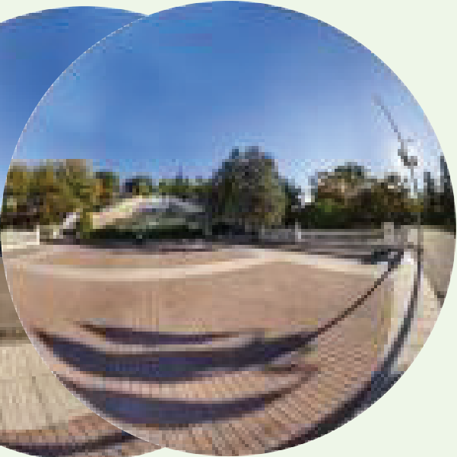
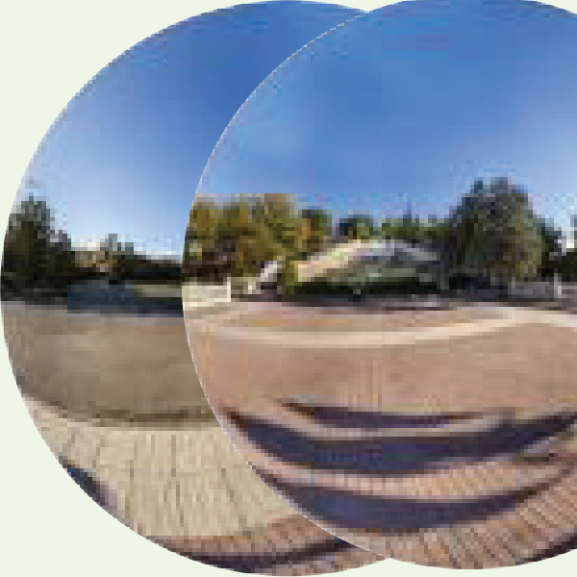
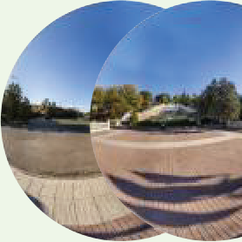
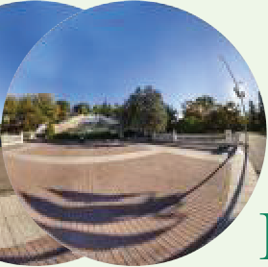
ERP HR
Object Plane
ERP LR*
3
.
�������
ERPDownsampling
3.3.OSRT:ModulateDistortioninODIs
�
Overall.
AsdiscussedinSec.
3.1
,ERPimagessuf-feradistortioncausedbyanon-consistencyareastretch-ingratiofromanidealsphericalsurface.ReferredfromEq.(
FocalLength
ERP LR
2
∈
R
C
×
M
×
N
,thedistortionmap
),foranLRinput
Image Plane
X
i
1
C
∈
R
×
M
×
N
isderivedby:
�
�
��
,y
�
d
Fisheye
�
�
m
+0
.
5
−
M/
Downsampling
Fisheye HRFisheye LR
Imaging area
2
C
=cos
,
d

