Slide 1
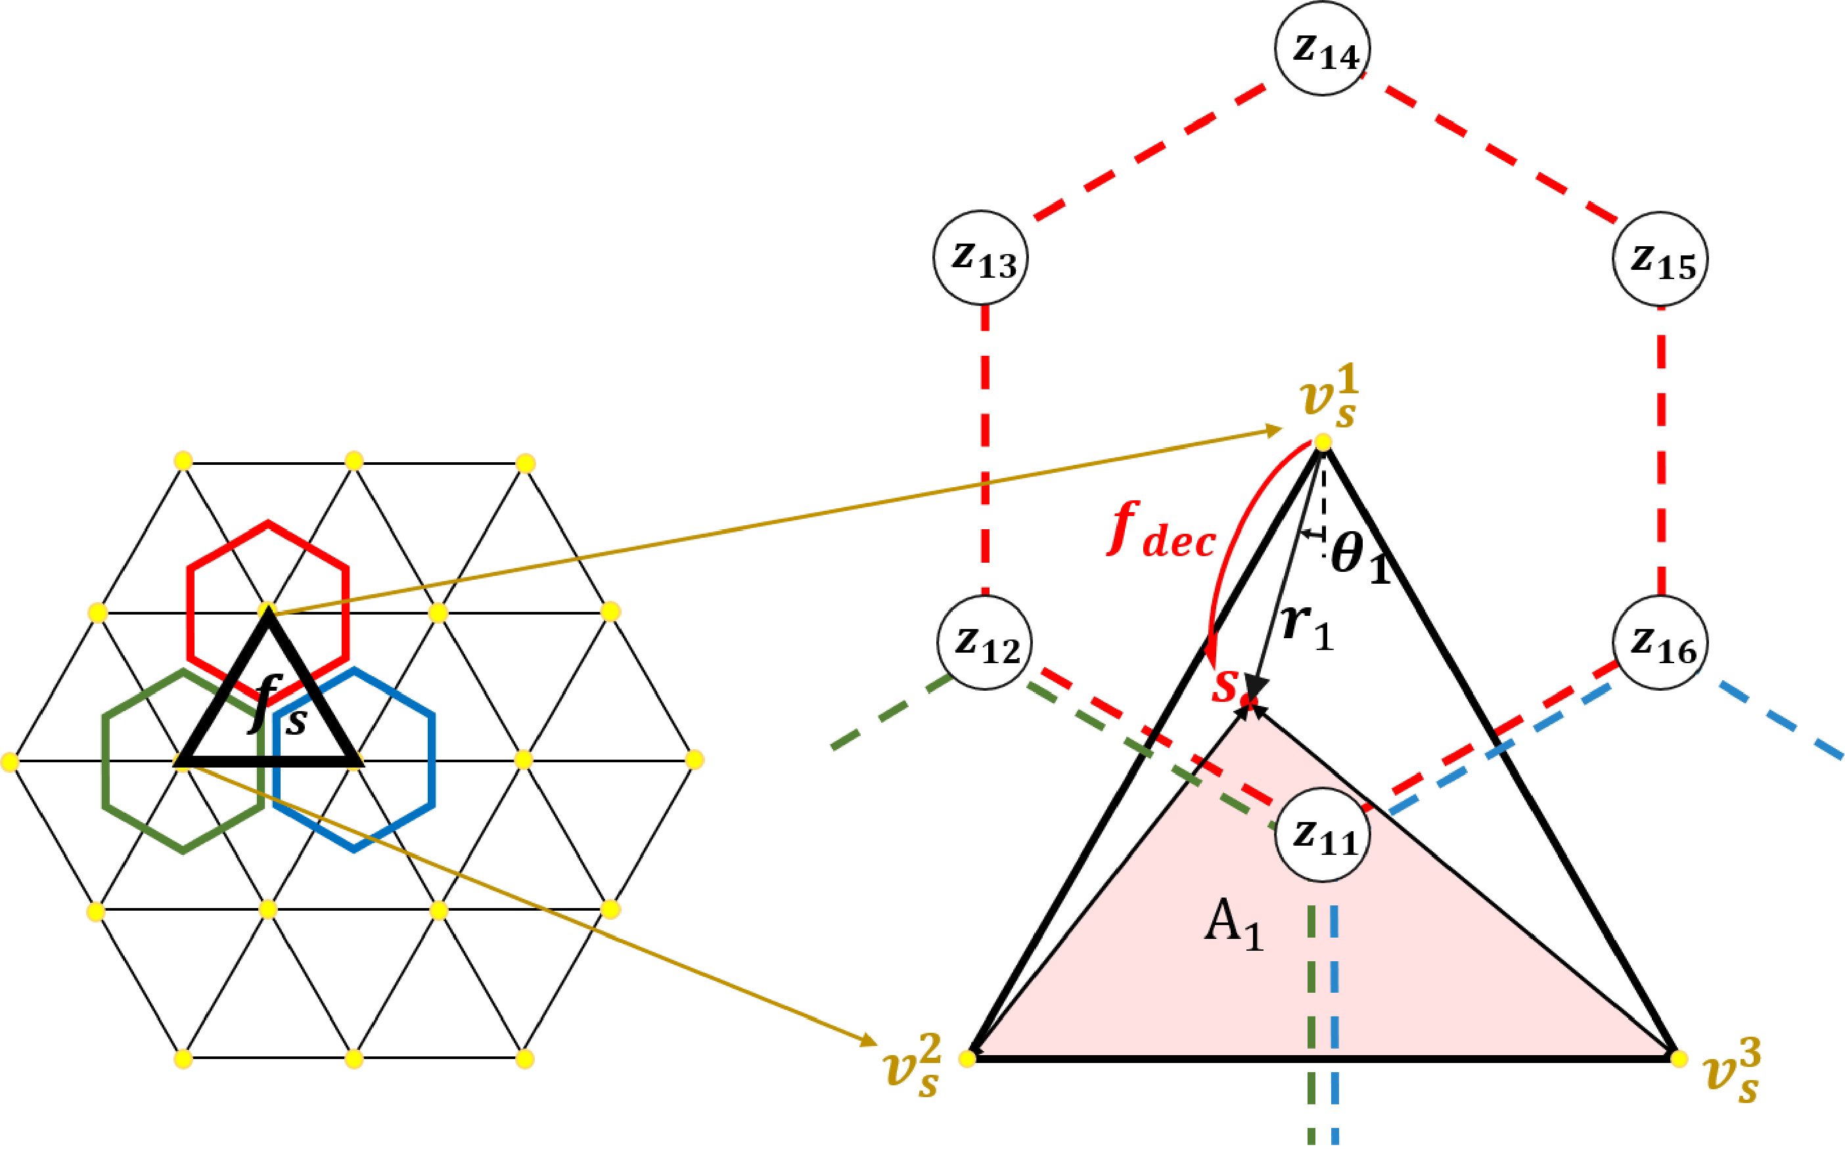
Before
Upward Kernel
𝒘
𝒘
𝒘
+
𝟑
𝒘
+
𝟑
𝟏
𝟒
𝟐
𝟒
𝒘
𝒘
𝒘
𝒘
𝟑
𝟗
𝒘
+
𝟑
𝟏𝟎
𝒘
+
+
𝟓
+
𝟒
𝟒
𝟒
𝟒
𝟒
𝒘
𝟕
𝒘
𝒘
𝒘
+
𝟏𝟎
𝒘
+
𝟗
𝟖
𝟒
𝟔
𝟒
𝒘
𝒘
𝒘
+
𝟗
𝟏𝟎
𝟏𝟏
+
𝟒
𝟒
𝒘
𝒘
𝒘
𝒘
𝟏𝟎
𝟏
𝒘
𝟐
𝒘
+
𝟗
𝒘
+
𝟑
𝟏𝟐
𝟒
𝟏𝟑
𝟒
𝒘
𝒘
𝟒
𝟓
𝒘
𝒘
𝒘
𝟔
𝟕
𝟖
𝒘
𝒘
𝒘
𝒘
𝟗
𝟏𝟎
𝒘
+
𝟒
𝒘
+
𝟓
𝒘
𝟏
𝟒
𝟏
𝟒
𝒘
𝟏𝟏
𝒘
𝟏𝟐
𝟏𝟑
𝒘
𝒘
GA
-
𝟒
𝟓
Conv
𝒘
𝒘
+
+
𝟒
𝟑
𝟒
𝟒
𝒘
+
𝒘
𝟔
𝟒
𝒘
+
𝟓
𝟖
𝟒
𝒘
𝒘
𝒘
𝒘
𝒘
𝟕
𝟓
𝟏𝟏
𝒘
+
𝟒
𝟏𝟏
𝒘
+
+
𝟗
+
𝟏𝟎
𝟒
𝟒

