Slide 1
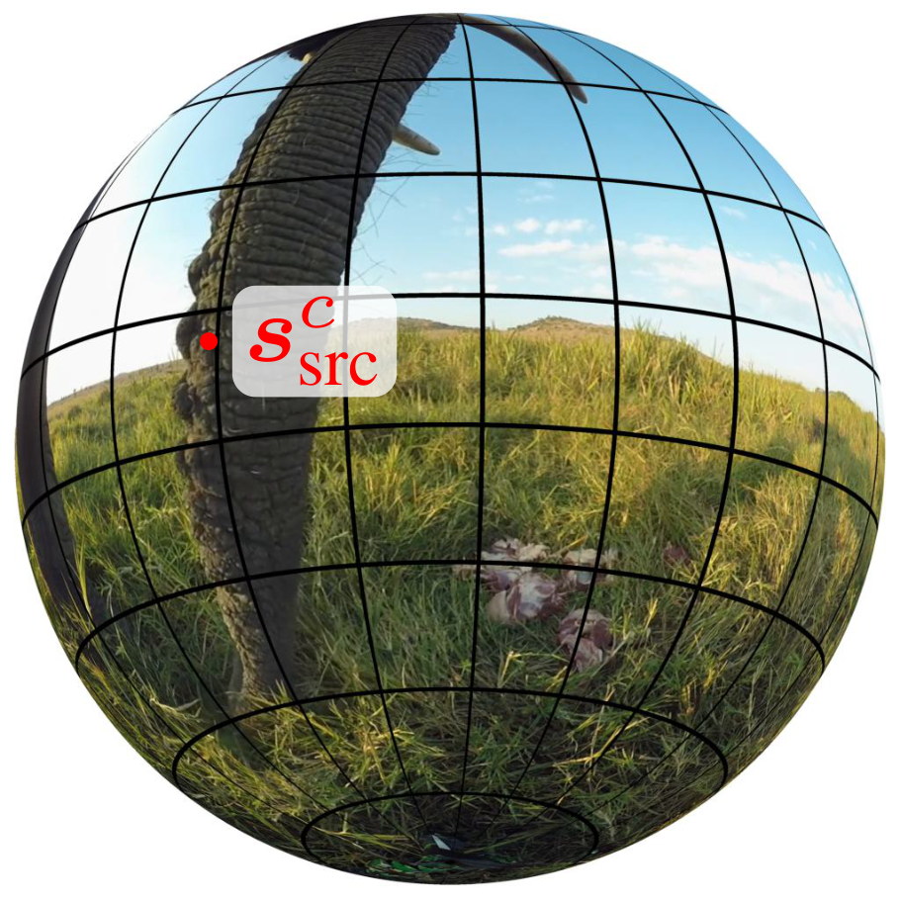
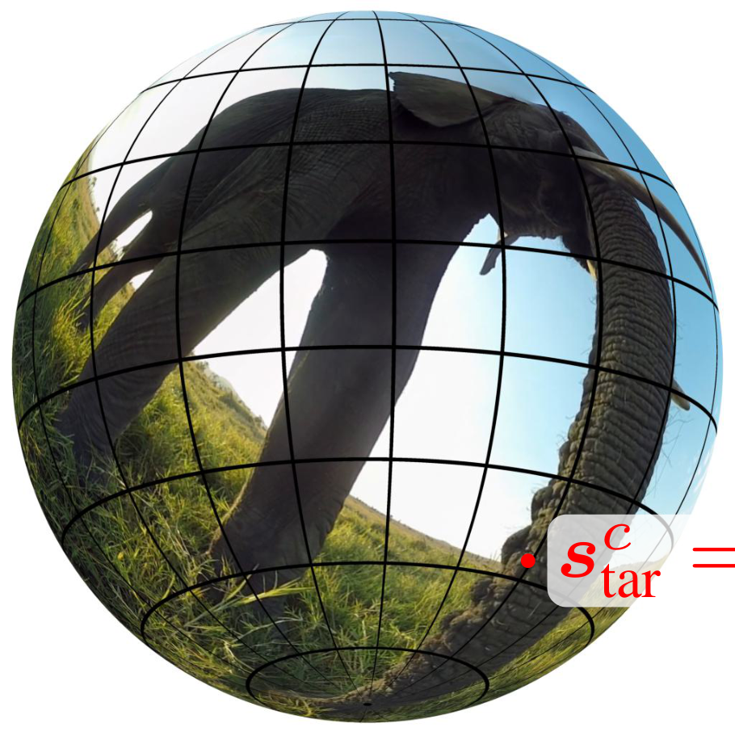
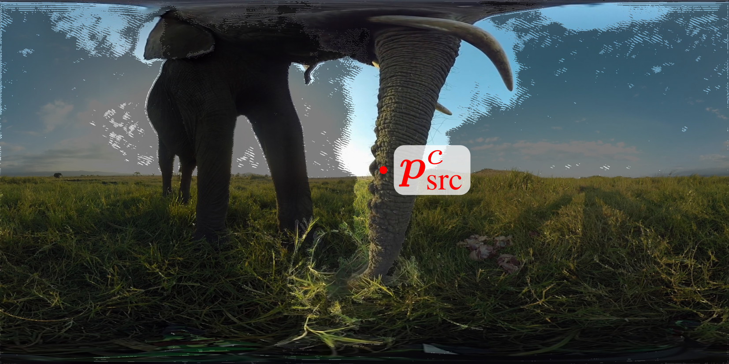
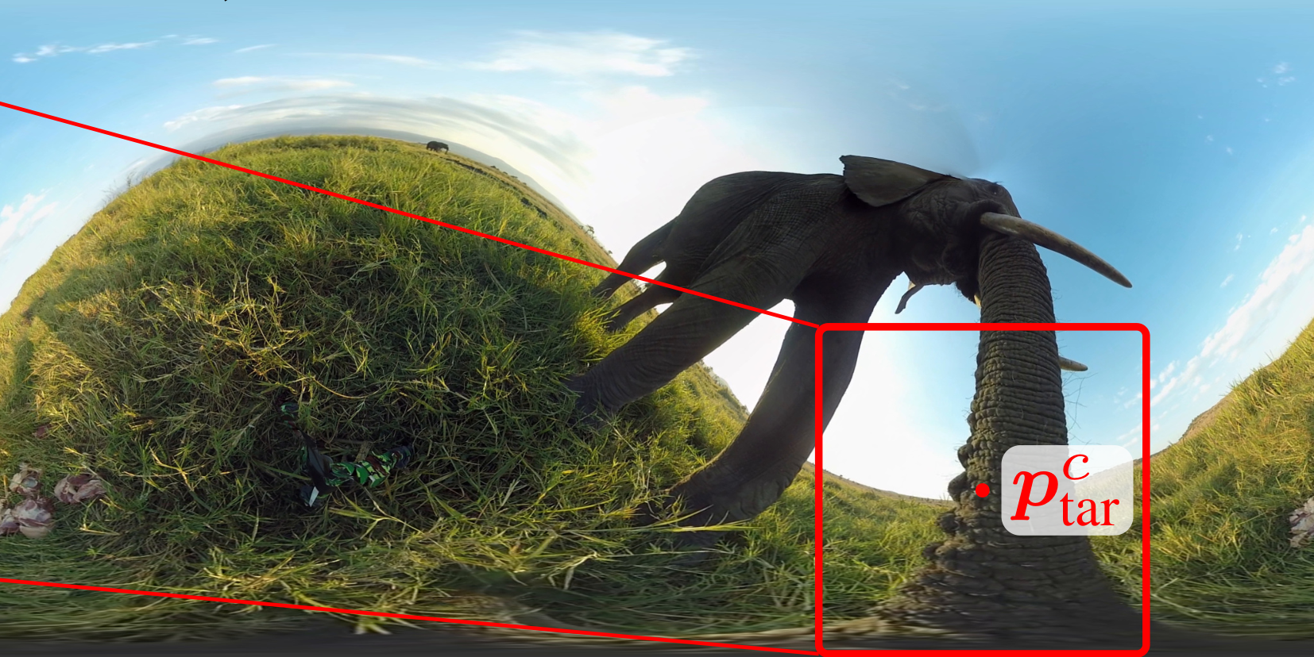
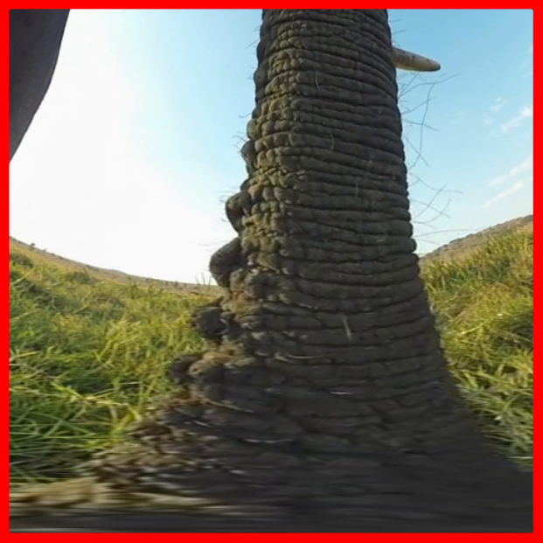
Originalimageinsphericaldomain
Rotatedimageinsphericaldomain
c
s
R
=
R
(
c
c
c
c
φ
)
R
(
θ
−
θ
)
R
(
src
z
y
src
z
−
φ
)
tar
tar
src
c
c
s
,
s
src
tar
z
c
c
s
=
Rs
src
tar
c
−
1
c
c
−
1
c
s
=
ξ
(
s
=
ξ
(
p
)
p
)
c
src
o
src
s
src
tar
o
tar
−
1
ξ
ξ
o
o
x
y
R
c
s
tar
p
c
src
Flow-guidedreprojection
p
c
tar
Reprojectedpatch
Originalimagewithoverlaidflowguide
Reprojectedimage

