Slide 1

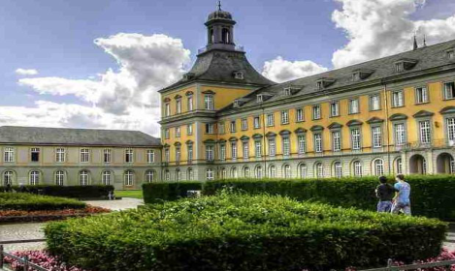
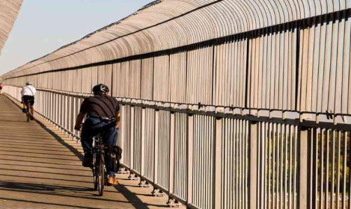
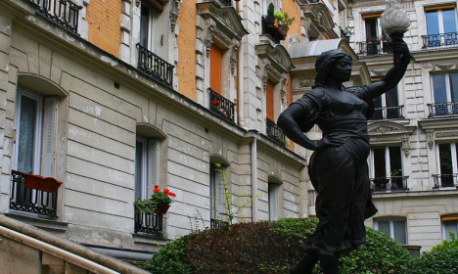

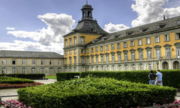


1
1
5
5
10
10
20
20
7.5
10.0
5.0
7.5
2.5
5.0
0.0
2.5
2.5
0.0
5.0
2.5
7.5
5.0
10.0
12.5
7.5
2
5.0
2.5
1
15
0.0
15
10
5
5.0
2.5
10
5
0
0
5
7.5
0
5
1
10
15
10.0
10
15
2
(a)Explicitlearning(b)Duallearning
QF=10
QF=20
QF=30
QF=90
...
Encoder
Explicit Learning
Implicit Learning
10
20
30
...
90
...
QF prediction
Image reconstruction
(c)Overviewofourduallearningstrategy.

