Slide 1
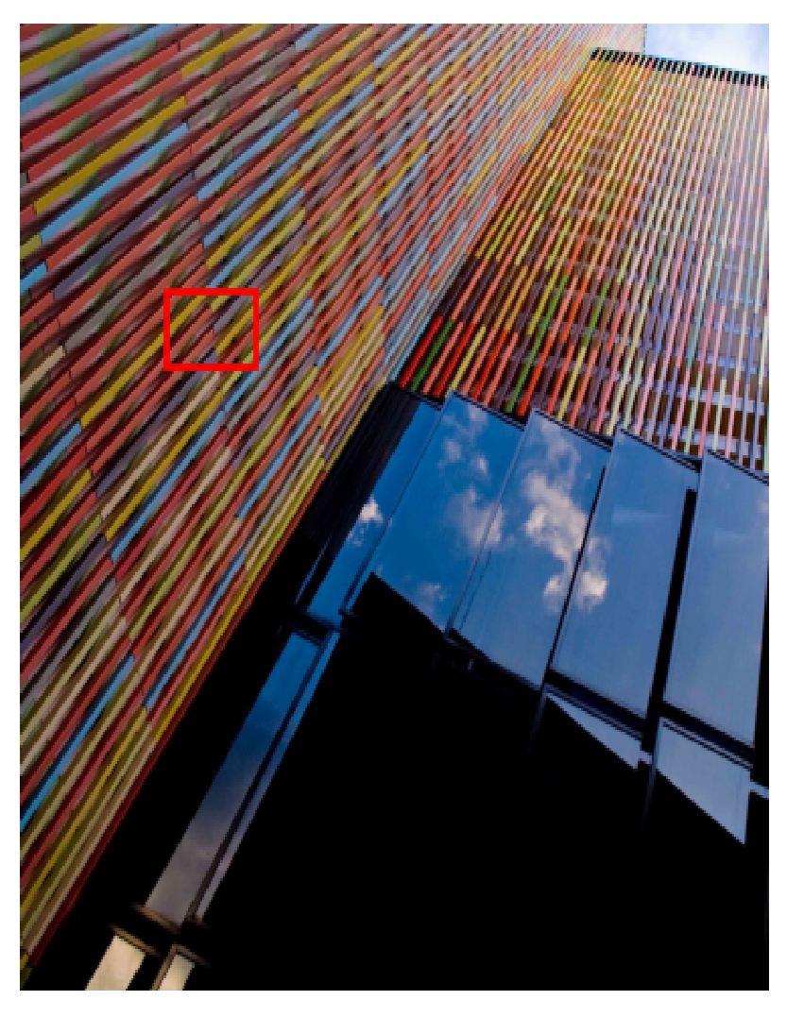
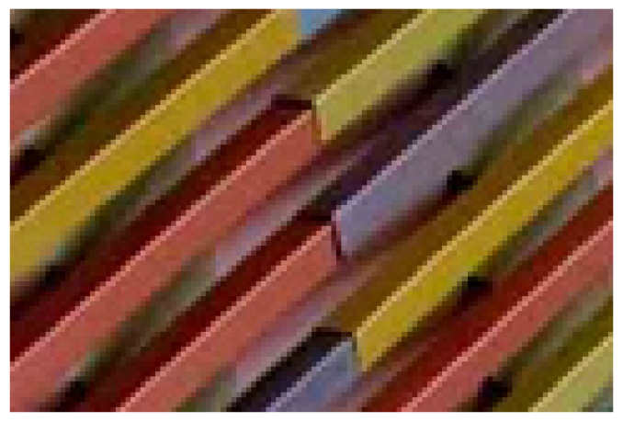
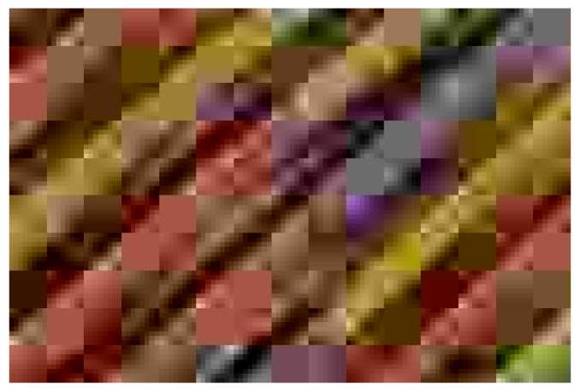
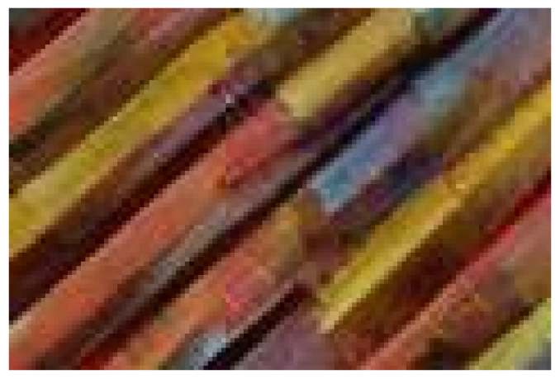

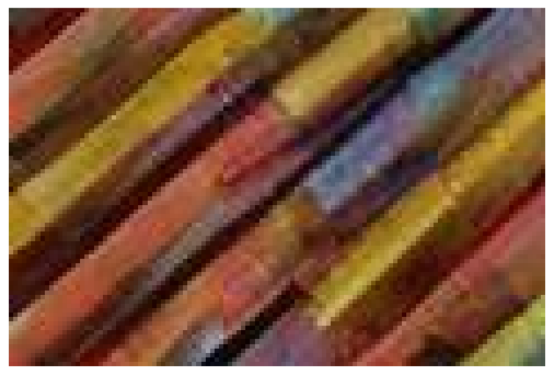
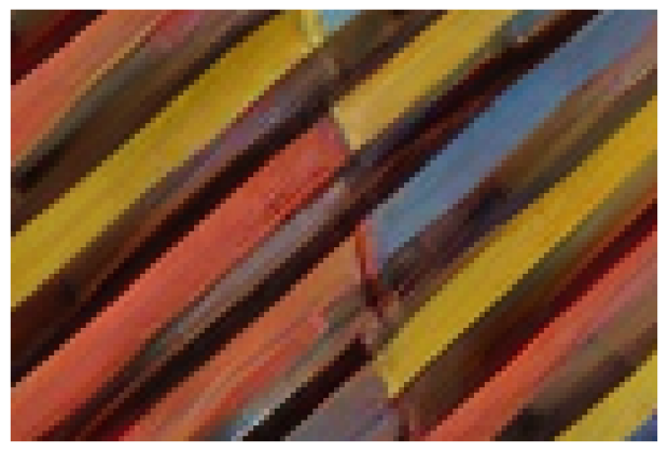
Method
LPIPS
LIVE-1
DIV2K-Val
↓
MUSIQ
↑
M-IQA
↑
LPIPS
↓
MUSIQ
↑
M-IQA
↑
Empty
0.348562.560.3793
0.324156.680.3142Learnable
DAPE[
44
0.3471
63.39
0.3900
0.323556.92
0.3262
]
0.3463
62.540.3793
0.3230
57.29
0.3240CaVE(ours)
0.3426
67.13
0.4584
0.3179
61.83
0.3709
Table3.AblationstudyofpromptembeddinggenerationonLIVE-1andDIV2K-valdatasets.Thebestandsecondbestre-sultsarecoloredwith
red
and
blue
,respectively.
HQJPEG(QF=5)EmptyString
Urban100:img
LearnableDAPE[
44
]CaVE(ours)
023
Figure6.Visualcomparisonofpromptembeddinggeneration.WeuseUrban100img
023asanexample.
4.4.AblationStudies
Compression-awareVisualEmbedder(CaVE).
Wecom-pareCaVEwithotherpromptstrategies,includingemptystrings,learnableembeddings,andDAPE[
44
].AsshowninTab.
3
,CaVEachievessuperiorperformanceonLIVE-1andDIV2K-Val,especiallyunderextremecompression.Fig.
6
furtherillustratesCaVE’seffectivenessinreducingartifactsandimprovingvisualquality.
DualLearning.
WecomparedifferenttrainingstrategiesforCaVE,whichisusedtoguidethereconstructioninCODiff.AsshowninTab.
7
,duallearningyieldsthebestperformance,highlightingitseffectivenessincapturingrichercompressionpriors.WefurtherassessgeneralizationbypredictingQFsnotseenduringtraining.AsshowninFig.
7
,CaVEwithduallearninggeneralizessignificantlybetterthanitsexplicitlytrainedcounterpart.
HighQFResults.
WeretrainandevaluateCODiffonhighQFsettingstoassessitseffectivenessunderlow-compressionconditions.AsshowninTables
5
and
6
,COD-iffconsistentlyoutperformstheleadingbaselines.
PSNREvaluation.
Tofurtherassessreconstructionfidelity,weevaluatepixel-wisedistortionusingPSNR.AsshowninTab.
4
,CODiffoutperformsleadingbaselinesacrossarangeofQFsandmultipledatasets.
CODiffTrainingLossFunctions.
CODiffistrainedwithacombinationofMSE,DISTS,andGANlosses.Asshownin

