Slide 1
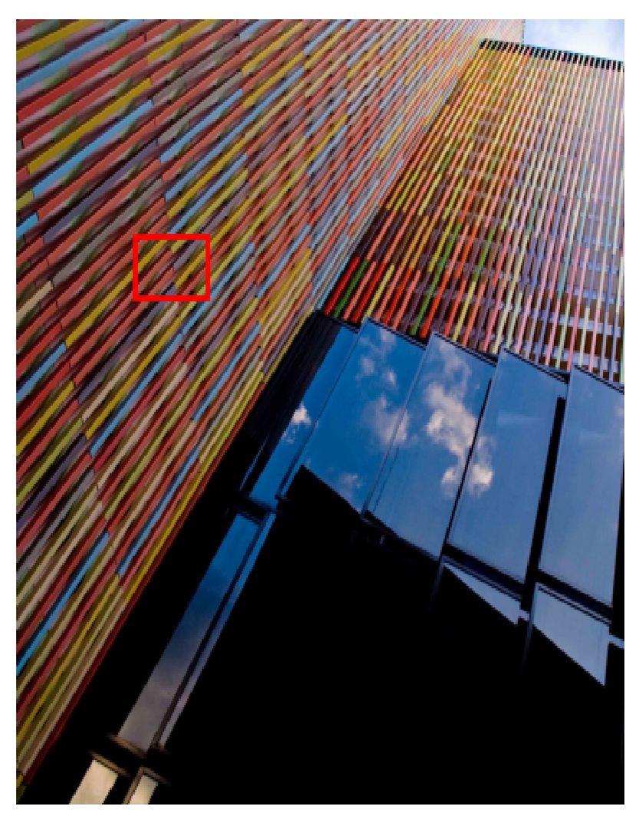
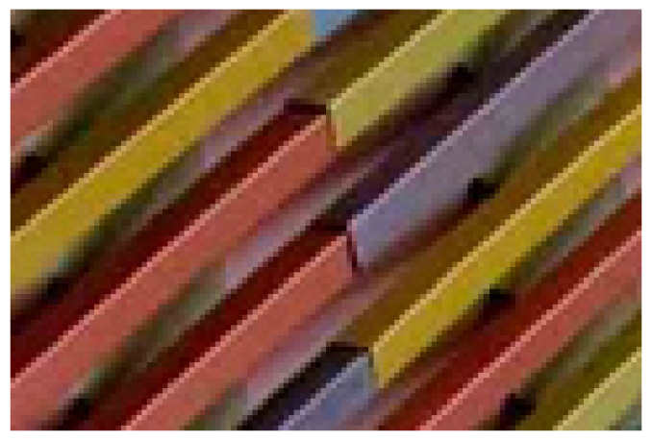
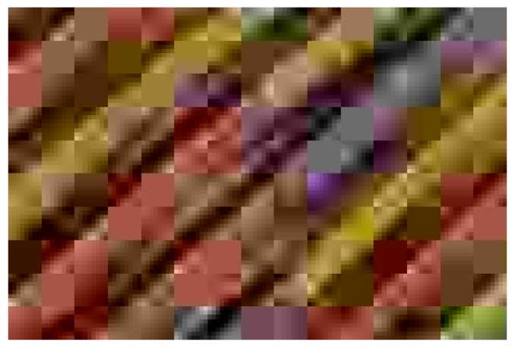
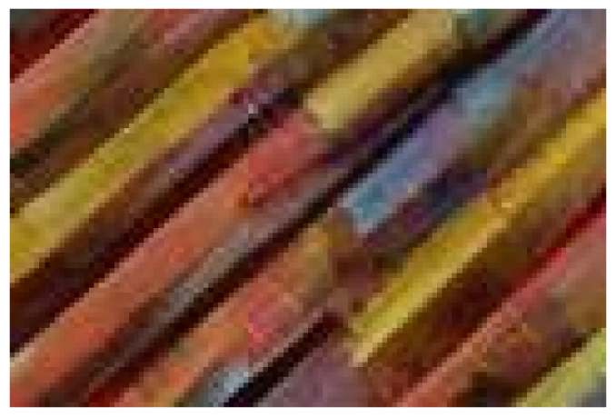

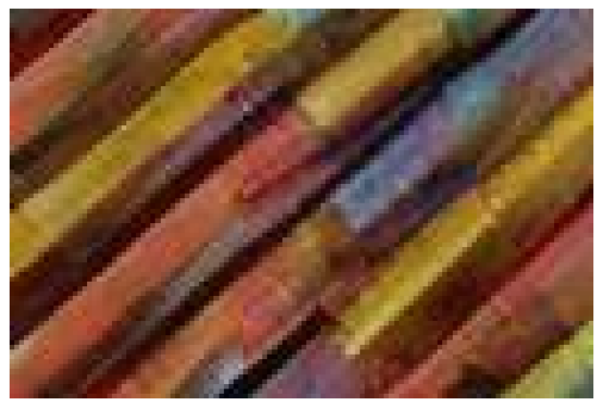
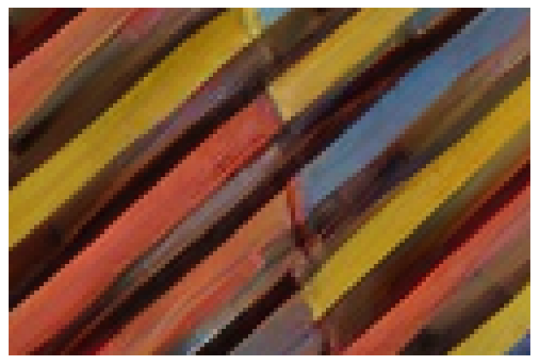
HQJPEG(QF=5)EmptyString
Urban100:img
LearnableDAPE[
44
]CaVE(ours)
023
Figure6.Visualcomparisonofpromptembeddinggeneration.WeuseUrban100img
023asanexample.
4.4.AblationStudies
Compression-awareVisualEmbedder(CaVE).
Wecom-pareCaVEwithotherpromptstrategies,includingemptystrings,learnableembeddings,andDAPE[
44
].AsshowninTab.
3
,CaVEachievessuperiorperformanceonLIVE-1andDIV2K-Val,especiallyunderextremecompression.Fig.
6
furtherillustratesCaVE’seffectivenessinreducingartifactsandimprovingvisualquality.
DualLearning.
WecomparedifferenttrainingstrategiesforCaVE,whichisusedtoguidethereconstructioninCODiff.AsshowninTab.
7
,duallearningyieldsthebestperformance,highlightingitseffectivenessincapturingrichercompressionpriors.WefurtherassessgeneralizationbypredictingQFsnotseenduringtraining.AsshowninFig.
7
,CaVEwithduallearninggeneralizessignificantlybetterthanitsexplicitlytrainedcounterpart.
HighQFResults.
WeretrainandevaluateCODiffonhighQFsettingstoassessitseffectivenessunderlow-compressionconditions.AsshowninTables
5
and
6
,COD-iffconsistentlyoutperformstheleadingbaselines.
PSNREvaluation.
Tofurtherassessreconstructionfidelity,weevaluatepixel-wisedistortionusingPSNR.AsshowninTab.
4
,CODiffoutperformsleadingbaselinesacrossarangeofQFsandmultipledatasets.
CODiffTrainingLossFunctions.
CODiffistrainedwithacombinationofMSE,DISTS,andGANlosses.Asshownin

