Slide 1



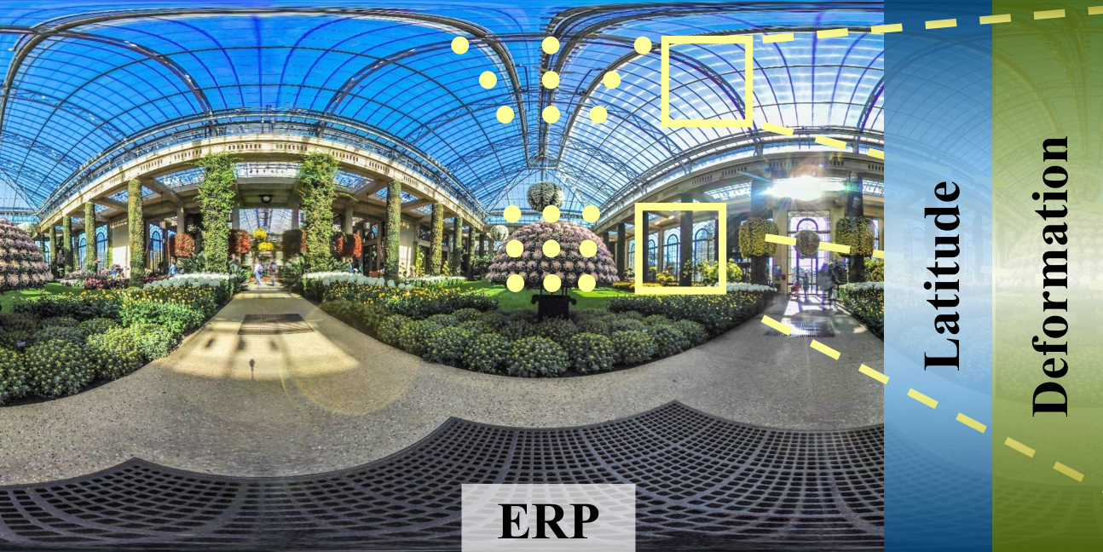





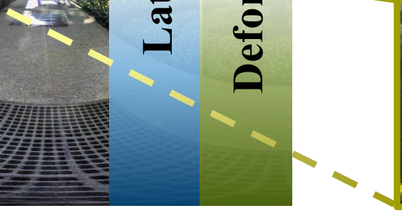











DINN360:DeformableInvertibleNeuralNetworkforLatitude-aware360
◦
ImageRescaling
1
1*
2
∗
2
YichenGuo
,MaiXu
,LaiJiang
,LeonidSigal
,YunjinChen
1
SchoolofElectronicandInformationEngineering,BeihangUniversity,Beijing,China
2
DepartmentofComputerScience,UniversityofBritishColumbia,Vancouver,Canada
90
Abstract
o
High latitude
Deformation
Severe deformation
Latitude
Latitude
0
◦
o
Withtherapiddevelopmentofvirtualreality,360
im-ageshavegainedincreasingpopularity.Theirwidefieldofviewnecessitateshighresolutiontoensureimagequal-ity.This,however,makesithardertoacquire,storeandevenprocesssuch360
Low latitude
ERP
Slight deformation
-90
o
Spherical Characteristic
Non-uniform sampling density
Guide
◦
DINN360 rescaling method
images.Toalleviatethisissue,weproposethefirstattemptat360
◦
1
2
imagerescaling,whichreferstodownscalinga360
Forward
Deformable downscaling
Latitude-aware HF projection
◦
LR
imagetoavisuallyvalidlow-resolution(LR)counterpartandthenupscalingtoahigh-resolution(HR)360
3
Reverse
Reverse upscaling
𝒛𝒛
◦
HR
Latent space

