Slide 1
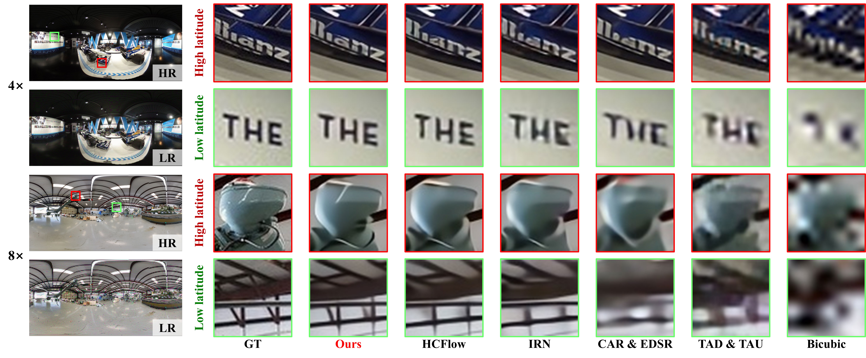
Scale
Method
ODISR[
5
]
SUN360[
42
]
F-360iSOD[
46
]
YouTube360[
29
Bicubic
29.46
]
±
2.54/86.23
±
5.05
30.06
±
2.46/87.92
±
4.85
30.68
±
4.53/87.43
±
7.23
34.93
±
4.92/94.82
Bilinear
28.94
±
4.47
±
2.45/83.15
±
5.83
29.39
±
2.40/85.09
±
6.08
29.97
±
4.23/84.61
±
8.61
33.20
±
4.21/9.255
Lanczos
28.58
±
6.06
±
2.54/84.04
±
5.57
29.16
±
2.47/85.72
±
5.48
29.86
±
4.56/85.44
±
8.11
34.26
±
5.13/93.95
Bicubic
±
5.24
&
360SR[
30
]
27.05
±
2.36/80.46
±
4.32
27.69
±
2.20/81.55
±
4.87
26.08
±
4.17/78.08
±
5.39
32.12
±
3.77/89.84
Bicubic
±
4.85
&
360SISR[
29
]
30.81
±
2.90/87.44
±
5.17
32.72
±
2.79/90.53
±
5.10
31.33
±
4.81/89.63
±
6.28
37.62
±
5.21/96.23
2
±
5.08
×
TAD
&
TAU[
17
]
35.84
±
3.28/96.12
±
8.12
37.70
±
2.68/97.17
±
1.10
33.94
±
5.11/93.87
±
4.47
39.50
±
4.08/98.22
CAR
&
EDSR[
24
±
1.00
,
36
]
33.00
±
3.51/91.31
±
4.41
35.68
±
3.37/93.91
±
4.07
35.38
±
5.48/93.05
±
5.09
40.49
±
5.24/97.75
IRN[
43
±
2.55
]
40.51
±
3.52/98.63
±
0.71
42.72
±
2.73/99.11
±
0.32
39.83
±
5.74/97.83
±
2.05
46.15
±
4.02/99.50
HCFlow[
±
0.32
23
]
42.05
±
3.79/99.02
±
0.57
45.05
±
3.00/99.49
±
0.24
40.53
±
5.78/97.92
±
1.99
50.56
±
3.07/99.71
DINN360
42.64
±
0.10
±
3.87/99.13
±
0.52
45.72
±
3.00/99.56
±
0.21
40.77
±
5.88/97.93
±
2.21
50.75
±
3.07/99.73
Bicubic
25.39
±
0.10
±
2.28/72.27
±
7.45
25.38
±
2.33/73.75
±
8.83
26.16
±
3.91/73.75
±
12.38
28.29
±
3.80/83.73
Bilinear
26.24
±
10.58
±
2.27/72.96
±
7.54
26.22
±
2.29/74.72
±
8.85
26.85
±
3.78/74.30
±
12.38
28.92
±
3.53/83.94
Lanczos
24.97
±
10.44
±
2.28/70.69
±
7.64
24.99
±
2.33/71.95
±
9.05
25.77
±
3.94/72.10
±
12.84
27.97
±
3.85/82.65
Bicubic
±
11.02
&
360SR
25.42
±
2.26/71.06
±
6.89
25.42
±
2.16/72.46
±
8.64
25.19
±
3.69/70.79
±
9.83
28.43
±
3.26/83.06
Bicubic
±
9.36
&
360SISR
27.03
±
2.45/76.15
±
7.97
27.81
±
2.44/80.45
±
9.39
27.45
±
4.35/78.79
±
11.66
30.96
±
3.87/89.36
4
±
10.75
×
TAD
&
TAU
28.98
±
2.51/82.69
±
5.91
29.70
±
2.47/84.86
±
6.21
28.71
±
4.55/81.34
±
10.40
33.24
±
4.61/92.48
CAR
&
EDSR
29.61
±
6.08
±
2.86/82.82
±
6.76
31.32
±
2.82/86.60
±
7.49
31.33
±
4.94/85.30
±
9.10
34.85
±
4.69/93.08
IRN
30.86
±
6.45
±
3.06/87.47
±
5.56
32.69
±
2.92/90.41
±
5.41
32.58
±
5.19/88.95
±
7.29
36.85
±
4.78/95.86
HCFlow
31.48
±
4.07
±
3.16/89.07
±
5.02
33.62
±
3.03/92.00
±
4.78
32.40
±
5.79/88.44
±
8.85
40.31
±
4.44/97.72
DINN360
31.92
±
2.13
±
3.26/89.90
±
4.82
34.19
±
3.12/92.77
±
4.48
32.93
±
5.90/89.34
±
8.82
40.55
±
4.29/97.89
Bicubic
23.25
±
1.89
±
2.19/64.10
±
8.64
22.92
±
2.21/65.18
±
10.24
23.45
±
3.48/64.12
±
15.04
24.98
±
3.06/74.70
Bilinear
24.16
±
12.89
±
2.19/65.35
±
8.65
23.81
±
2.19/66.77
±
10.20
24.25
±
3.41/65.42
±
14.89
25.78
±
2.96/75.86
Lanczos
22.95
±
12.65
±
2.19/63.15
±
8.68
22.65
±
2.21/63.98
±
10.27
23.19
±
3.49/63.05
±
15.18
24.77
±
3.08/73.78
Bicubic
±
13.03
&
360SR
23.61
±
2.06/64.15
±
8.53
23.28
±
2.17/65.11
±
10.14
23.19
±
3.17/63.30
±
13.68
25.02
±
2.85/78.19
Bicubic
±
12.37
&
360SISR
24.63
±
2.26/67.75
±
8.99
24.56
±
2.27/70.80
±
10.66
24.53
±
3.62/68.64
±
14.76
26.28
±
3.01/80.02
8
±
12.73
×
Bicubic
&
LAU-Net[
5
]
24.37
±
2.22/66.64
±
8.83
24.21
±
2.26/69.37
±
10.63
24.18
±
3.57/66.94
±
14.99
25.81
±
2.94/77.33
TAD
&
TAU
26.36
±
12.61
±
2.30/71.36
±
7.86
26.50
±
2.33/73.43
±
9.36
25.94
±
4.10/70.35
±
14.15
28.36
±
3.46/81.61
CAR
&
EDSR
25.97
±
11.04
±
2.38/69.40
±
8.82
26.40
±
2.42/72.77
±
10.75
26.87
±
4.12/71.19
±
14.36
27.98
±
3.44/79.83
IRN
28.06
±
11.27
±
2.72/77.41
±
8.12
29.48
±
2.74/82.02
±
9.66
29.55
±
4.89/80.03
±
11.87
32.16
±
4.24/89.01
HCFlow
28.25
±
9.30
±
2.76/78.20
±
8.00
29.77
±
2.77/82.84
±
9.42
29.83
±
4.94/80.98
±
11.47
34.19
±
4.02/91.78
DINN360
28.60
±
7.14
±
2.86/79.17
±
7.98
30.36
±
2.87/84.02
±
9.36
30.29
±
5.13/82.07
±
11.22
34.93
±
4.17/92.58
±
6.83
Figure8.Quantitativeresultsof
4
×
and
8
×
imagerescalingonODISRdataset.
comparedmethods.AsshowninTab.
◦
1
,DINN360achievesthebestperformanceovertheODISRdataset,intermsofbothWS-PSNRandWS-SSIM.Specifically,ourDINN360methodincreasesWS-PSNRbyatleast0.59dB,0.44dBand0.35dB,respectively,forthe
thetaskof360
imagerescaling.Inaword,theresultsverifythehighqualityoftherescaledHRimagesbyourDINN360method.
Generalizationresults.
Tovalidatethegeneralizationabil-ity,wefurthertestourDINN360andothercomparedmeth-odsoverotherthreedatasets(SUN360,F-360iSODandYouTube360)withoutfine-tuning.Tab.
2
×
,
4
×
and
8
×

