Slide 1
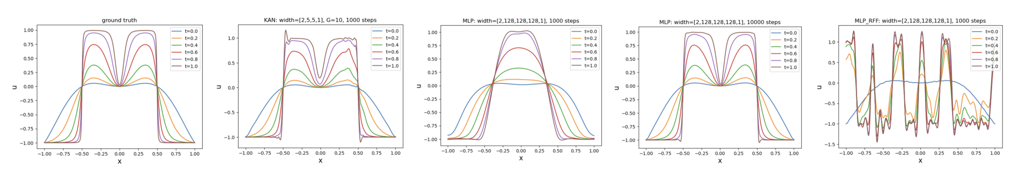
Figure11:Solvingthe1DAllen-Cahnequation.
B.2A
LLEN
-C
AHN
E
QUATION
TotestKANs’abilitytosolvetemporalPDEsandmodelphasetransitions,weconsidertheone-dimensionalAllen-Cahnequationwiththeperiodicboundaryconditionsandthequarticdouble-wellpotentialenergy,formulatedasbelow
u
−
0
3
.
0001
u
+5(
u
−
u
)=0
,x
∈
[
−
1
,
1]
,t
∈
[0
,
1]
t
xx
,u
(
x,
0)=
2
x
cos(
πx
)
≡
u
(
x
0
)
,u
(13)Sincewedonothaveanexactsolution,areferencesolutionisobtainedviathedirectEulerforwardmethod(1000meshpointsinspaceandintime).Althoughthistemporalequationseemsinnocuous,usingstandardPINNtraining(usingMLPs)canleadtoaproblem–thesolutionwouldcollapsetoazerosolutionveryquicklyintime!Tosolvethisissue,Wangetal.(2022)proposescausaltrainingwherethetemporaldomainisdividedintoseveralblocks.EachblockcorrespondstoaseparatePINNandthesePINNsaretrainedsequentiallyintime,wherethepreviousblockisusedtoinitializethenextblock.Eachblockcovers
(
−
1
,t
)=
u
(1
,t
)
,u
(
−
1
,t
)=
u
(1
,t
)
x
x
.
∆
t
=0
.
1
,sothereare10blocksintotal.ThetraininglossisthePINNlossloss
�
=
α
loss
:=
1
n
3
2
+
α
loss
+
α
loss
α
|
u
−
0
.
0001
u
+5(
u
−
u
)
pde
i
i
b
b
t
t
i
i
i
t
xx
|
+
n
=1
i

