Slide 1
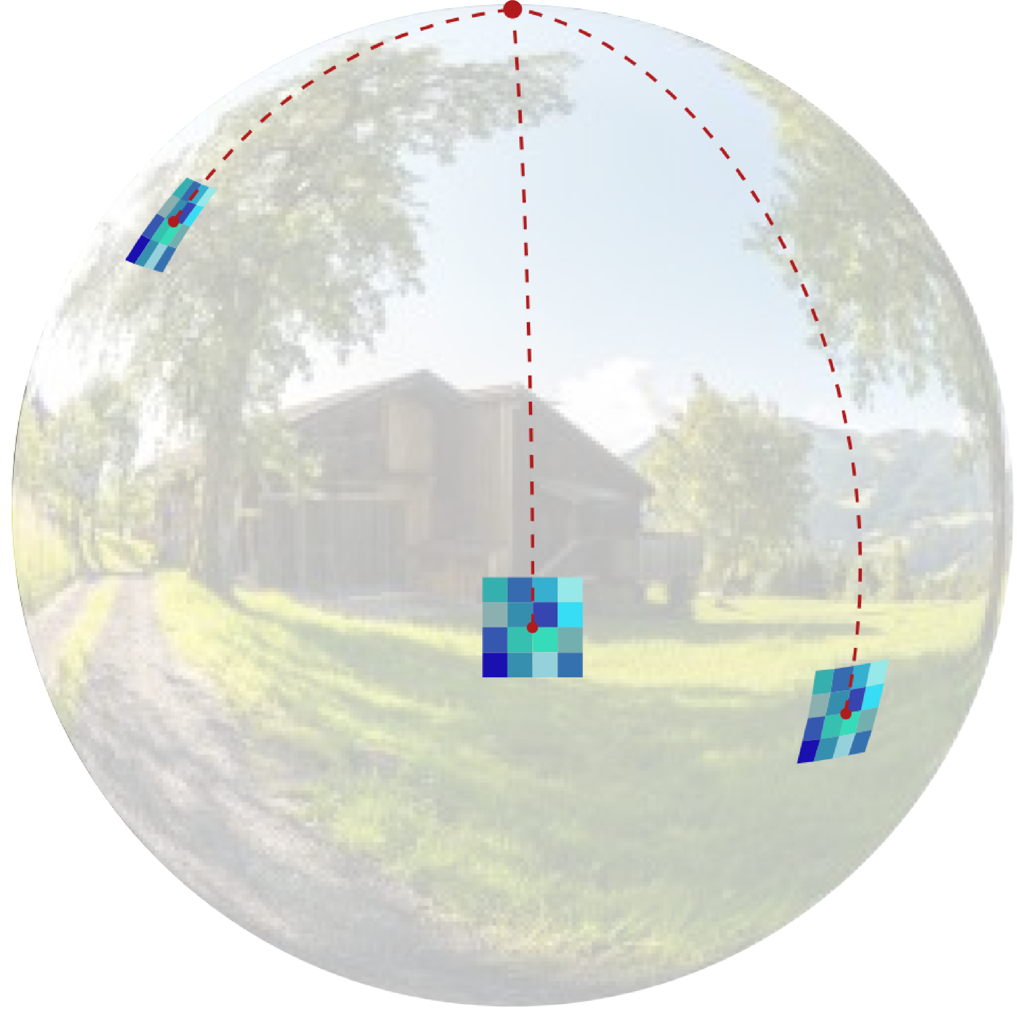
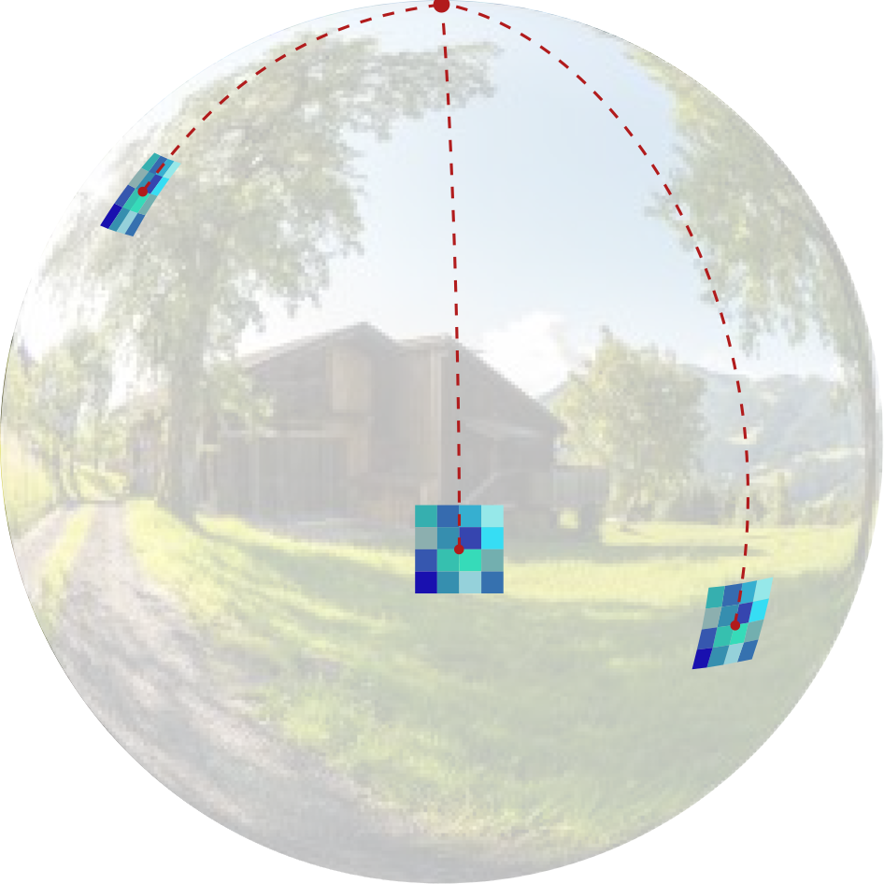
OSLO:On-the-SphereLearningforOmnidirectionalimagesanditsapplicationto360-degreeimagecompression
NavidMahmoudianBidgoli,RobertoG.deA.Azevedo,ThomasMaugey,AlineRoumy,PascalFrossard
Abstract
—State-of-the-art2Dimagecompressionschemesrelyonthepowerofconvolutionalneuralnetworks(CNNs).AlthoughCNNsofferpromisingperspectivesfor2Dimagecompression,extendingsuchmodelstoomnidirectionalimagesisnotstraight-forward.First,omnidirectionalimageshavespeciﬁcspatialandstatisticalpropertiesthatcannotbefullycapturedbycurrentCNNmodels.Second,basicmathematicaloperationscomposingaCNNarchitecture,
e.g.
,translationandsampling,arenotwell-deﬁnedonthesphere.Inthispaper,westudythelearningofrepresentationmodelsforomnidirectionalimagesandproposetousethepropertiesofHEALPixuniformsamplingofthespheretoredeﬁnethemathematicaltoolsusedindeeplearningmodelsforomnidirectionalimages.Inparticular,we:i)proposethedeﬁnitionofanewconvolutionoperationonthespherethatkeepsthehighexpressivenessandthelowcomplexityofaclassical2Dconvolution;ii)adaptstandardCNNtechniquessuchasstride,iterativeaggregation,andpixelshufﬂingtothesphericaldomain;andtheniii)applyournewframeworktothetaskofomnidirectionalimagecompression.Ourexperimentsshowthatourproposedon-the-spheresolutionleadstoabettercompressiongainthatcansave13.7%ofthebitratecomparedtosimilarlearnedmodelsappliedtoequirectangularimages.Also,comparedtolearningmodelsbasedongraphconvolutionalnetworks,oursolutionsupportsmoreexpressiveﬁltersthatcanpreservehighfrequenciesandprovideabetterperceptualqualityofthecompressedimages.Suchresultsdemonstratetheefﬁciencyoftheproposedframework,whichopensnewresearchvenuesforotheromnidirectionalvisiontaskstobeeffectivelyimplementedonthespheremanifold.

