Slide 1
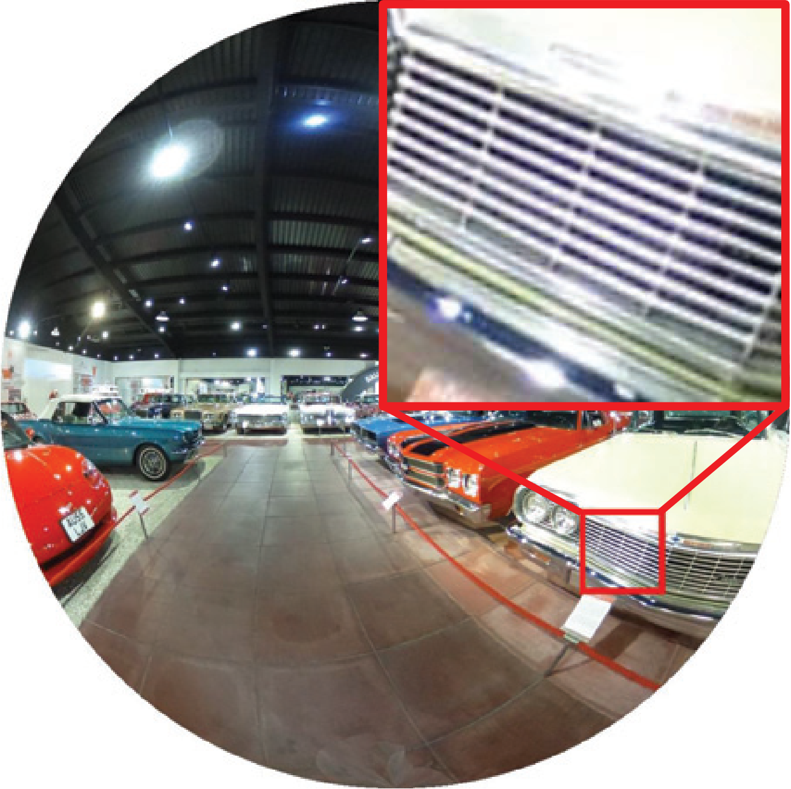
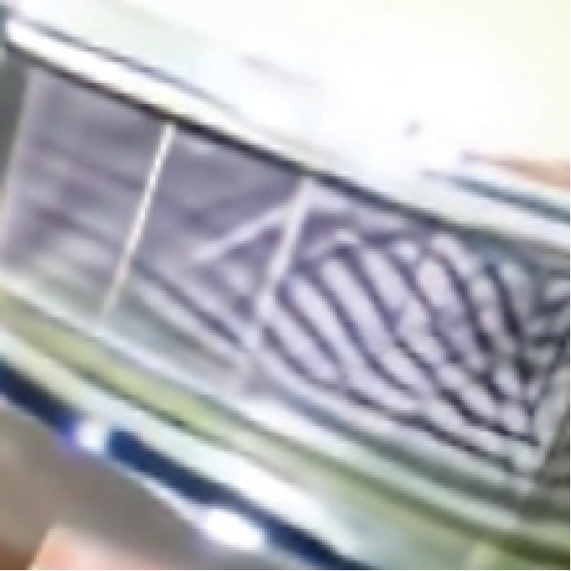


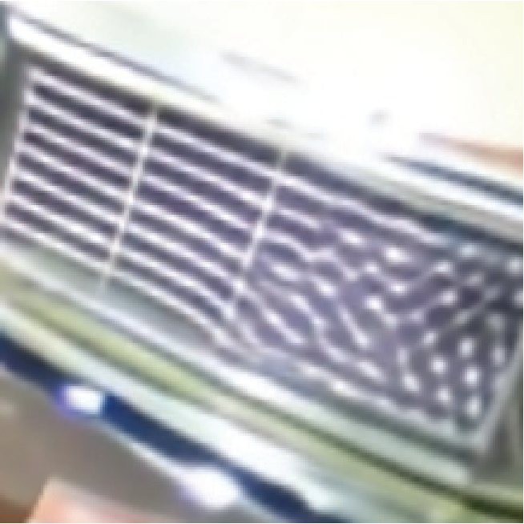

performspreviousmethodsby0.3dBonPSNR.AlthoughdirectlyapplyingSwinIRontheODISRtaskhasalreadyreachedSOTAperformance,OSRTsurpassesSwinIRover0.1dBontwodatasetsforboth
feature
DACB
DAAB
ODI-SR
SUN360
Params.dim
PSNRSSIM
PSNRSSIM
(M)
60
×
×
30.270.8739
30.780.8742
0.9160
×
2and
✓
×
30.410.8775
31.000.8793
1.1660
×
4SRtasks,whichdemonstratestheeffectivenessofitsdistortionmodulationability.TheperformanceofRCANdegradesunderFish-eyedownsampling,whichiscausedbytheincompatibilitybetweenchannelattentionandFisheyedownsampling
×
w/o
C
w
30.310.8746
30.830.8755
1.0060
×
w/
C
w
30.320.8746
30.840.8753
1.0160
✓
w/
C
w
30.440.8780
31.040.8800
1.2672
×
×
30.320.8748
30.850.8755
1.29
5
Table3.AblationstudyonOSRTcomponents.Allmodelsaretrainedon
.
×
2
SRtaskunderFisheyedownsampling.
Qualitativecomparison.
Fig.
6
showsthevisualizationresultsof
andmakestheODISRtaskidenticaltothestandardplainimagesuper-resolutiontask.Theevidenceisthatastan-dardSISRmodel(SwinIR)trainedonaplainimagedataset(DF2K)canoutperformpreviousSOTAintheODISRtask,whichyieldsWS-PSNRresultsof24.63dB/24.49dB(22.68dB/22.13dB)on
×
4
ODISRtask.Whileothermethodsstrug-gletounderstandthegeometrictransformationprocessindistortedimages,OSRTcanreconstructsharpandaccurateboundarieswiththeadvantagesofdistortionmodulation.ItisobservedthatOSRTisskilledatreconstructingrigidtex-ture.Moreover,beneﬁtingfromthedistortionmodulationability,OSRTcanpreservetheoriginalstructureasmostwhenbeingprojectedtootherprojectiontypes(Fig.
×
8(
×
16)ODI-SR/SUN360testingset,respectively.Inconclusion,whentheintrinsicpropertyofODIsisbrokenbyERPdownsampling,theODISRtaskdegeneratesintoaplainimagesuper-resolutiontaskwithaparticulardatadistribution.
7
).
4.3.EvaluationunderERPDownsampling
TocomparewithpreviousODISRmethods[
12
,
30
,
40
],wetrainOSRTunderthepreviousERPsetting.Regard-lessofover-ﬁttingissues,weonlytrainonthedatasetpro-videdby[
12
]forfairness.AsshowninTab.
2
,OSRTstilloutperformsLAU-Net[
12
]andSphereSR[
40
]underlargeupscalingfactorandERPdownsampling.Withoutacom-plicatedtrainingpipelineanddiscreteinferenceprocess,OSRTyieldsthebestPSNRvaluesandsurpassesallprevi-ousmethodsonmostSSIM-relatedmetrics(threeoffour).
EDSR[
24
]SwinIR[
23
]

