Slide 1
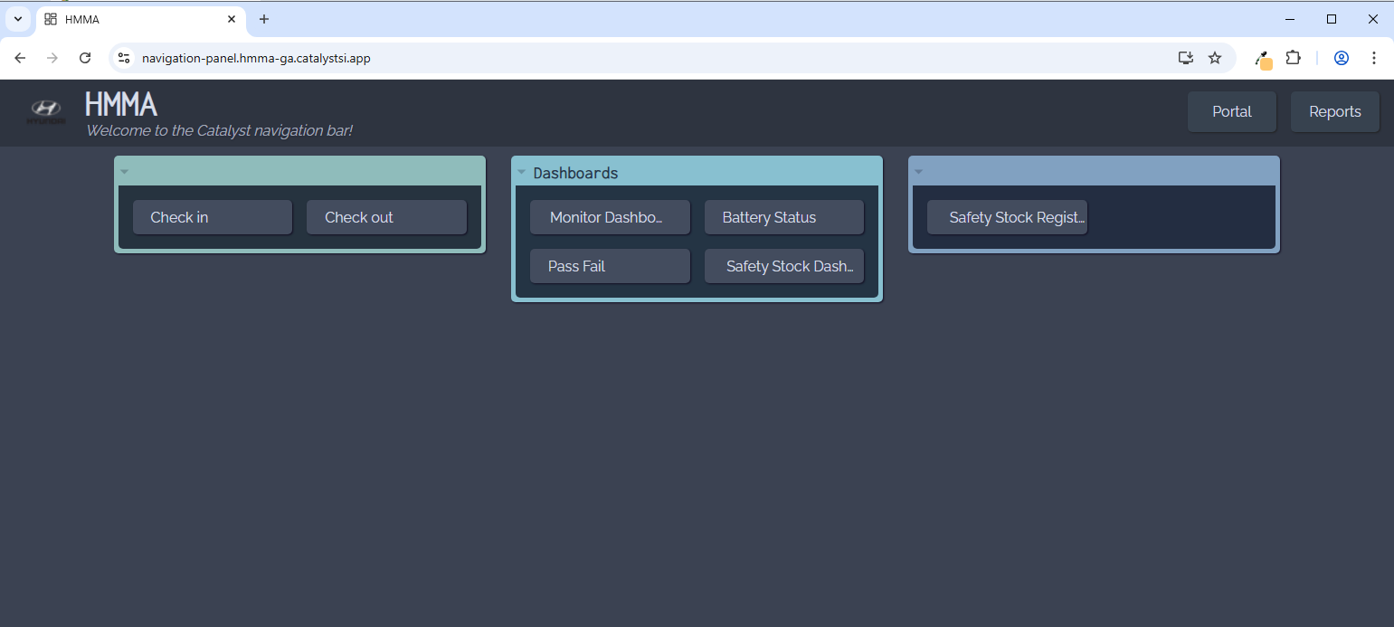
https://navigation-panel.hmma-ga.catalystsi.app/

Slide 2
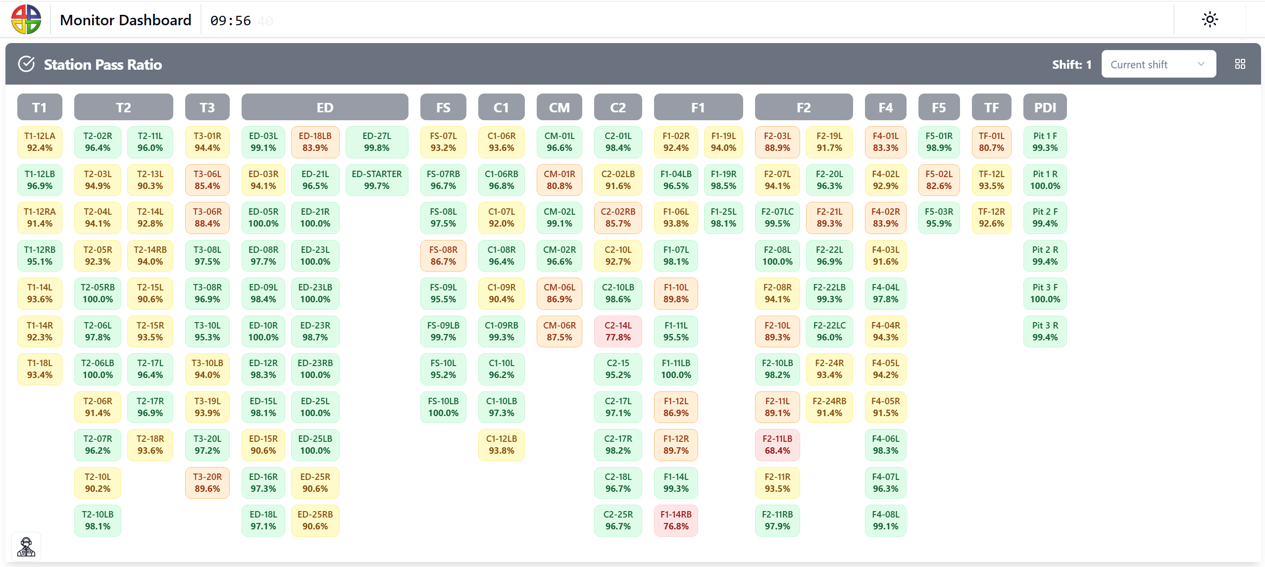

Slide 3
