Slide 1
Improved Dynamic Programming for the Shortest Path Problem with Resource Constraints in DAG

Slide 2
Abstract
An efficient yet flexible solution framework for the shortest path problem with resource constraints
Critical subproblem in a bunch of optimization problems in the airline industry
Apply the skyline algorithms to speed up the computation of pareto-optimal labels
Specialized memory management strategy
Bi-directional dynamic programming

Slide 3
Problem Definition
The shortest path problem with resource constraints (SPPRC) searches for a shortest path in a directed graph subject to some additional resource constraints defined along the path, e.g. the total time should not be greater than some bound.

Slide 4
Applications
Vehicle routing
Crew scheduling in the airline industry

Slide 5
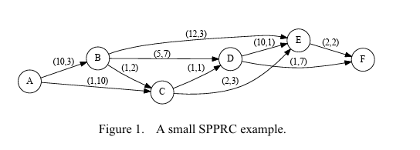
SPPRC is formulated on a graph with a set of nodes and a set of arcs. Each arc is associated with a cost and one or more nonnegative resources. The cost and resource consumption of a path are simply those of all arcs along the path combined. SPPRC then seeks a path from a given source to a given destination such that the cost is minimized and the consumption of each resource is not greater than its given upper bound

Slide 6
LABELING ALGORITHM IN BGL
A generic and open-source implementation of the standard labeling algorithm for SPPRC could be found in the Boost Graph Library (BGL), which is part of the well-known Boost C++ libraries
A label on a node represents a path from the source to this node, as well as the cost and resource consumptions along the path.
From the initial label representing the trivial path with a single node, i.e. the source, the dynamic programming approach extends paths into all directions in case they are resource feasible.
The algorithm is also referred as the multi-label algorithm because in contrast to the shortest path problem without resource constraints, multiple labels at the same node could be incomparable

Slide 7
Dominance Test
One path may cost less but consume more in (at least) one resource than a second path. In this case, the former path may become infeasible after extension while the latter one remains feasible
On the other hand, one path may be better off in all criteria. In this case, the other path is dominated and should be removed by the idea of optimal substructure in dynamic programming
The efficiency of the multi-label algorithm heavily relies on the label dominance tests to filter pareto-optimal labels and remove dominated labels which cannot be extended to an optimal solution.

Slide 8
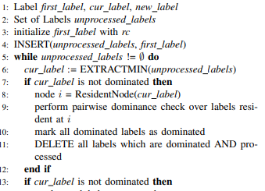
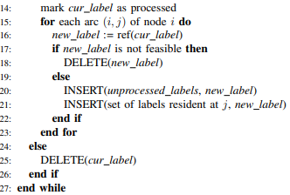
LABELING ALGORITHM IN BGL

Slide 9
rc: the resource container of the initial label (usually zeroes for the cost and all resources).
ref: the resource extension function defined on each arc in the graph, which controls how the cost and resource consumptions are aggregated along the path and the resource feasibility.
dominance: the condition when one label is dominated by another one at the same node.

Slide 10
DAG
The algorithm in BGL is designed for a general directed graph.
In many applications, the underlying graph is a directed acyclic graph (DAG) by definition
e.g. a time-space network where each arc represents an activity in a certain period of time; apparently, no arc goes from the future to the past.
Thus in this work, we concentrate the discussion for DAG.
The special structure of DAG can usually reduce the complexity of shortest path problems.

Slide 11
For DAG, there always exists a linear ordering of nodes called a topological ordering such that for every directed arc (i, j) from node i to node j, i comes before j.
It is well-known that a topological ordering of any DAG can be found in linear time by e.g. depth-first search
For each node, we first perform the dominance test and obtain all pareto-optimal labels at this node, then extend these labels to successive nodes for new labels.
In the BGL version, a label may be not dominated at first, extended, and finally found dominated by another label generated later.
Therefore, the number of labels and dominance comparison could be greatly reduced for DAG.

Slide 12
Improvement

Slide 13
Skyline Algorithm
Dominance tests among labels at the same node play a significant role in the algorithm.
In pursuit of better performance, we may expect a “smarter” way to do the test than the naive implementation of two nested loops of labels.
In fact, such problems have been considered in the database community known as the maximum vector problem or the skyline operator . We may reduce the number of label comparison following the idea of skyline algorithms.

Slide 14
A naive implementation of the skyline operator is composed of two nested loops of labels. For a pair of labels l1 and l2, we perform the dominance test in both directions: we check whether l1 is dominated by l2, and whether l2 is dominated by l1
Several skyline algorithms are proposed to accelerate the process.
We choose to apply the skyline algorithm called sort-filter-skyline proposed in [10] for both its simplicity and efficiency.

Slide 15
Sort-filter-skyline
The idea of the algorithm is that, if we presort the labels such that the former l1 can never be dominated by the latter l2 in the ordering, then we can perform the dominance test in just one direction.
Thus we replace a certain amount of label comparison in dominance test by label comparison in sorting.
Then we can benefit from the well-studied sorting algorithms.
For the classical SPPRC we discuss, a lexicographical ordering of resources (including cost) can do the trick.
If l1 comes before l2 in such an ordering, at least one resource of l1 is less than l2 unless they are exactly the same, thus l1 is never dominated by l2.

Slide 16
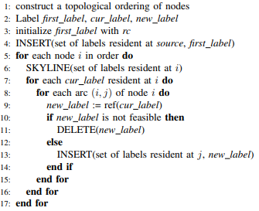
LABELING ALGORITHM IN DAG

Slide 17
Memory Management
Dominance tests are only performed between labels at the same node.
Therefore, it is very attractive to organize labels in the memory in a way that labels resident at the same node are close to each other to improve memory data locality.
In case of large instances, the number of labels and dominance tests can be vast.
If the two labels in the dominance test are located close to each other in the memory, we can accelerate memory access to take advantage of CPU caching.

Slide 18
At the beginning of the algorithm, every single node is associated with its own memory block.
When a new label is generated, it is contained in the associated memory block of its resident node.
Once the block of a node is full, a new memory block is allocated to this node. Blocks are occasionally re-organized if necessary such that blocks associated with the same node are located close to each other. In this way, the data locality of two labels at the same node are significantly improved.

Slide 19
Bi-directional Search
Bi-directional dynamic programming to further reduce the number of labels.
Bi-directional dynamic programming has been considered to accelerate algorithms for the classical shortest path problems and the elementary SPPRC
Bi-directional dynamic programming search is composed of three stages.
First is a forward pass from the source to nodes “somewhere in the middle” to generate forward labels, just as the one directional labeling algorithm we discussed; then a symmetric backward pass from the destination generates backward labels; and finally at each node with both forward and backward labels, it joins any pair of labels to form a feasible complete path.

Slide 20
If the searches do not stop appropriately, redundant labels will be generated and duplicate paths will be obtained many times at multiple nodes.
For DAG with a topological ordering, however, we can pick any node (usually right in the middle) as a milestone to stop the path extension.
Specifically, a forward label should stop extension when it reaches a node after the milestone in the topological ordering for the first time; symmetrically, a backward label stops when it reaches a node before the milestone for the first time.
Lastly, we join labels resident at only one half of the nodes, say after the milestone. The other half of the nodes should be ignored since they only provide duplicate paths.

Slide 21
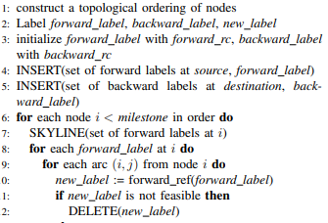
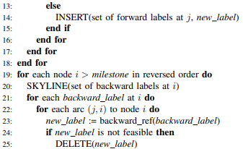
BI-DIRECTIONAL LABELING ALGORITHM IN DAG

Slide 22
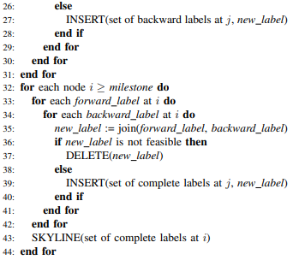

Slide 23
Our Improvements
We can observe that forward and backward dynamic programming are independent to each other , so we can parallelize forward and backward dynamic programming.
We can also see that labels can be joined paralleling , because joining of a label at a node is independent of labels on other nodes. This can help us improving run time for large instances.

Slide 24
Comparison of Generated Labels for SPPRC Instances
Instances | BGL | DAG (skyline) | DAG (Bi-dir) | DAG (parallel Bi-dir)
Instance 1 | 14 | 11 | 19 | 19
Instance 2 | 19 | 14 | 18 | 18

Slide 25
Comparison in time
Instance | BGL | DAG (skyline) | DAG (Bi-dir) | DAG (parralel Bi-dir)
Instance 1 | 0.33302 | 0.1928 | 0.28734 | 0.2736
Instance 2 | 0.4217 | 0.25942 | 0.3246 | 0.35966

Slide 26
Implementation of code
Implementation
Labeling Algorithm (la_bgl.cpp)
Skyline Algorithm (la_dag.cpp)
Bi-directional Search (la_bi.cpp)
Parallel version of Bi-directional (la_bi_pa.cpp)
Link for codes : codes

Slide 27
Thank You

