Slide 1
Project : Karaoke night
- Which PM Software does we should use?
by Yangha Park

Slide 2


· Project Management Software
- Dapulse
(rating: 5 out of 5)
- Asana
(rating:4.5 out of 5)
from 'Top Project Management tools review(http://www.capterra.com/project-management-software/)'

Slide 3
· Product Introduction
· About This Software
dapulse is a project management tool your team will actually enjoy using. It makes it fun and easy for everyone to collaborate, focus on what's important, and get more done at work. It's the first visual tool of its kind and shows you exactly where things stand at a single glance. Finally get rid of painfully long email threads, cut down on meetings, and experience the satisfaction of turning things green when they're done.

Slide 4
· Product Details
· Product Details
Starting Price | $5.00/month/user
Pricing Details | Simple, fair pricing that scales with your workforce. Save up to 32%!
Free Trial | Yes , get a free trial
Deployment | Cloud, SaaS, Web Installed - Mac Installed - Windows Mobile - Android Native Mobile - iOS Native
Training | Documentation Webinars Live Online
Support | Online 24/7 (Live Rep)

Slide 5
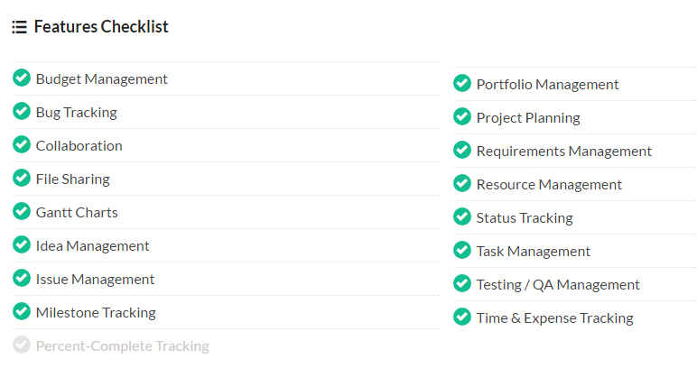

Slide 6
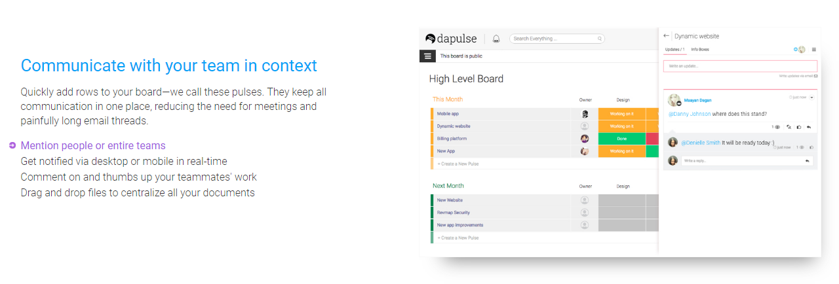

Slide 7
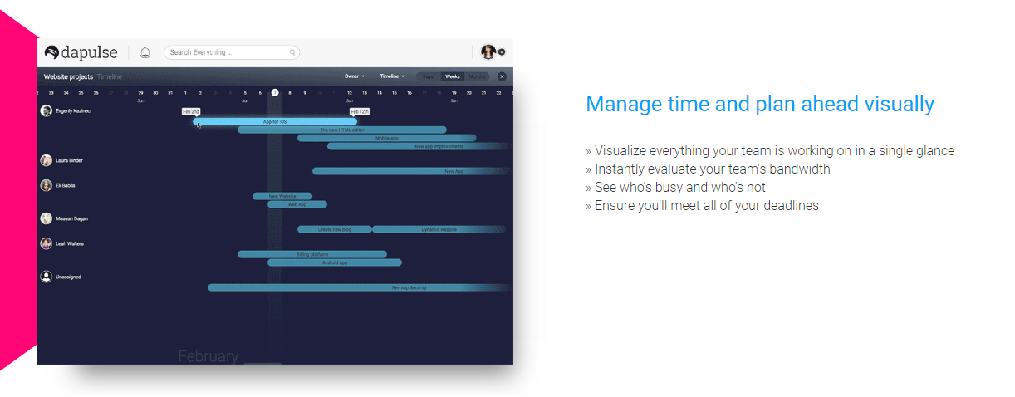

Slide 8
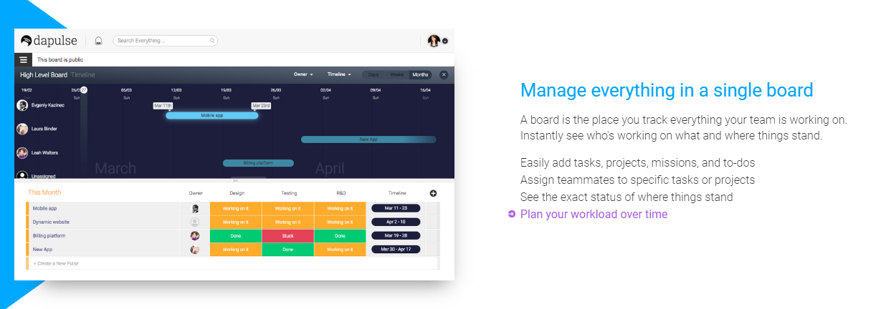

Slide 9
· Product Introduction
· About This Software
Asana is a project management tool that makes teams up to 50% more efficient. Asana goes beyond typical PM software by enabling teams to track everything they're working on. With tasks, projects, conversations, and Kanban boards, Asana lets your entire team know who's doing what by when to help you get results. You can use Asana for meetings, launches, campaigns and easily add integrations for GANTT charts, time tracking and more. Asana is always free for teams of up to 15.

Slide 10
· Product Details
· Product Details
Starting Price | $8.33/month/user
Pricing Details | Free for teams up to 15 members.
Free Trial | Yes , get a free trial
Deployment | Cloud, SaaS, Web Installed - Mac Installed - Windows Mobile - Android Native Mobile - iOS Native
Training | Documentation Webinars Live Online
Support | Online Business Hours

Slide 11
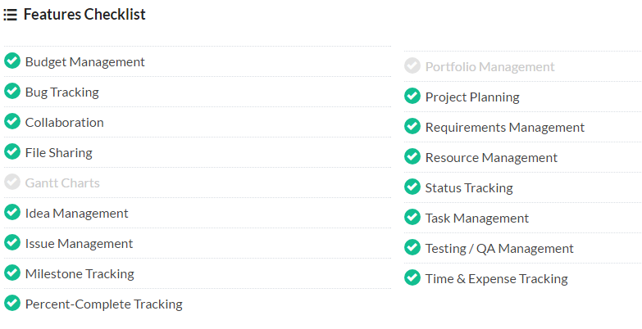

Slide 12
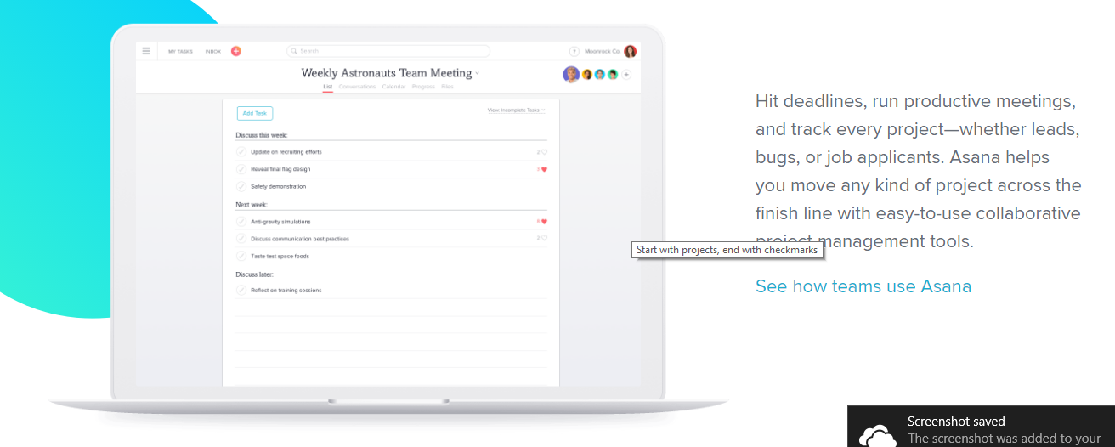

Slide 13
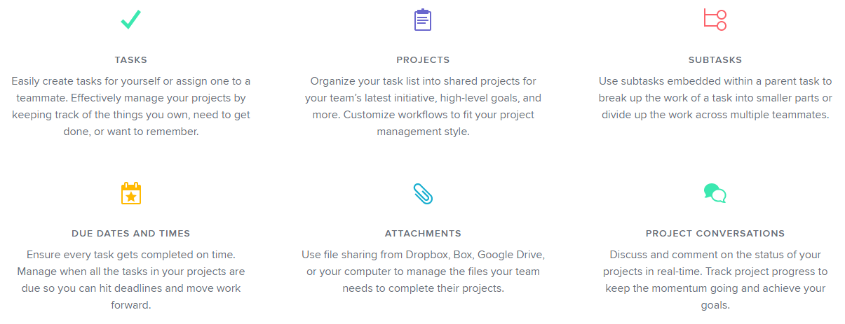

Slide 14
· Products Comparison
Starting Price | $5.00/month/user
Pricing Details | Simple, fair pricing that scales with your workforce. Save up to 32%!
Free Trial | Yes , get a free trial
Deployment | Cloud, SaaS, Web Installed - Mac Installed - Windows Mobile - Android Native Mobile - iOS Native
Training | Documentation Webinars Live Online
Support | Online 24/7 (Live Rep)
Starting Price | $8.33/month/user
Pricing Details | Free for teams up to 15 members.
Free Trial | Yes , get a free trial
Deployment | Cloud, SaaS, Web Installed - Mac Installed - Windows Mobile - Android Native Mobile - iOS Native
Training | Documentation Webinars Live Online
Support | Online Business Hours

Slide 15
· Products Comparison

Slide 16

Therefore, My Choice is...

Slide 17

ASANA!
I'm free up to 15 users!
The reason I choose this :
The Cheaper, The Better since our project is just a practise. It's even free!
And it has almost all technical features required in project management.
That's the best advantage for getting classmates' consent, I think.

