Slide 1
djbox
Kotecki, Neussl, Rieder

Slide 2
Basic idea
Enable interaction with music in realtime
  Fun
  Intuitive (for everyone)
Use as
  Party gadget (guests can influence the sound)
  Controller for live dj set (djbox in the audience)
  Musical intsrument/creative outlet

Slide 3
Setup
Sensors
  Supersonic (distance measurement)
  …
Raspberry Pi 3B
  Python:
    read and preprocess data
    Send to Pd via OSC
  Pd:
    Apply effects to audio (filters, amplification, pitch, ...)

Slide 4
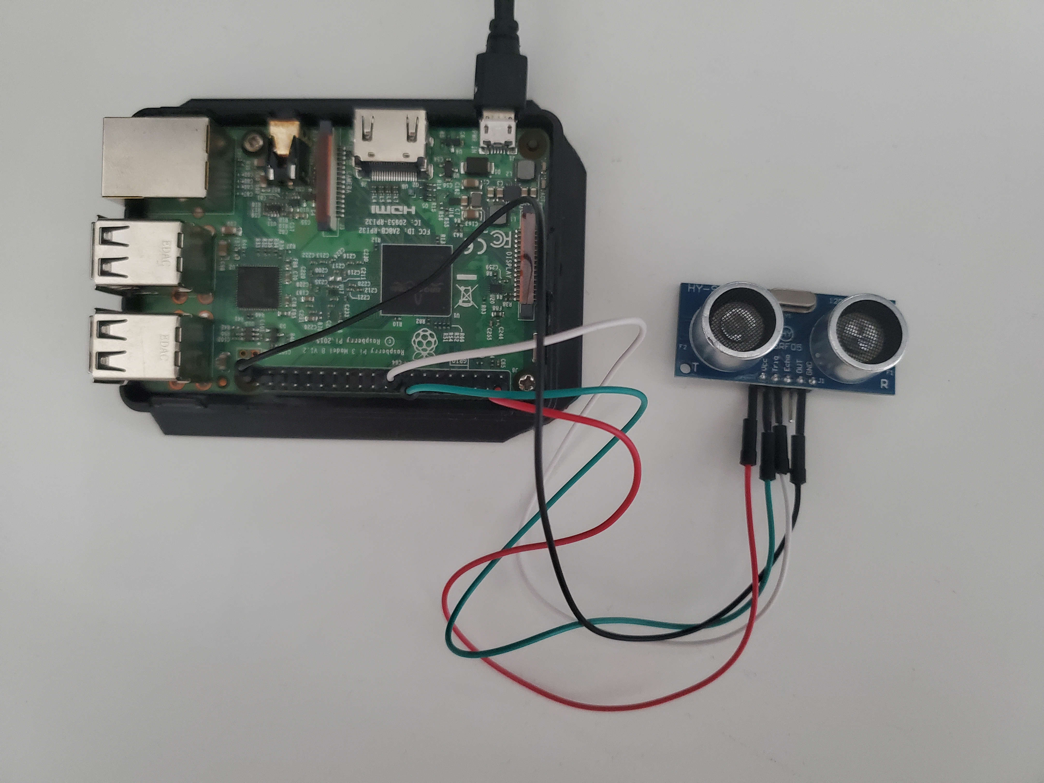
Physical (test) setup so far
Raspberry Pi 3B
1 supersonic sensor

Slide 5
Software setup 1 (Python)
Python
  Read distance data from supersonic sensor
  Smoothing: 1Hz LP for error conciliation
  Send data via OSC to localhost

Slide 6
Software setup 2 (Pd)
Load audio track
Receive OSC data and control
  Low pass filter corner frequency
  Pitch of oscillator
  Reverb parameters (freeverb)
  Amplitude (audio track or noise)
Play back to audio output

Slide 7
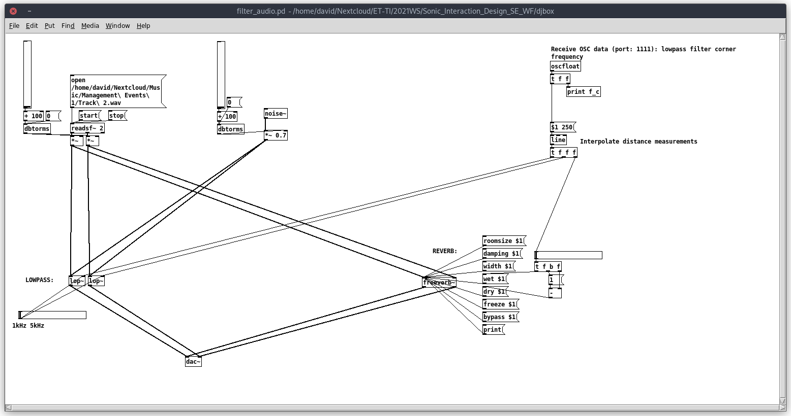
Software setup 2 (Pd)

