Slide 1
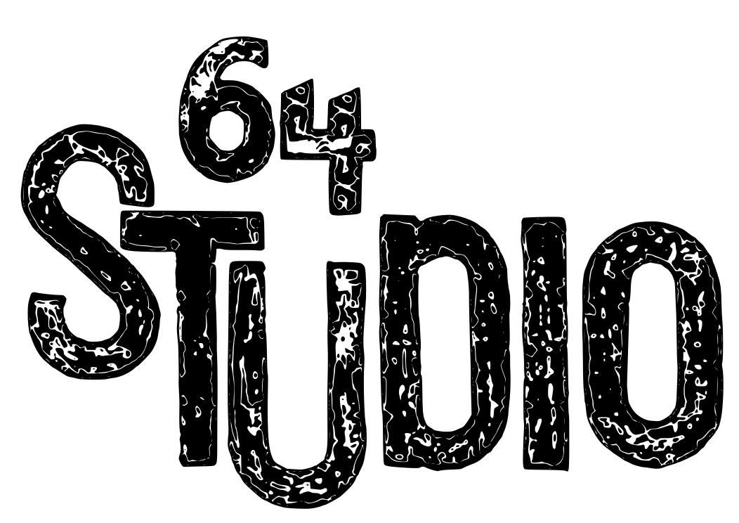
Creating real-time audio appliances with Debian GNU/Linux
© Copyright 2018, 64 Studio Ltd.
Creative Commons BY-SA 3.0 license.
Latest update: May 30, 2018.
Document sources, notes and forum:
http://github.com/64studio/lac-2018
Please open Github issues for feedback!
Christopher Obbard Daniel James
Chief Engineer Director
chris@64studio.com daniel@64studio.com
64 Studio Ltd
63 School Green Road
Freshwater, Isle of Wight
Great Britain
PO40 9AT

Slide 2
Who we are!
Daniel James started 64 Studio Ltd in 2005
64 Studio GNU/Linux distribution released in 2006
Chris Obbard met Daniel James in 2008, work experience while at College
Lots of client work on custom GNU/Linux distributions
Lots of work on in-house software tools
How to create real-time audio appliances with Debian GNU/Linux
https://github.com/64studio/lac-2018

Slide 3
What do we do?
Mainly create custom Linux Distributions for multimedia products
Usually Amd64 PC, Arm dev-board or custom board
Embedded Linux development: custom board drivers, board support
Board bring-up & hardware design: sound-cards, audio amplifiers
Maintain minimal Linux base distros
Future IoT prototypes: WiFi, Bluetooth etc
Our own products: Pideck, Plegger
How to create real-time audio appliances with Debian GNU/Linux
https://github.com/64studio/lac-2018

Slide 4
Why create your own distro?
ARM boards are supplied with general-purpose distro to evaluate system
… but they contain a lot of useless software & bloat!
We supply minimal base distros ready to base your distro on…
Support for Rasberry Pi 3B/3B+, Compute Modules, Zero etc
Support for BeageBone (thanks HörTech gGmbH!)
Future support for Allwinner (Orange Pi, Banana Pi etc. linux-sunxi)
Concentrate on the important part… Your product!
How to create real-time audio appliances with Debian GNU/Linux
https://github.com/64studio/lac-2018

Slide 5
What is a Linux Distribution?
Basically a collection of software packages
But also a collection of like-minded developers
Each distribution has different common goals
Some goals may be related to monetary gains
Debian/Ubuntu uses dpkg/apt
Red Hat/Fedora uses rpm/yum
How to create real-time audio appliances with Debian GNU/Linux
https://github.com/64studio/lac-2018

Slide 6
Yocto & Buildroot
Tools to creates totally custom Linux Distributions for embedded boards
Fancy menuconfig interface
All packages are re-compiled on your machine each time changes are made
Industry-standard software
Lots of supported boards
No simple update facility, flash memory has to be over-written
Can generate some very nice minimal images!
Not suitable for our needs, though...
How to create real-time audio appliances with Debian GNU/Linux
https://github.com/64studio/lac-2018

Slide 7
But we needed middle-ground
Most ARM boards now have a lot of CPU & very small audio latency, so we don’t need a teeny-tiny system
Start from a known-base and add packages (disto in ~0.5hr)
Clients & we were already used to Debian/Ubuntu
Package manager, extra software & easy updates
Ease of getting started
We can trade off some bogomips for this...
How to create real-time audio appliances with Debian GNU/Linux
https://github.com/64studio/lac-2018

Slide 8
Debian Advantages
Widely used by individuals and companies (DistroWatch 3rd)
Stability is maintained by passionate users
Remarkable package QA & mailing list support
Over 51,000 different pieces of multi-arch free software
No one company leading the development & very-free
Apt-get update || apt-get install firefox
How to create real-time audio appliances with Debian GNU/Linux
https://github.com/64studio/lac-2018

Slide 9
Debian Disadvantages
Only caters for systemd with libc
Designed with desktop/server use in mind, not embedded
Conservative of very new versions of packages & technologies
Limited Paid Security support
Slow release cycle (not always bad!)
How to create real-time audio appliances with Debian GNU/Linux
https://github.com/64studio/lac-2018

Slide 10
Platform Development Kit (PDK)
Software created by Progeny Linux Systems in 2005
Distributions are built up of modular “components”
Pull ready-tested components from us
Packages may come from multiple sources
Integrated GIT Version Control
Originally created APT repos & ISO images
Now also creates fully-custom images for ARM boards!
How to create real-time audio appliances with Debian GNU/Linux
https://github.com/64studio/lac-2018

Slide 11
Installation
We recommend you install PDK on a Debian Stretch VM
We use DigitalOcean 2 vCPU, 4GB RAM ($40/mo)
Follow instructions:-
  https://github.com/64studio/lac-2018/
How to create real-time audio appliances with Debian GNU/Linux
https://github.com/64studio/lac-2018

Slide 12
Workshop: Pideck
Follow instructions:-
  https://github.com/64studio/lac-2018/
How to create real-time audio appliances with Debian GNU/Linux
https://github.com/64studio/lac-2018

Slide 13
Questions!
© Copyright 2018, 64 Studio Ltd.
Creative Commons BY-SA 3.0 license.
Latest update: May 30, 2018.
Document sources, notes and forum:
http://github.com/64studio/lac-2018
Please open Github issues for feedback!
Christopher Obbard Daniel James
Chief Engineer Director
chris@64studio.com daniel@64studio.com
64 Studio Ltd
63 School Green Road
Freshwater, Isle of Wight
Great Britain
PO40 9AT
How to create real-time audio appliances with Debian GNU/Linux
https://github.com/64studio/lac-2018

Slide 14
Page title
My important point #1
My important point #2
My important point #3
My important point #4
My important point #5
My important point #6
How to create real-time audio appliances with Debian GNU/Linux
https://github.com/64studio/lac-2018

