Slide 1
Tiny Robot
A guide for whoever picks this up next
A two-wheel robot that follows a black line, stops at a QR code and takes orders from a phone. Everything from an empty laptop to a run on the course.
STM32 Blue Pill · ESP32 · ESP32-CAM · Python
Notes:
This deck is for handing the robot over. It runs from installing the toolchain, through wiring and flashing, to a first drive, and finishes with the faults we actually hit and what each turned out to be.
Keep the robot on the bench while presenting, so each part can be pointed at.

Slide 2
What the robot can do
Follows a line
Takes orders
Sees
Five sensors under a PD controller, bend-tolerant, and it brakes itself at the finish
Forward, back, turn and stop from any phone browser, with a speed slider
The ESP32-CAM streams into the web page and feeds the QR reader on the PC
Reads five codes
Reacts
Logs itself
DOG CAT BIRD LION TIGER, decoded on the PC and sent back
A valid code stops it for five seconds and paints that animal on the OLED
Speed and steering written to a CSV every second, ready to open in Excel
It needs nobody else’s Wi-Fi
The ESP32 on the robot runs its own access point, My_Robot2, and the phone and PC join that directly.
It demonstrates anywhere, without asking for a site password and without a slow network to blame.
Notes:
Make the point that the system is built in layers and does not need all of itself to work.
The STM32 alone follows the line. The ESP32 adds the remote and the screen. The camera and the PC add QR stopping. Lose any one of them and the rest carries on.

Slide 3
The four parts
1
2
3
4
STM32 Blue Pill
ESP32
ESP32-CAM
The PC
The brain. Drives the motors, reads the sensors, follows the line
Runs the Wi-Fi access point, the web remote and the OLED
The eye. Streams to the PC and calls the stop when a code is found
Decodes the QR codes and writes the run to a CSV on the desktop
stm32_robot_controller
esp32_remote_controller
esp32_camera_server
qr_scanner.py
You can start with less than all of it
The STM32 on its own already follows the line. Add the ESP32 for the remote and the screen, and bring in the camera and the PC when you get to QR stopping.
Notes:
The folder under each card is the one to open for that board. Learn those four pairings: uploading the wrong sketch to the wrong board costs an afternoon of confusion.

Slide 4
Who talks to whom
Path 1 · Driving it by hand
Phone
WebSocket 81
ESP32 remote
Serial2 115200
STM32
opens 192.168.4.1
Wi-Fi AP + OLED
motors + sensors
Path 2 · Reading a code and stopping
The PC
UDP 1234
ESP32-CAM
Serial 9600 'S'
STM32
qr_scanner.py
camera + bridge
stops for 5 seconds
Two more lines this picture leaves out
The camera pings the remote every 2 seconds so the remote learns its IP and can link to the stream, and the STM32 sends its state back every 200 ms for the PC to collect into the spreadsheet.
Notes:
Everything runs on My_Robot2, the network the ESP32 remote creates. No home router is involved.
The remote is always the gateway, so it is always 192.168.4.1. The camera gets whatever address is free from .2 upward, which is why the Python script hunts for it on every start.

Slide 5
Install and wire
01
Software on the laptop, wires on the robot, firmware on all three boards

Slide 6
Software on the laptop first
1
2
3
Arduino IDE and cores
Libraries for the ESP32
On the PC side
Add the STM32 Board Manager URL under File > Preferences, then install STM32 MCU based boards and the ESP32 package.
WebSockets by Markus Sattler
Adafruit GFX Library
Adafruit SH110X ← this robot’s screen
Adafruit SSD1306 only for a 0.96 inch panel
Install Python, then these four libraries from a command prompt.
You should create environment for install library it will secure for your code
github.com/stm32duino/
BoardManagerFiles
py -m pip install
opencv-python numpy
pyzbar requests
Two different controllers hide behind identical-looking OLED modules
This robot has the SH1106. Drive it with the SSD1306 library and the whole frame lands in the top strip of the panel, with power-on noise below it.
Notes:
The full Board Manager URL is in README.md under Getting started. Copy it from there rather than typing it.
If the python command is not recognised on Windows, use py instead. That is normal, not a broken install.

Slide 7
Wiring the STM32
Function | Pin
Left motor AIN1 / AIN2 | PA0 / PA1
Right motor BIN1 / BIN2 | PB0 / PB1
Line sensors L2 L1 C R1 R2 | PB9 PB8 PB7 PB6 PB5
Serial2 from the ESP32 remote | PA2 TX / PA3 RX
Serial3 from the ESP32-CAM | PB10 TX / PB11 RX
Cross the data lines
One side’s TX always goes to the other side’s RX, and the grounds must be joined or the signal has no reference.
Sensors run left to right
The physical pins behind Serial2 and Serial3 depend on the board and the core, so check them before cutting wire.
L2 is leftmost, R2 rightmost. Reverse the order and the robot steers away from the line instead of onto it.
Do not swap the motor pin pairs in setSpeed()
It reverses both motors: forward becomes backward, left becomes right, and line following drives the robot off the course.
Notes:
The pin names for Serial2 and Serial3 come from the variant, not from the chip, so a different core or board part number can move them. Verify before wiring, every time.

Slide 8
Wiring the ESP32 and the camera
Function | Pin
OLED SDA | GPIO21
OLED SCL | GPIO22
To STM32 Serial2 RX (PA3) | GPIO17 TX
From STM32 Serial2 TX (PA2) | GPIO16 RX
CAM to STM32 Serial3 RX (PB11) | GPIO14 TX
The OLED sits at 0x3C
A 128x64 I2C module. Change OLED_ADDR in the sketch if yours answers at 0x3D instead.
A missing screen is survivable
The camera reaches the STM32 on Serial3, a different port from the remote, so both can command the robot at once.
If the display is not found the sketch skips every draw and everything else keeps running.
Solder the four screen wires rather than pushing them on
A loose contact cuts a frame mid-transfer and the panel stays dark while the code runs perfectly. It is the hardest fault here to track down.
Notes:
The loose-wire version of this cost us a full day of looking in the wrong place. Tell whoever takes over to solder those four from the start.

Slide 9
Setting up ST-Link for the STM32
1
Install STM32CubeProgrammer
ST-Link | Blue Pill
SWDIO | DIO (PA13)
SWCLK | DCLK (PA14)
GND | GND
3.3V | 3V3 only if unpowered
A free download from ST, account required. Keep the default path, and it brings the ST-Link driver with it.
2
Connect four wires
As in the table. Match them by the names printed on the dongle, never by pin number: the clones do not agree on a layout.
PA13 and PA14 are not on the side headers
3
Set it in the IDE
Follow the numbering and it jumps from A12 to A15. Both are on the 4-pin header at the far end from the USB socket, labelled DIO and DCLK.
Upload method becomes STM32CubeProgrammer (SWD), and Port stays empty. Every other setting is on the next slide.
What switching to ST-Link buys you
BOOT0 never moves again, and no COM port is tied up, because the upload does not travel over one.
Notes:
Those two are exactly what made the old route fail: a BOOT0 left in the wrong position, and a Serial Monitor holding the port.
The dongle can stay plugged in permanently, since nothing in this firmware uses PA13 or PA14.

Slide 10

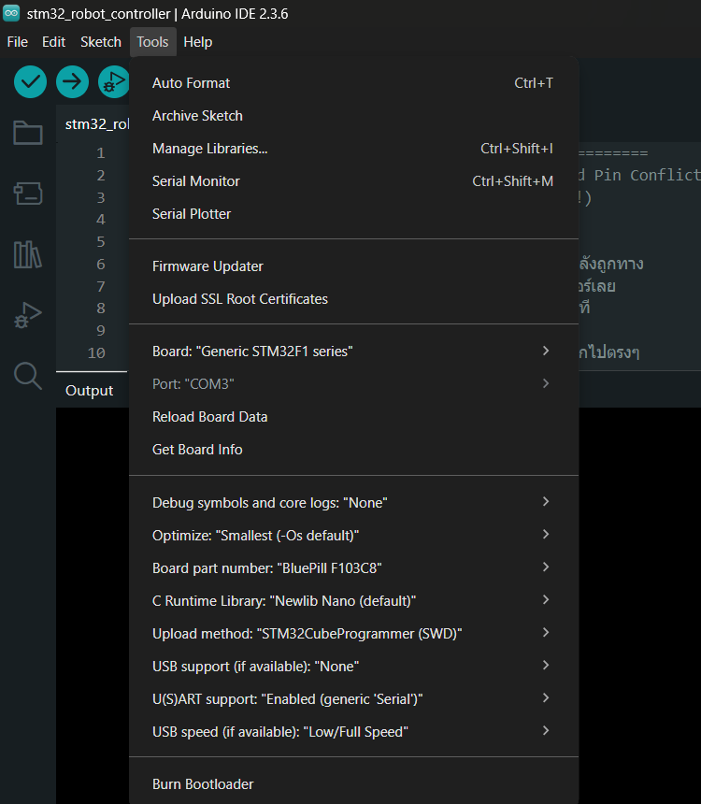
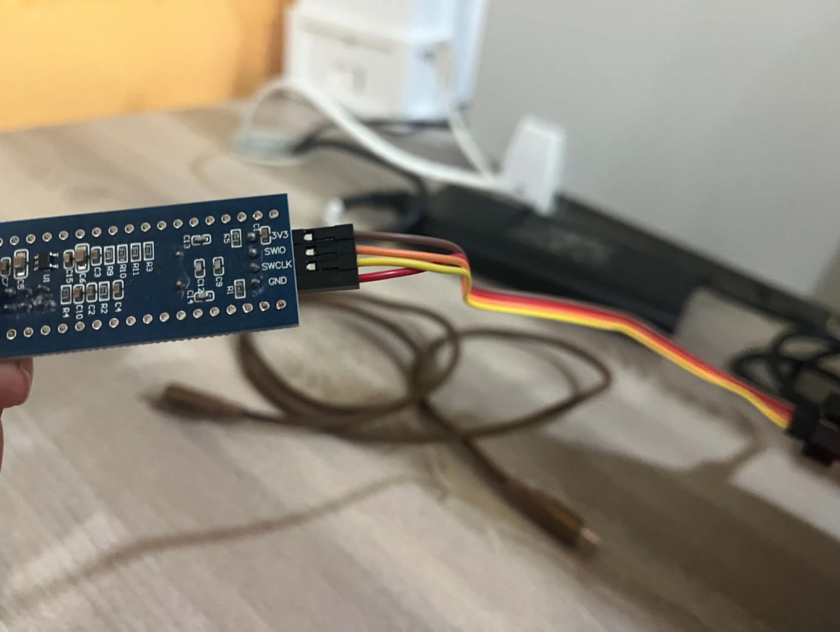
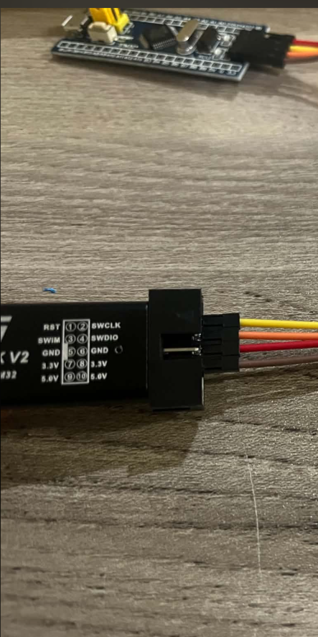
Configuration and wire
3v3
DIO
CLK
GND

Slide 11
Every Tools setting for the STM32
Tools menu | Set to | What a wrong value looks like
Board | Generic STM32F1 series | No Upload method entry in the menu at all
Board part number | BluePill F103C8
Upload method | STM32CubeProgrammer (SWD) | Upload fails, it is calling another route
U(S)ART support | Enabled (generic 'Serial') | No Serial at all, and the log goes with it
USB support | None | Serial moves to the USB socket, so the PA9 log falls silent with no error
Optimize, Debug, C Runtime | Leave every default alone
Port | Leave it empty
The three rows with a note in the last column are the three worth checking twice
The rest still compile and run if you get them wrong.
An empty Port is correct, not a fault: an ST-Link never appears as a COM port in the first place.
Notes:
Board is the one people miss. Open Tools and if there is no Upload method entry anywhere, a board from a different core is selected.
USB support is the cruellest. Set to CDC it moves Serial onto the board USB socket, and the PA9 log goes quiet with nothing printed to explain it, while the code runs perfectly.
BluePill F103C8 is the 64 KB entry and the firmware uses about 25 KB. If it ever outgrows that, BluePill F103CB unlocks the 128 KB the chip really holds.

Slide 12
Flashing each board
1
STM32 over ST-Link
undefined reference to 'Serial2'
Open stm32_robot_controller, pick Generic STM32F1 series and press Upload. No BOOT0, no port to choose.
Not a mistake in the sketch. The official STM32 core does not create Serial2 and Serial3, so the sketch creates them itself in two lines at the top. Do not delete them.
2
ESP32 remote over its own USB
Open esp32_remote_controller and pick ESP32 Dev Module. Adafruit GFX and Adafruit SH110X must be installed or it will not compile.
Knowing the upload took
ST-Link prints Download verified successfully, which it only does after reading the flash back and comparing it to the file.
Otherwise open the Serial Monitor at 115200, reset, and check the compile timestamp against the upload you just made.
3
ESP32-CAM over USB-TTL
This board has no USB socket. Tie IO0 to GND before uploading and release it afterwards. Pick AI Thinker ESP32-CAM.
Notes:
The order does not matter. Changing Tools > Board to match the board in front of you does, every single time.
Forgetting that is the most common mistake here: the sketch gets compiled for the wrong board, and sometimes it even uploads and only goes wrong at run time.
A change to the camera code needs only esp32_camera_server reflashed, not all three.

Slide 13
Flashing without the IDE
1
Export the binary first
Part of the command | What it does
-c port=SWD mode=UR | Connect through ST-Link
-w file 0x08000000 | Write to the start of flash
-v | Read it back and compare
-rst | Reset so it runs straight away
Sketch > Export Compiled Binary. STM32CubeProgrammer cannot compile; it only writes a finished file to the chip.
stm32_robot_controller\build\
STMicroelectronics.stm32.GenF1\
2
Then write it to the chip
The address belongs to .bin only
Leave the ST-Link connected as usual and run the command below.
A .hex carries its own address, so pass it as -w file.hex with no number after it, or the file lands in the wrong place.
STM32_Programmer_CLI.exe -c port=SWD
mode=UR -w firmware.bin 0x08000000
-v -rst
When this is worth it
Putting one build on several boards, or handing a build to someone who should not need the whole toolchain. For one edit and one upload, the IDE button is quicker.
Notes:
This is what the IDE Upload button does behind the scenes; here we just call the steps ourselves.
For buttons instead of typing, open the STM32CubeProgrammer window, choose ST-LINK top right, press Connect, then Erasing and Programming with Verify and Run after programming ticked.

Slide 14
Running it
02
The order to switch things on, what the screen says, and what gets logged

Slide 15
Six steps to a first run
1
Power the robot
2
Join the robot’s Wi-Fi
The welcome screen holds for 2.5 seconds, then the status screen takes over
My_Robot2, password1234. Both the phone and the PC need to be on it
3
Open the web page
4
Raise the speed slider
Browse to 192.168.4.1. The camera image appears once the ESP32-CAM has joined
It starts at 0 every time. Leave it there and the robot will not move, auto or not
5
Start the PC script
6
Place it on the line
py pc_qr_scanner/qr_scanner.py. It finds the camera on the network by itself
Centre sensor over the black, then switch to Auto
The script runs fine without a camera
If it cannot find one it carries on without QR reading, and still logs the whole run to the CSV exactly as before.
Notes:
Step 4 is where newcomers get stuck. The robot sits there and they assume it is broken, when the slider simply has not been raised from zero.
It starts at zero on purpose, so nothing lurches the moment the page loads.

Slide 16
What the screen is telling you
Screen | When | What it means
Welcome | First 2.5 seconds after power | The board booted, and the screen and its wires are fine
Status | Whenever the robot is stopped | Shows the mode, the speed and the camera IP
Eyes glancing | The whole time it is moving | Hunting for a QR code: 600 ms ahead, then 450 ms each side
Found | First second after a code is read | A code got through and the stop is coming
Animal | The rest of the five-second stop | Which animal the code turned out to be
The screen is the best diagnostic tool on the robot
It says how far the board got without a laptop attached. A welcome screen that never changes means the program hung during boot, which is not a Wi-Fi problem.
Notes:
Every screen except Status is a full 128x64 bitmap with its lettering drawn into the artwork, so the firmware only blits an image.
To change one, edit the PNG in assets/oled and run py tools/png_to_bitmaps.py.

Slide 17
The web remote
Direction buttons
Speed slider
Trim slider
Forward, back, left, right and stop. Manual mode only
Starts at 0. What you set is what the motors get, with nothing rounded up
Corrects a robot that pulls to one side, live, while it drives. No reflash
Auto / Manual switch
Camera image
No numbers here
Auto follows the line, Manual takes the buttons. Switch any time
Appears once the camera joins, and disappears if it goes quiet
Deliberate. This page is for driving; every figure goes to the spreadsheet
The page hangs even though the Wi-Fi is connected
Some phones notice the network has no internet and quietly switch back to mobile data. Turn that automatic switching off first.
Notes:
If the page will not open at all, check the phone is really on My_Robot2 rather than assuming it.

Slide 18
What lands in the spreadsheet
Column | Holds
Timestamp Event | The time, and the kind of row: START, RUN each second, or QR
Mode Action | The mode, and what it was doing: STRAIGHT, BEND, SEARCH, FINISH
Base_Speed | What the slider is asking for
Left_PWM Right_PWM | What the motors were actually handed, after trim
Turn Error | The steering output, and how far off the line it was
Kp Kd Trim | The gains in force, so an old file explains its own tuning
S_L2 to S_R2 | The five sensors one per column; 1 means that one is over black
Where the file goes
robot_mission_log.csv on the desktop. The script asks Windows where that really is, so OneDrive does not hide it.
Close Excel before a run
Windows locks an open file outright. If it cannot write, the script falls back to a new name with the time appended.
One row a second, plus one per QR hit. Plot Turn against time in Excel and you can see exactly where on the course the robot fights hardest.
Notes:
The sensors get a column each because a single 00100 field is read as a number by Excel, which drops the leading zeros and leaves 100.
Kp and Kd are constants and logged anyway, so last week file says what tuning produced it instead of relying on anyone memory.

Slide 19
Tuning and faults
03
The constants worth touching, how it hunts for a lost line, and what keeps going wrong

Slide 20
The constants worth touching
Name | Now | When to change it
Kp | 45 | Raise it if the robot cuts corners wide, lower it if it weaves on the straights
Kd | 35 | Damping. Raise it when the robot oscillates coming out of a bend
leftMotorOffset | 25 | Corrects a pull to one side. The Trim slider sets this live from the web page
MIN_PWM | 0 | What you ask for is what the motors get. Set 135 to have low values pushed up instead
LOST_CONFIRM_MS | 150 | How long the line may be missing before it reacts. Raise it if it lurches on tight bends
FINISH_CONFIRM_MS | 40 | How long all five black must hold to count as the finish, and not a crossing
Too much Kp makes the robot spin instead of turn
Error peaks at 4, so Kp of 80 asks for 320 against the 255 the motors have. The outer wheel saturates, the inner one reverses, and every bend becomes a pivot.
Notes:
Change one at a time and drive it after each. Change two and you cannot tell which helped.
Kp and Kd are written into every CSV row, so an old file tells you the tuning it was recorded with.

Slide 21
How it hunts for a lost line
No sensor on the line does not mean lost. A tight bend swings the line past the end of the sensor row for a moment, and that is normal.
1
2
3
Wait 150 ms
Reverse 400 ms
Sweep up to 6 s
Decide nothing. Keep turning the way it already was, which is the direction that chases the line. Most bends are over before this timer is
Back up, angled toward the side the line was last seen. Covers taking a bend too fast
Pivot on the spot at 55% speed, alternating sides, each leg wider than the last. Only then does it give up
All white and all black are opposite answers, not similar ones
Nothing on the line means the line is off the row and the robot must move itself until a sensor finds it again. The reading that stops it is the exact opposite: all five over black, which is the finish bar.
Notes:
The sweep is deliberately slower than ordinary steering. Spin fast and the line crosses under the sensor row quicker than the row can register it, so the robot overshoots a line it has already passed.
The direction of the first leg is chosen once when the search begins and never recomputed, or it would keep sweeping the same way and walk further from the line each time.

Slide 22
Faults we actually hit
Symptom | What it turned out to be | Fix
Screen dark on a restart | The panel still holding the I2C line | Firmware frees it at boot. If not, unplug power for 10 s
STM32 will not take an upload | Wrong core selected, or no CubeProgrammer | Generic STM32F1 series, Upload method SWD
undefined reference to 'Serial2' | The core does not create Serial2 or Serial3 | The sketch creates them at the top. Keep those lines
Web page will not open | Not actually joined to My_Robot2 | Join it, then stop the phone switching to mobile data
Robot always pulls one way | One motor stronger than the other | Move the Trim slider while it drives. No reflash
Robot stops mid-course | Sensor polarity inverted: read as a finish bar | The black row in Serial must read 0 0 1 0 0 on the line
CSV never updates | The file is open in Excel | Close it and run the script again
Stripes across the camera image | Pixel clock too fast for the board | Already halved in the firmware. Reflash the camera
Slider raised but nothing moves | Still at 0, or below what the wheels need | Go above 135. Below that the motors buzz but do not turn
QR never decodes | Blurred, or the code is too far away | Move closer, and light the code instead of shading it
Notes:
This is the page people will come back to. Tell them to photograph it.
Every row happened to us. None of them are hypothetical, and most were not what anyone suspected first.

Slide 23
Before a real run
Battery charged, and motor power separate from the boards
All four screen wires soldered, not just pushed on
Data lines crossed correctly, grounds joined
Compile timestamp in the Serial Monitor matches the upload
On the line, the sensors read 0 0 1 0 0
Phone and PC both joined to My_Robot2
The CSV closed in Excel before starting the script
Manual mode drives forward and back before switching to Auto
Top to bottom, every time
Eight checks take under two minutes and rule out almost everything that otherwise costs a whole day.
Notes:
Worth printing and taping up beside the test course.

Slide 24
Go and build it
Where to read further
Everything in this deck is written out in full in the project README, together with the reasoning behind every constant.
README.md
tests/
assets/oled/
The full guide: every constant and why it is what it is
Sketches that isolate the screen and the I2C bus from the wiring
Source artwork for every screen; edit and regenerate
Notes:
Finish by opening README.md on screen once, so they know where to go when something breaks.

