Slide 1

IshLu SatsSaver
400M+
$53B
Your Wealth
is Rooted.
Unbanked
Africans
Annual
Remittances
0
42x
Bitcoin
Credit Scores
LTV:CAC
Yr 1
Bitcoin micro-savings + credit scoring
for 400M+ unbanked Africans.
₿ Bitcoin-Backed
KES M-Pesa Native
🌍 Africa-First
DadaHub Residency · Demo Day 2026

Slide 2


MINUTE 1 · THE PROBLEM
Meet Aisha
Delivery rider, Nairobi · KES 8,000 saved
-7%
"Her money shrinks while she sleeps.
Her bike breaks down.
She needs KES 15,000 fast.
The bank wants 3 months of payslips.
The loan app charges 30%.
She sells her phone to survive.
That is the liquidity trap.
400 million Africans live in it."
Kenya Inflation Rate
Savings accounts lose value every year. Silently.
30%+
Predatory Loan Rates
No credit score = no fair loans. One emergency = debt trap.
IshLu is how Aisha escapes it.

Slide 3
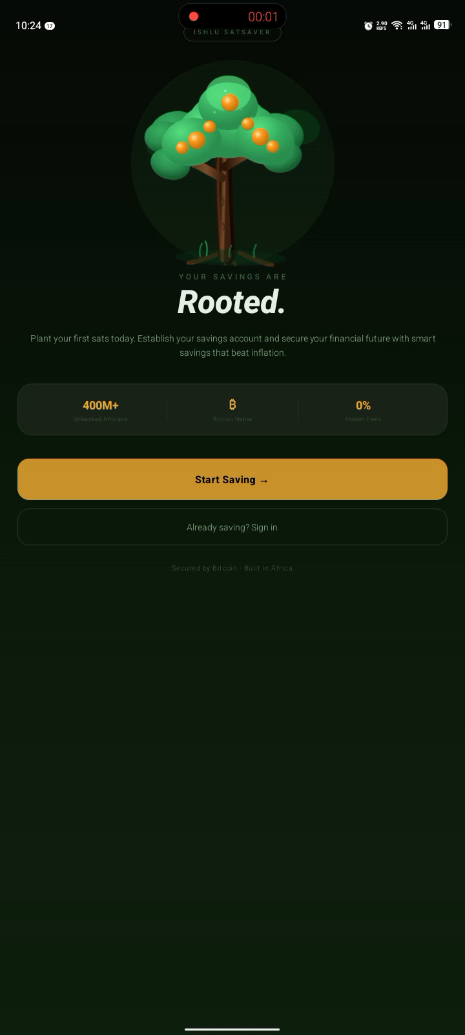
MINUTE 2 · LIVE DEMO
1
Open app
Dashboard with Sats Tree
2
Tap Save → M-Pesa
Select KES 100
3
Phone vibrates
M-Pesa STK Push arrives
4
Enter PIN
Tap Confirm
5
Sats credited
Tree grows. Balance updates.
KES 100 → 750 sats. Bitcoin. Forever.

Slide 4



MINUTE 3 · THE TECH
Three layers make this special.
01
The fastest payment rail on earth. Sats settle in seconds. Non-custodial per-user wallets.
Lightning Network
Breez SDK · LNbits · M-Pesa Daraja STK Push
02
Proprietary 5-factor algorithm. 300–850 scale. Like FICO — but Bitcoin-native. No bank needed. No payslips. Just behavior.
Trust Score
35% Consistency · 25% Goals · 15% Tenure · 15% Velocity · 10% Repayment
03
Explains your score in plain English and Swahili. Personalized nudges. Offline fallback.
Akili AI Coach
Claude (Anthropic) · English + Swahili · Offline fallback mode

Slide 5
THE MOAT · TRUST SCORE ALGORITHM
35%
Savings Consistency
Weekly saving frequency over 8 weeks
842
25%
Goal Completion
Goals hit on time vs. withdrawn early
15%
Account Tenure
PLATINUM
Days on platform (log curve)
Max loan: 500,000 sats
15%
Savings Velocity
Month-over-month sats growth
10%
Loan Repayment
On-time repayment rate
🌱
🥉
🥈
🥇
💎
Score persists on-chain forever. Every user's history is a data flywheel competitors can't replicate.
Seed
300+
Bronze
450+
Silver
600+
Gold
750+
Platinum
850+

Slide 6



MINUTE 4 · REAL USER FEEDBACK
We tested with real users in Nairobi.
3 sec
Instant
🌳
M-Pesa prompt arrives
KES → sats conversion
Sats Tree engagement
"It came before I even put my phone down."
"I understood it immediately. 100 shillings = 750 sats."
"I didn't want to break my streak. That's the point."
Demo Day Metrics
10+
5+
20+
3+
450+
Users signed up
Deposits made
Trust Score calcs
Lightning settled
Avg Trust Score

Slide 7
MARKET OPPORTUNITY
A $50B+ market hiding in plain sight.
400M+
$53B
67%
0
Unbanked
Africans
Annual
Remittances
Mobile Money
Penetration
Bitcoin
Credit Scores
Total addressable market
Africa cross-border 2024
Sub-Saharan Africa
No competitor exists
TAM
$50B+
SAM
$8B
SOM
$120M
All unbanked Africans with mobile money
East & West Africa smartphone users
Kenya + Nigeria — Year 1 target
We don't compete with banks. We solve what banks can't — behavioral discipline + inflation-proof value storage.

Slide 8


BUSINESS MODEL
Multiple streams. All aligned with user success.
NOW
MONTH 6
YEAR 2
YEAR 2
0.5% FX Spread
5% Loan Interest
B2B SaaS API
Premium Tier
Every KES→Sats conversion.
Invisible to user. Scales with volume.
Emergency loans backed
by user's own sats. Fully collateralised.
License Trust Score to
banks, SACCOs, microfinance.
Auto-DCA, chama groups,
higher limits, advanced features.
Year 1 Unit Economics
KES 200
KES 1,200/yr
KES 8,400
42x
CAC
ARPU
LTV
LTV:CAC

Slide 9
MINUTE 5 · TEAM & THE ASK
[Founder Name]
PRE-SEED
$50,000
[Photo]
Founder & CEO
▸ Designed, coded, shipped IshLu — solo
SAFE · $600K cap · 20% discount
▸ DadaHub Residency 2026, Nairobi
MVP to Market — 6-month runway
▸ [Your background — 2–3 words]
40%
$20K
Product & Engineering
▸ [Prior project / community work]
30%
$15K
User Acquisition
20%
$10K
Compliance & Legal
Solo = full ownership, no co-founder risk, proven builder.
Funding builds the team.
10%
$5K
Operations
Advisors / first hires: [Add here]
500 users M3 → KES 2M ARR M9 → Series A ready M18

Slide 10
IshLu SatsSaver
Your Wealth is Rooted.
IshLu SatsSaver is how 400M Africans start
building Bitcoin wealth one shilling at a time.
[lucyk7770@gmail.com] · [+254 740683490] · [twitter:@TheeNerdd /
https://www.linkedin.com/in/lucy-kamau-242675204/]
Build in Public
Ship Real Things
Context Matters
Give Back
🌐 ishlusatssaver-production.up.railway.app · 💻 https://github.com/650DataNerd/IshLu_SatsSaver]

