Slide 1
中期检查

Slide 2
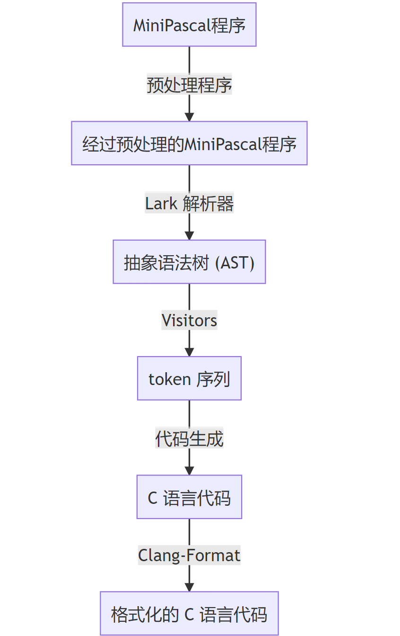
数据流

Slide 3
预处理
program Answer;
{Answer to the Ultimate Question of Life, the Universe, and Everything}
begin
X := 42; {Set X to 42}
writeln(X) {Write X to the screen}
end.
program answer;
begin
x := 42;
writeln(x)
end.

Slide 4
解析
programstruct
program_head
id answer
program_body
const_declarations
empty
var_declarations
empty
subprogram_declarations
empty
compound_statement
statement_list
statement
assign_statement
variable
id x
id_varpart
empty
:=
expression
simple_expression
term
factor
num 42
statement
procedure_call
id writeln
expression_list
expression
simple_expression
term
factor
variable
id x
id_varpart
empty
program answer;
begin
x := 42;
writeln(x)
end.

Slide 5
Visitors
programstruct
program_head
id answer
program_body
const_declarations
empty
var_declarations
empty
subprogram_declarations
empty
compound_statement
statement_list
statement
assign_statement
variable
id x
id_varpart
empty
:=
expression
simple_expression
term
factor
num 42
statement
procedure_call
id writeln
expression_list
expression
simple_expression
term
factor
variable
id x
id_varpart
empty
['int main()',
'{',
'x',
'=',
'42',
';',
';',
'writeln',
'(',
'x',
')',
';',
';',
'}']

Slide 6
代码生成与格式化
['int main()',
'{',
'x',
'=',
'42',
';',
';',
'writeln',
'(',
'x',
')',
';',
';',
'}']
#include mp2c.h
int main() {
x = 42;
;
writeln(x);
;
}

Slide 7
mp2c.h
在 C 语言下复现的 Pascal 下的常用库函数
目前包含
Read
Write
readln
writeln
abs
sqrt
random

Slide 8
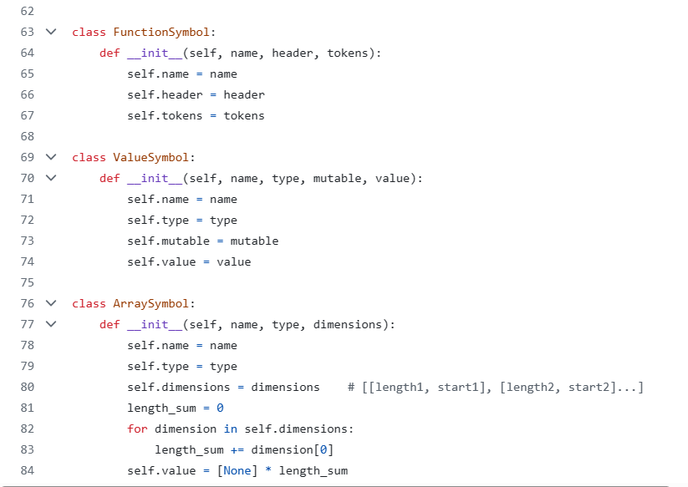
符号的定义：函数符号，内建类型符号，数组符号

Slide 9
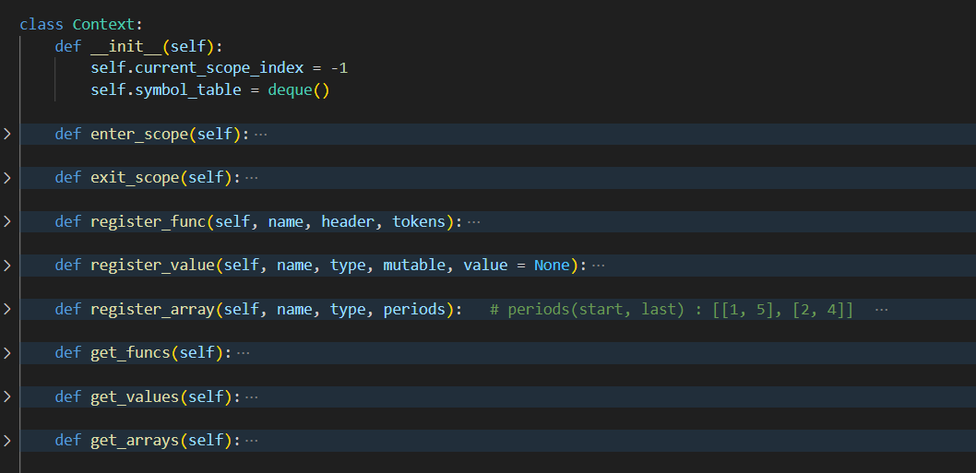
符号表相关操作：进出作用域，插入符号，获取符号

Slide 10
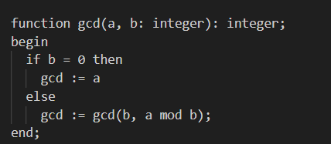
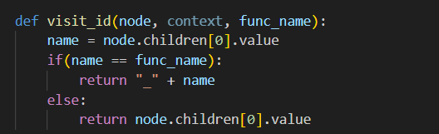
与函数名相同变量的转换：
pascal允许在没有事先定义的情况下使用与函数名相同的变量作为返回值
因此在函数体内遇到与函数名相同的id，且并非函数递归调用时，对id做转换

Slide 11
Todo
完善类型检查
错误处理
错误的具体原因
错误定位
GUI界面

