Slide 1
Title: "A Hybrid Intrusion Detection System" Subtitle: Utilizing Fuzzy Logic and Neural Networks Name: Asit Pramod Bakade PRN: 2041003 Branch: Computer

Slide 2
1) Introduction 2) Overview of Current Intrusion Detection Systems 3) Generic Hybrid Intrusion Identification Strategy 4) The Conceptual Model: NeGPAIM 5) Practical Implementation of NeGPAIM 6) Conclusion 7) References

Slide 3
Introduction
Briefly introduce the importance of intrusion detection in the context of information security.
Mention the shortcomings of current intrusion detection systems.

Slide 4
Overview of Current Intrusion Detection Systems
Define intrusion detection and intrusion detection systems.
Explain the difference between misuse detection and anomaly detection
Highlight the limitations of current commercial intrusion detection systems.

Slide 5
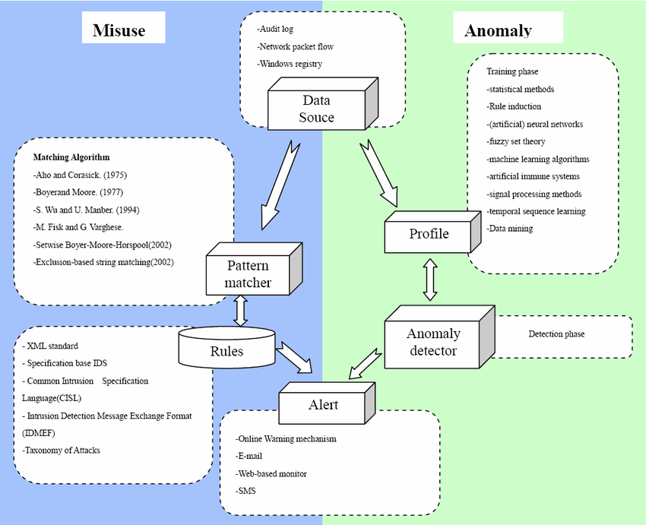

Slide 6
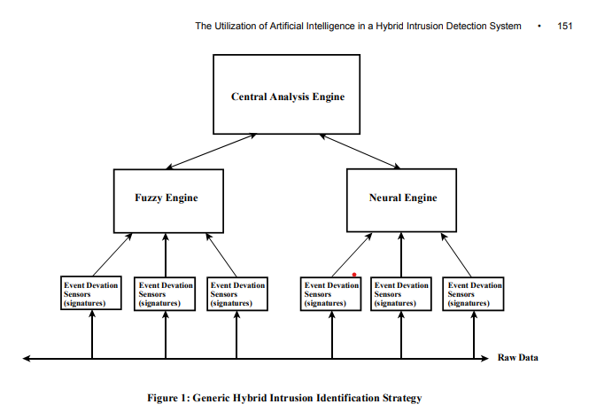
Generic Hybrid Intrusion Identification Strategy
Explain the concept of a hybrid intrusion detection system.
Describe the three key components: central analysis engine, fuzzy engine, and neural engine

Slide 7
Misuse Detection - Fuzzy Engine
Discuss how the fuzzy engine works, focusing on its use of fuzzy logic..
Mention the generic intrusion phases and how they're used for misuse detection.

Slide 8
Anomaly Detection - Neural Engine
Explain the operation of the neural engine for anomaly detection.
Describe the two stages of neural engine processing.

Slide 9
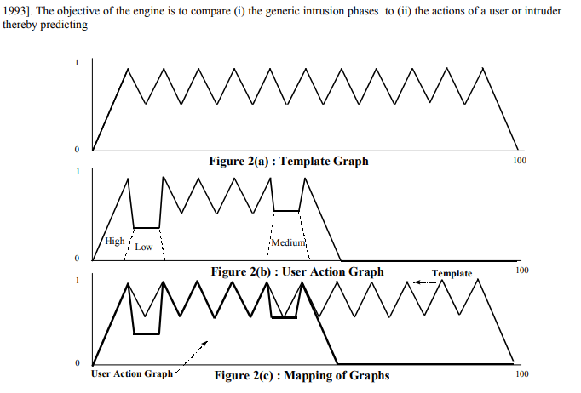
Central Analysis Engine
Present the high-level central analysis engine.
Emphasize its role in combining outputs from fuzzy and neural engines..

Slide 10
Responder and Manager
Briefly explain the internal and external responders.
Introduce the manager components' role in managing the system.

Slide 11
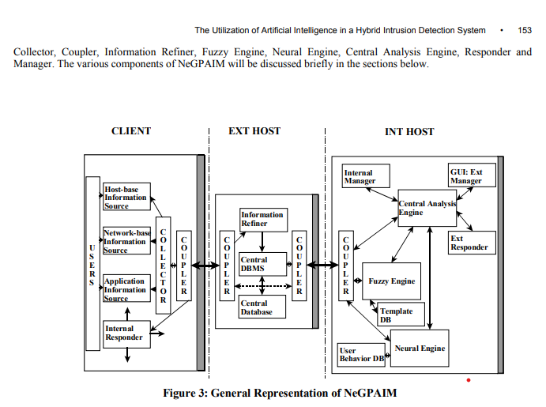
The Conceptual Model: NeGPAIM
Provide an overview of NeGPAIM.
Describe its three-tier architecture.

Slide 12
Practical Implementation of NeGPAIM
Mention the implementation approach and prototype (IFEP).
Share your results from testing IFEP.

Slide 13
Conclusion
Summarize the key points of your study and the proposed model.
Reiterate the advantages of a hybrid intrusion detection system.

Slide 14
References
BACE, R.G. (2000). Intrusion Detection. Macmillan Technical Publishing, Indianapolis, In USA. [ISBN: 1-57870-185-6]. BERKAN, R.C.(1997).
Fuzzy System Design Principles(1st ed.). United States of America : IEEE Press Marketing. BERST, J. (1999).
Hacking 101 : Why Should You Know What They Know [on-line]. Zdnet. Available from Internet : URL http://www.zdnet.com/anchordesk/story/story 3163.html

Slide 15
Thank You 1

