Slide 1

Cisco Packet Tracer
— From Software Basics to Two Network Labs
EE6108 · LAB TEACHING
Notes:
Welcome. This session uses two labs to teach the Packet Tracer workflow: build, configure, verify, and explain.

Slide 2
What the Two Labs Cover
Build, configure, check.
01
Build
Place devices and connect the topology.
Two labs
LAB 01
Same subnet vs. cross-subnet
02
Configure
Set PC addresses, router interfaces, and static routes.
IP / mask / gateway
LAB 02
03
Check
Use ping and show commands to confirm the result.
Static routing with 3 routers
ip route / routing table
Topology files: 1.pkt and 2.pkt
You should finish both topologies and explain each ping result.
2
Notes:
This session covers the two labs: build, configure, and check.

Slide 3
Contents
CONTENTS
01
Get Started
Interface layout and the role of Packet Tracer
02
Build and Configure
Devices, cables, Config/CLI, IP addressing
03
Two Labs
Same-subnet connectivity and three-router static routing
04
Troubleshoot and Summary
Symptoms, checklists, and the L2/L3 picture
3
Notes:
Four sections: software basics, build/configure, the two labs, and troubleshooting.

Slide 4
01
Get Started
Notes:
Section one: understand the workspace before touching a device.

Slide 5
What Is Packet Tracer?
A simulator for the two lab topologies.
✓
Build the topology
Two labs
CLI output
Place devices, connect cables, and configure them without hardware.
LAN addressing in Lab 1; static routing in Lab 2.
Use ping and show results to check the configuration.
No lab hardware
1.pkt and 2.pkt
ping and show
Packet Tracer is Cisco’s simulator. Build each lab, configure it, and check the result with the CLI.
Match the manual: same devices, same cables, same addresses.
5
Notes:
Packet Tracer replaces the hardware. Students still need to match the manual and check the CLI output.

Slide 6
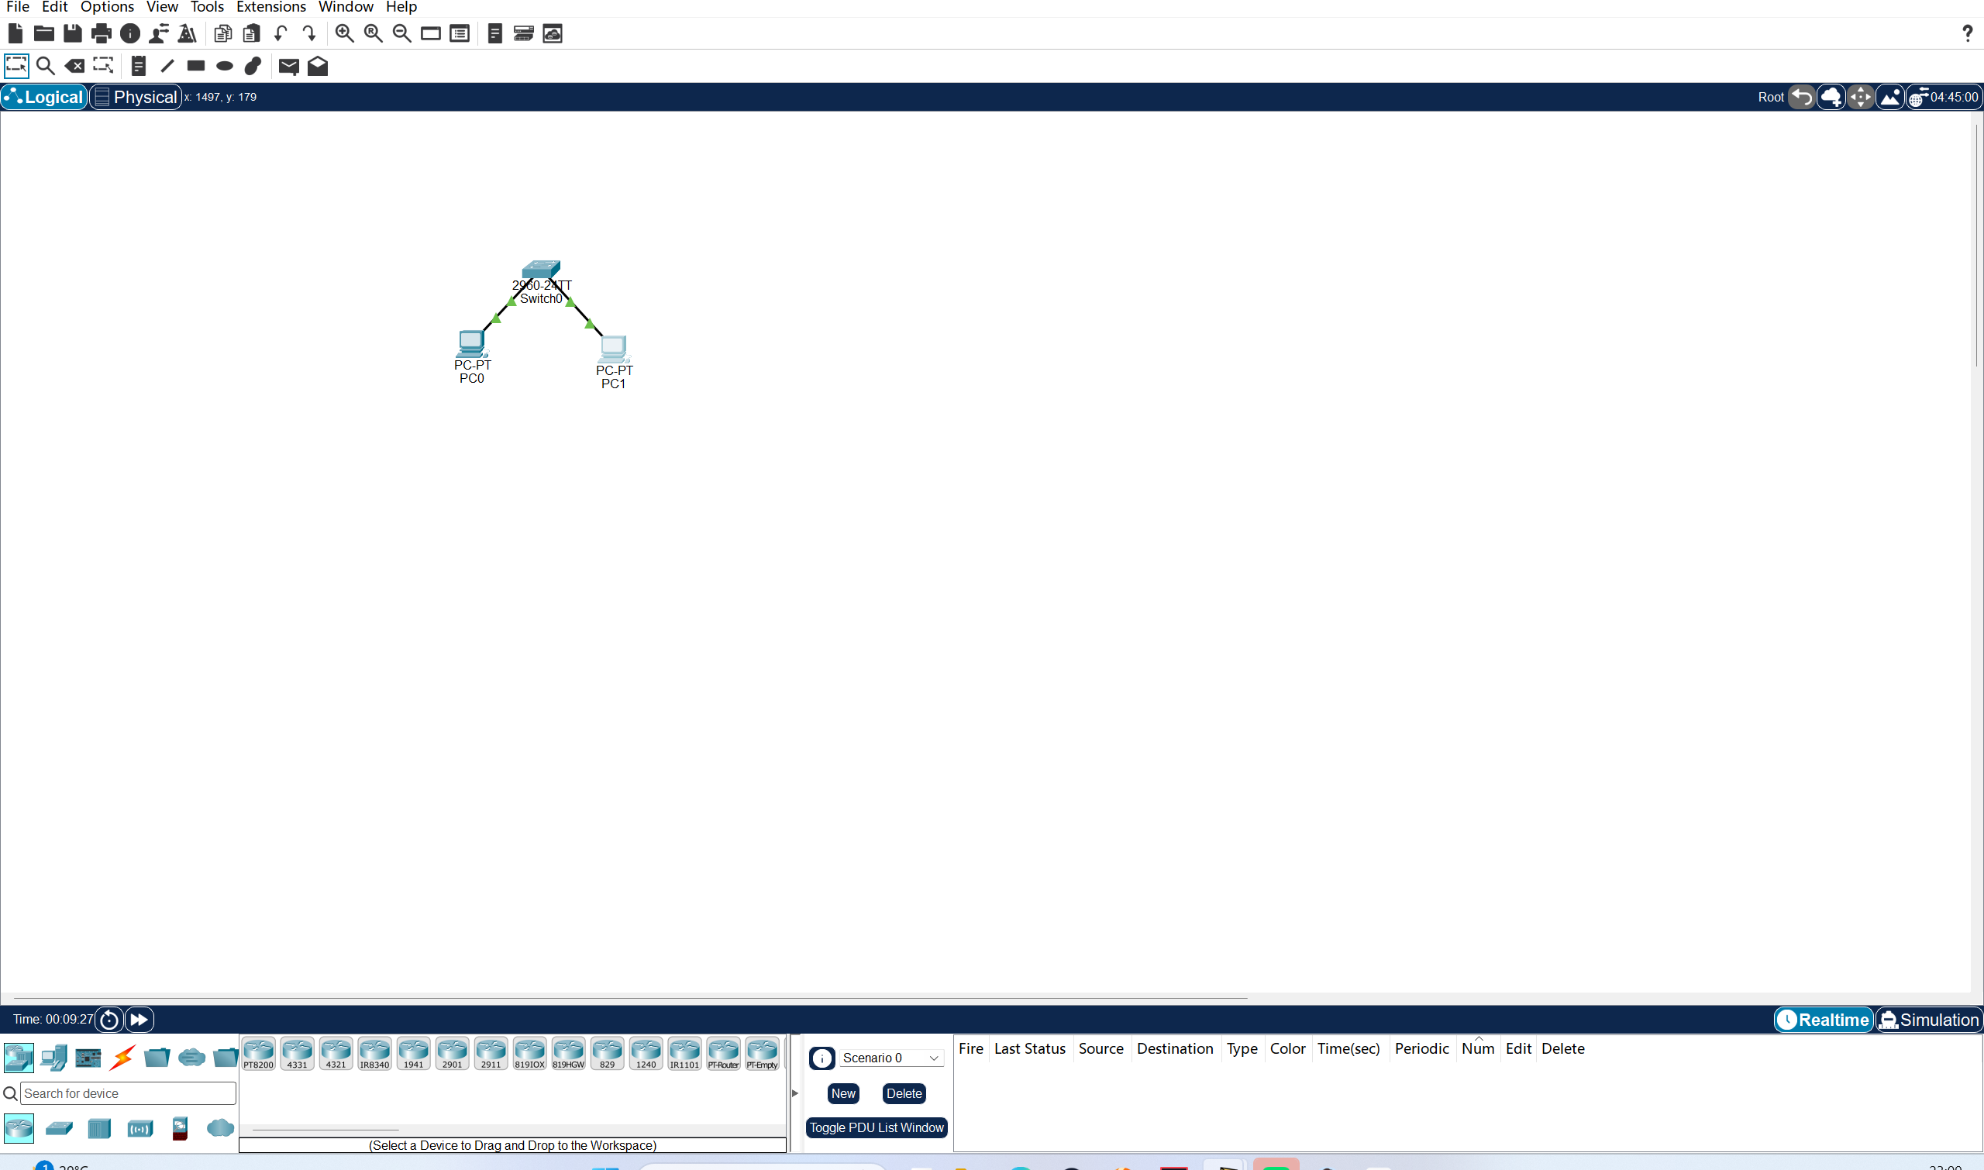
Interface Overview: Five Areas
Know where to choose devices, where to cable, and where to read status
1
Top: menu bar + main toolbar
File / Edit / Options / View / Tools; new, save, zoom, inspect, delete.
2
Center: workspace
Drop devices, draw cables, add text notes; the topology lives here.
3
Lower left: device palette
Choose PCs, switches, routers, and cables by category.
4
Lower right: Realtime / Simulation
Keep Realtime for these labs; the clock shows elapsed time.
5
Bottom: Scenario / Event List
Records events and PDUs; observation only in this lesson.
Actual window: Lab 1 topology in 1.pkt.
6
Notes:
Use the actual Lab 1 window. Keep students in Realtime mode; they do not need Simulation for these two labs.

Slide 7
02
Build and Configure
Notes:
Section two: the shared procedure used by both labs.

Slide 8
Step 1: Add Devices
Drag from the device palette into the workspace; core devices first
Category | Device / model | Role in these labs | Used in
End devices | PC-PT | Configure IP / mask / gateway; run ping tests | Lab 1, 2
Switches | 2960-24TT | Layer 2 forwarding inside the LAN | Lab 1, 2
Routers | Router-PT (2911) | Layer 3 forwarding and static routes | Lab 2
Cables | Automatically Choose | Automatically selects the correct cable type | Lab 1, 2
Cables | Copper Straight-Through | PC ↔ switch when a manual choice is required | Lab 1, 2
Place switches and routers first, then the PCs; leave room for network labels.
8
Notes:
Only five device types are needed. The “Used in” column prevents students from adding equipment the labs do not require.

Slide 9
Step 2: Choose the Right Cable
A wrong cable is one of the most common reasons a link stays down
Auto-connect (recommended)
Straight-through
Crossover
· Orange lightning icon
· PC ↔ switch
· Switch ↔ switch
· Chooses by port type
· Same pinout both ends
· Router ↔ router
· Used in both labs
· Most common LAN cable
· 2960 supports Auto-MDIX
· No pinout decision
· Different device classes
· Same device classes
Course convention
Both labs use Automatically Choose Connection Type. Only override it when the task explicitly asks for a cable type.
9
Notes:
In practice students should use auto-connect. If a link is down, check cable and interface before changing IP settings.

Slide 10
Config Tab and CLI
PCs use Config; routers and switches use CLI.
Config tab
For PCs
CLI
For network devices
Double-click the PC → Config
Double-click the device → CLI
Set IP, mask, default gateway
Interfaces, static routes, verification
Graphical and immediate
Matches Cisco IOS
Limited for advanced router features
Start with enable, then configure terminal
Use for: all PC addresses
Use for: routers and switches
Use Config for PC addresses. Use CLI for routers and switches.
10
Notes:
Keep the split clean. PC addressing is faster in Config; everything routed or switched is configured in CLI.

Slide 11
IOS Command Modes
The prompt tells you which commands are available
>
#
cfg
if
User EXEC
Privileged EXEC
Global config
Interface config
Router>
Router#
Router(config)#
Router(config-if)#
View basic information; no configuration changes.
show, save, debug; enter global configuration.
Hostname, static routes, and global settings.
IP address, no shutdown, interface settings.
Enter: enable
Enter: configure terminal
Enter: interface g0/0
Enter: exit / end
Router> enable → Router# configure terminal → Router(config)# interface g0/0 → Router(config-if)# ip address …
If the prompt is wrong, the command will be wrong.
11
Notes:
Use the prompt to orient students. They should know how to move between modes before the router lab.

Slide 12
PC IP Settings
Address, mask, and default gateway.
PC0
IP Configuration
Same subnet
Physical
Config
Desktop
Programming
Attributes
The gateway may be left blank. In Lab 1, both PCs use the same /24.
Static
DHCP
IPv4 Address
192.168.1.1
Different subnet
The default gateway is required. In Lab 2, the PC hands remote packets to the router.
Subnet Mask
255.255.255.0
Default Gateway
192.168.1.254
Check yourself first
DNS Server
(optional; not used here)
One wrong address, mask, or gateway breaks ping; run ipconfig before blaming the network.
Press Enter or click away; verify with ipconfig.
Same subnet: the gateway can stay blank. Different subnet: set the gateway.
12
Notes:
Connect this to Lab 1: the first failure is caused by a wrong mask/network, with no gateway available.

Slide 13
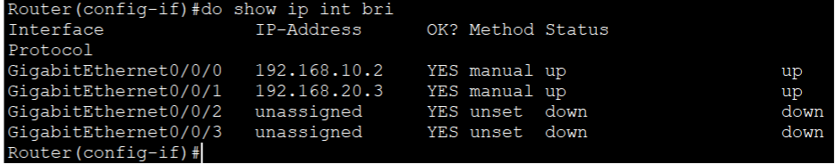
Router1: Interface Status Check
Both LAN interfaces should show up/up after configuration
Actual CLI from 2.pkt — do show ip int bri
G0/0/0
G0/0/1
G0/0/2–3
192.168.10.2 /24
192.168.20.3 /24
not assigned
up / up
up / up
down / down
up/up means the interface is enabled and the link is live. down means the link is missing or the interface is not configured.
13
Notes:
Use the actual show ip int bri output. G0/0/0 and G0/0/1 are up/up; G0/0/2 and G0/0/3 are unused and down.

Slide 14
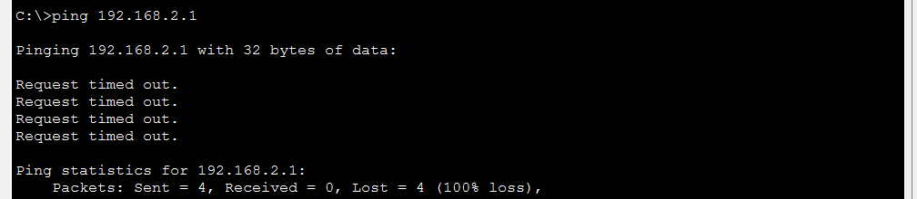
Ping: Check Near, Then Far
Do not start with the far end.
01
Ping the same-subnet peer
Checks the link, mask, and Layer 2 forwarding.
02
Ping the gateway first
If the gateway replies but the far end does not, check routing.
Use tracert if it still fails
Actual CLI from 1.pkt: four timeouts, 100% loss.
03
The first timed-out hop shows where forwarding stops.
Read the output
100% loss means no reply. PC0 has no path to 192.168.2.1 because it has no gateway.
04
Write down the result
Reply, timeout, unreachable, and loss percentage.
Reply from …
Request timed out
Host unreachable
Link and configuration are basically correct
No reply: routing, gateway, or physical link
Cannot deliver locally: gateway / ARP / subnet
14
Notes:
This slide establishes the verification language used in both labs: reply, timeout, unreachable, and loss.

Slide 15
03
Two Labs
Notes:
Section three: the two experiments. Each starts from its actual topology and uses CLI screenshots as evidence.

Slide 16
Two Labs: From Local Switching to Static Routing
Each lab adds one capability; Lab 1 is the foundation for Lab 2
Lab | Topology | Core skill | Success criterion
01 LAN addressing | 1 switch + 2 PCs | IP / mask, same-subnet test | After correcting PC1, ping succeeds
02 Static routing | 3 routers + 2 switches + 2 PCs | Default gateway, ip route | PC0 reaches PC1 with 0% loss
One method
Shared workflow: build → assign addresses → configure forwarding → ping → explain the result. The commands change; the method does not.
16
Notes:
Frame the two labs as a sequence. Lab 1 teaches local delivery; Lab 2 adds a gateway and routing.

Slide 17
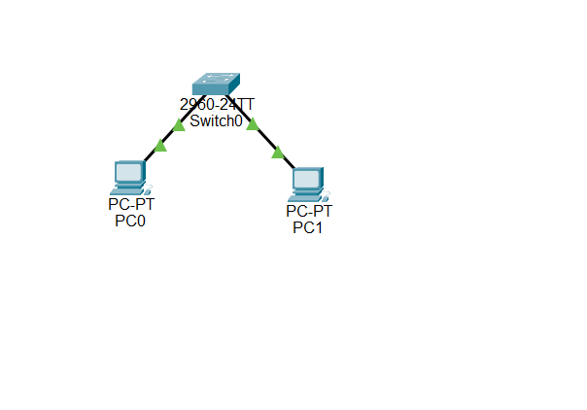
Lab 1: Same Subnet vs. Cross-Subnet
LAB 01 · one 2960 switch + two PCs; create a failure, then correct it
Lab goal
· Cable PC–switch–PC
· Ping across subnets and fail
· Correct PC1 and succeed
Device | Initial IP | Corrected
PC0 | 192.168.1.1 | 192.168.1.1
PC1 | 192.168.2.1 | 192.168.1.2
Switch0 | — | Layer 2
Mask 255.255.255.0; gateway left blank.
Original topology: 1.pkt (PC0 / PC1 / 2960-24TT)
Task: PC0 pings 192.168.2.1 (fail) → change PC1 to 192.168.1.2 → ping again (success).
17
Notes:
Start with the actual 1.pkt topology. The failure is intentional: it makes the subnet mask visible.

Slide 18
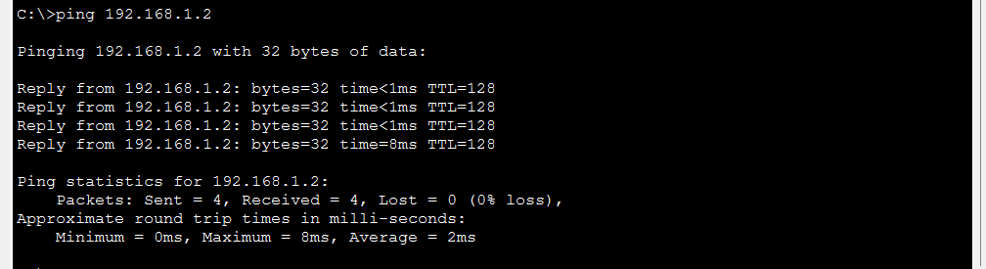
Lab 1 Procedure: Fail, Correct, Verify
The screenshots below are the real CLI output from 1.pkt
Place and cable
1
2 × PC-PT and 1 × 2960-24TT; PC0 to Fa0/1, PC1 to Fa0/2.
Set the initial addresses
PC0 → 192.168.2.1: 100% loss
2
PC0 192.168.1.1/24; PC1 192.168.2.1/24; leave the gateway blank.
Test the failure
3
From PC0, ping 192.168.2.1; expect four timeouts.
PC0 → 192.168.1.2: 0% loss, TTL=128
Correct PC1 and retest
4
Set PC1 to 192.168.1.2/24; ping 192.168.1.2; expect 0% loss.
Compare the two
The only change between the two screenshots is PC1’s IP address.
18
Notes:
These are real captures from 1.pkt. Ask students to compare loss, reply lines, and TTL.

Slide 19
Lab 1: Why Did the First Ping Fail?
The switch was fine; the two hosts had different network IDs
PC0
No gateway → packet cannot leave
≠
PC1
≠
192.168.1.1/24
192.168.2.1/24
PC0 treats PC1 as remote. With no default gateway, it cannot hand the packet to a router, so it is dropped locally.
Network 192.168.1.0
Network 192.168.2.0
1
Network ID
2
Switch role
3
Correction
IP AND mask. With /24, the first three octets must match.
A Layer 2 switch reads the destination MAC and forwards the frame; it does not change IP addresses.
Change PC1 to 192.168.1.2. Both hosts now share 192.168.1.0/24.
Q1 Does the switch change the IP?
Q2 What does the mask do?
No. It looks only at the destination MAC and its MAC address table.
It separates network bits from host bits and decides local vs. remote.
Conclusion: same subnet is not “same switch”; it means the same network ID.
19
Notes:
The first ping failed because PC1 was remote and PC0 had no gateway. The switch itself was doing its L2 job.

Slide 20
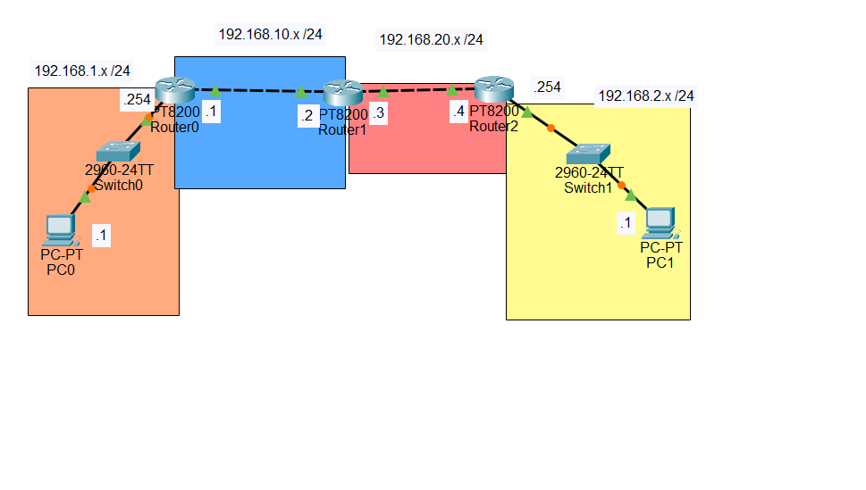
Lab 2: Three Routers and Static Routing
LAB 02 · 2 PCs + 2 switches + 3 routers; four /24 networks
Lab goal
· PC gateways configured
· All router links up/up
· Bidirectional static routes
Area | Network | Gateway / link
Orange LAN | 192.168.1.0/24 | R0 G0/0/0 .254
Blue transit | 192.168.10.0/24 | R0 .1 ↔ R1 .2
Red transit | 192.168.20.0/24 | R1 .3 ↔ R2 .4
Yellow LAN | 192.168.2.0/24 | R2 G0/0/1 .254
PC0 .1 and PC1 .1; all masks /24.
Original topology: 2.pkt (PC0–Route0–Route1–Route2–PC1)
Task: configure host gateways, router interfaces, and both forward and return static routes.
20
Notes:
This is the actual 2.pkt topology. Point out the four subnets and the three-router chain.

Slide 21
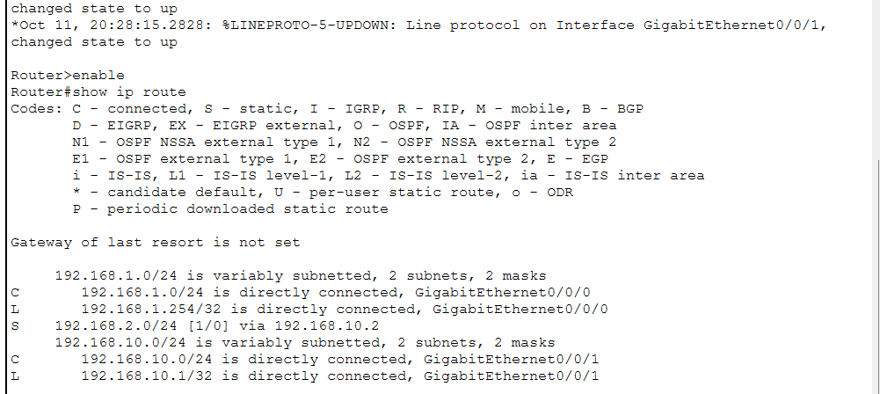
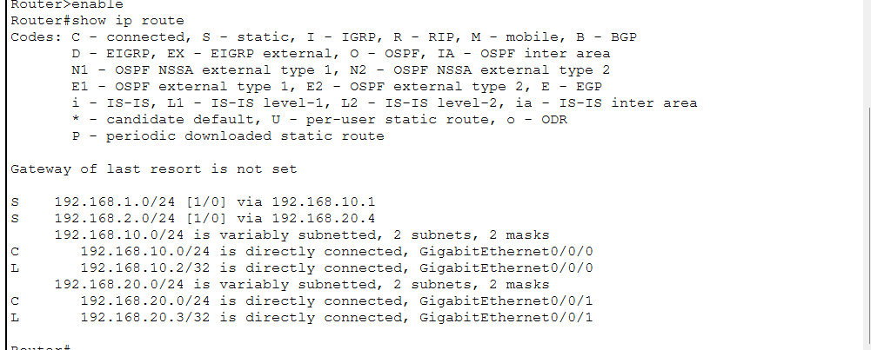
Lab 2: Interfaces and Static Routes
Use CLI output from 2.pkt to confirm what each router knows
Route0: S 192.168.2.0/24 via 192.168.10.2
Route1: S 192.168.1.0 via .10.1 and 192.168.2.0 via .20.4
Router | Destination | Mask | Next hop
Route0 | 192.168.2.0 | 255.255.255.0 | 192.168.10.2
Route1 | 192.168.2.0 | 255.255.255.0 | 192.168.20.4
Route1 | 192.168.1.0 | 255.255.255.0 | 192.168.10.1
Route2 | 192.168.1.0 | 255.255.255.0 | 192.168.20.3
Static-route pattern: ip route <destination> <mask> <next hop>. Every router needs a forward and a return path.
21
Notes:
These are real screenshots of show ip route. The table summarises all four routes that must exist.

Slide 22
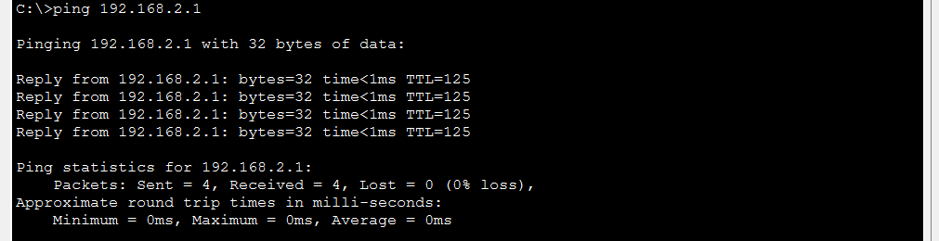
Lab 2: Check the Path
One working ping, plus three common failures.
No return route on Route2
The request reaches PC1, but the reply has no route back to 192.168.1.0 and is dropped. PC0 times out.
Missing route on Route1
PC0 → PC1: 0% loss, TTL 125 (three routers)
The packet reaches Route1, which has no route to 192.168.2.0; forwarding stops and PC0 times out.
TTL check
TTL 125 = 128 − 3. The packet crossed three routers, as shown in the topology.
No default gateway on PC0
PC0 treats the remote destination as local and cannot deliver the frame; the ping fails immediately.
Fixed order
Troubleshooting order: PC gateway → interface up/up → show ip route → return route → ping again.
22
Notes:
Use the actual ping capture. TTL 125 is strong evidence that the packet crossed three routers.

Slide 23
04
Troubleshoot and Summary
Notes:
Section four: turn the two labs into a reusable troubleshooting method.

Slide 24
Troubleshooting: Match the Symptom to the Layer
Check physical → Layer 2 → Layer 3, and change one variable at a time
Symptom | Most likely cause | Check first | Action
Link LED off or red | Wrong cable or interface shutdown | Both ends; interface state | Replace cable; no shutdown
Same-switch PC cannot ping | IP / mask not in the same subnet | ipconfig on both PCs | Use the same network ID
Gateway replies, far end does not | Missing route or return route | show ip route on each router | Add forward and return routes
First ping times out, later replies | ARP resolution or convergence | Second ping; ARP entry | Wait and retest; not a config fault
Router link stays down | Interface still administratively down | show ip interface brief | Enter no shutdown
Discipline
Do not change three things at once. If you do, a working network will not tell you which change fixed it.
24
Notes:
Only the symptoms that occur in Labs 1 and 2 are included. The first-ping timeout is real and was observed in 2.pkt.

Slide 25
Submission Checklist
Check each item as you finish a lab, not after writing the report
Shared
Lab 1
Topology matches the manual; labels are clear
Initial failure captured (100% loss)
All PC addresses, masks, and gateways checked
PC1 corrected to 192.168.1.2/24
Key interfaces are up/up
Second ping shows 0% loss
Every test has a CLI capture or written record
Can explain why the first ping failed
Lab 2
Report
Both PC gateways configured
Configuration commands included
Three routers have interface addresses
Verification output included
Four static routes installed
Result explained in your own words
PC0 reaches PC1 with 0% loss
Screenshots match the stated conclusion
Report
For each test, include the command, the output, and one sentence explaining the result.
25
Notes:
Use this as a formative checklist. Students should tick items immediately after each lab.

Slide 26
Where the Packet Is Decided
Lab 1 is local. Lab 2 uses a gateway.
LAB 01
LAB 02
Same subnet
Different subnet
Host resolves the peer MAC; switch forwards the frame.
Host sends to the gateway; routers forward hop by hop.
L2 local delivery
L3 routed delivery
Same subnet → MAC
The destination is local; ARP gives the destination MAC and the switch forwards.
Different subnet → IP route
The destination is remote; the host uses the gateway and each router looks up the destination network.
Check the address first
A ping result means little until the address, gateway, interface state, and route table are correct.
Check the destination first: local → MAC; remote → gateway and route.
26
Notes:
This is the conceptual bridge: Lab 1 is local L2 delivery; Lab 2 is gateway plus L3 routing.

Slide 27
Three Checks for Both Labs
Use these before you ask for help.
01
Check the link.
Cable, interface status, and no shutdown.
02
Ping near, then far.
Peer first. Gateway before a remote host.
03
Match output to config.
If ping fails, compare address, mask, gateway, and route table.
After class
Next: complete 1.pkt and 2.pkt, then submit command → output → explanation for each required test.
27
Notes:
Close with three habits: physical first, direct first, evidence first.

Slide 28
Thank You
Questions & Discussion
EE6108 · Cisco Packet Tracer · Labs 1 and 2
Lab Teaching
Notes:
End of session. Remind students to use the checklist before submitting.

