Slide 1

Computer Networking Fundamentals
— From LAN Communication to Routing and Forwarding
Presented by: group 18

Slide 2
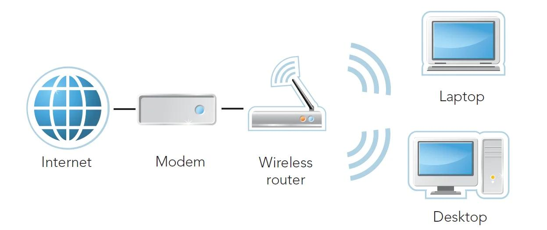
We all use Wi-Fi, visit websites, and move files between our phones and computers. But when you click a web page, have you ever wondered: how does the data leave your computer? And if the destination device is not even in the same network, how does the data find it?
Today we start from the most basic network connections and build up, step by step, an understanding of how data travels across a network.
Two computers on the same Wi-Fi — can they always talk to each other directly?
If a computer knows the other side's IP address, can it simply send the data?
If the destination computer is in another network, who should the data be handed to?

Slide 3
Contents
01 Network Basics
02 Addressing and Subnetting
03 Packet Forwarding and Hop-by-Hop Delivery
04 Routing Decisions and Static Routes
05 Practice and Summary

Slide 4
01
Network Basics

Slide 5
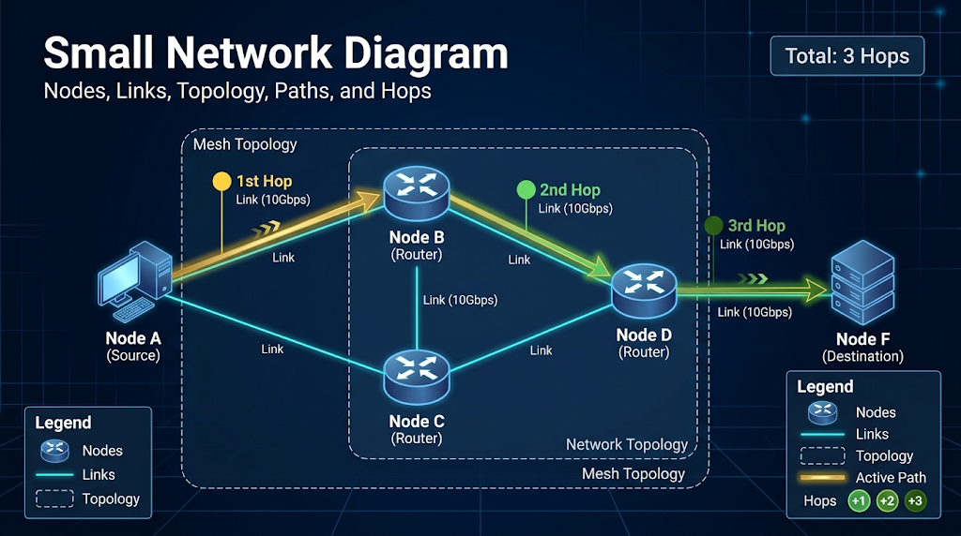
Network Topology and Architecture
Basic topology vocabulary
Paths are dynamic — the job of a routing protocol is to find the best path.

Slide 6
Network Topology and Architecture
What devices exist in a network, and what does each one do?
↔
End Host
L2 Switch
L3 Router
Generates, sends and receives application data
Forwards Ethernet frames by MAC address
Forwards packets using the destination IP and its routing table
PC / phone / server
Connects devices in the same LAN
Connects different IP networks
Think of these three device types as three roles in network communication. End hosts create and receive the data, switches handle frame forwarding inside a LAN, and routers handle packet forwarding between different networks.
Remember one simple distinction: a switch looks at MAC addresses, while a router looks up routes by destination IP address.

Slide 7
Reference Models and the Layers We Focus On
OSI 7-Layer Model
TCP/IP 4-Layer Suite
Application
Presentation
Session
Transport
Network
Data Link
Physical
Application
Transport
Internet
Network Interface
Data link layer: MAC addresses, Ethernet frames, Layer 2 switching
Network layer: IP addresses, routing, forwarding between subnets

Slide 8
02
IPv4 Addressing and the Default Gateway

Slide 9
IPv4 Addressing and Subnet Masks
IPv4 Example
192.168.1.10
192
first byte
168
second byte
1
third byte
10
fourth byte
32 bits = 4 bytes, each byte holding 8 bits
In binary: 11000000.10101000.00000001.00001010
An IPv4 address is 32 bits long in total.
It is normally written in dotted-decimal notation.
Each decimal number stands for 8 bits, ranging from 0 to 255.

Slide 10
IPv4 Addressing and Subnet Masks
Subnet mask: separating the network part from the host part
IP: 192.168.1.10
Subnet mask: 255.255.255.0
CIDR notation: /24
Network address: 192.168.1.0
Host part: the last 8 bits
192
168
1
10
Network part: 24 bits
Host part: 8 bits

Slide 11
IPv4 Addressing and Subnet Masks
Now that we know an IP address, how do we tell whether two addresses are on the same subnet?
Question:
Are A and B, A and C on the same subnet?
A: 192.168.1.10/24
B: 192.168.1.20/24
C: 192.168.2.20/24

Slide 12






The Default Gateway
The default gateway is the next hop a host uses to send data to other networks when no more specific local route is available.
Same-Subnet Communication
L2 Local Segment
Cross-Subnet Communication
L3 Gateway
A
B
A
C
switch
gateway
Destination check
Destination check
Destination IP is in the local subnet
Destination IP is outside the local subnet
Next delivery target
Next delivery target
Destination host
Normally the default gateway
Destination MAC of the local frame
Destination MAC of the local frame
Destination host MAC
Gateway interface MAC
Routing needed?
Routing needed?
No Layer 3 routing required
Layer 3 routing required

Slide 13
VLAN: One Switch, Several LANs
A VLAN groups switch ports into their own broadcast domain
One switch, one broadcast domain
Ports grouped into VLANs
Every ARP and DHCP broadcast reaches every port.
Lab, office and server traffic all share one LAN.
Adding devices only adds more broadcast noise.
VLAN 10, 20 and 30 act as separate LANs on one switch.
A broadcast stays inside its own VLAN.
One switch now behaves like several independent switches.
L2 Switch
VLAN 10
VLAN 20
PC-A
192.168.10.11
PC-B
192.168.10.12
PC-C
192.168.20.11
PC-D
192.168.20.12
Frames and broadcasts stay inside their VLAN. Crossing between VLANs needs Layer 3.

Slide 14
VLAN and Subnet: A Matching Pair
One VLAN, one subnet, one gateway — and two kinds of switch port
VLAN | Subnet | Gateway | Ports
VLAN 10 · Office | 192.168.10.0/24 | 192.168.10.1 | Fa0/1–Fa0/8
VLAN 20 · Servers | 192.168.20.0/24 | 192.168.20.1 | Fa0/9–Fa0/12
VLAN 30 · Guests | 192.168.30.0/24 | 192.168.30.1 | Fa0/13–Fa0/16
Access port
One VLAN, untagged — faces a PC or printer.
Trunk port
Many VLANs, 802.1Q tagged — faces a switch or router.
VLAN preview — Cisco IOS (the full lab comes in the Packet Tracer part)
Switch(config)# vlan 10
Switch(config)# interface fa0/1
Switch(config-if)# switchport mode access
Switch(config-if)# switchport access vlan 10
Switch(config)# interface gi0/1
Switch(config-if)# switchport mode trunk
Switch(config-if)# switchport trunk allowed vlan 10,20,30
Each VLAN gets its own subnet and gateway. A trunk is the single cable that carries them all.

Slide 15
03
Packet Transport and Hop-by-Hop Forwarding

Slide 16
Addressing and Layer 2 / Layer 3 Forwarding
Following One Packet: From PC-A to PC-B
Example:
PC-A: 192.168.1.10/24
R1 LAN interface: 192.168.1.1/24
R1 far-side interface: 192.168.2.1/24
PC-B: 192.168.2.20/24
Four steps:
PC-A checks whether the destination is in the local subnet.
PC-A resolves the MAC address of the default gateway.
Router R1 receives the packet and looks up its route.
The packet crosses the far-side link and is delivered to PC-B.
PC-A
R1
R2 / next hop
PC-B
192.168.1.10
192.168.1.1
10.0.0.2
192.168.2.20
Check subnet
Look up route
Forward to next hop
Deliver to target

Slide 17
ARP: we know the next-hop IP — how do we find its MAC?
ARP Request: who has 192.168.1.1?
PC-A
Default gateway R1
192.168.1.10
192.168.1.1
ARP Reply: 192.168.1.1 is at AA:AA:AA:AA:AA:01
ARP Request: asks by broadcast which device on the local link owns an IPv4 address.
ARP Reply: returns the matching MAC address by unicast.
ARP Cache: the resolved result is cached so we do not broadcast on every conversation.

Slide 18
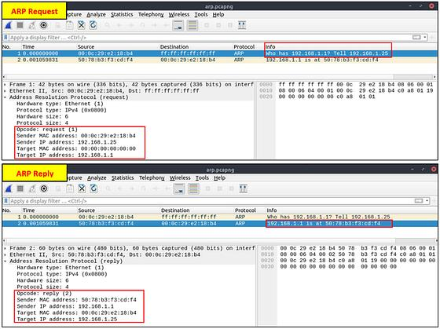
ARP: we know the next-hop IP — how do we find its MAC?
① ARP Request: the query
② ARP Reply: returns the MAC address
When a host knows the target IP but not the target device's MAC address, it must perform address resolution.
An ARP Request asks for the MAC address that belongs to a target IP.
An ARP Reply returns that MAC address.
Only after it has the MAC address can the host build and send the Ethernet frame on the local link.

Slide 19
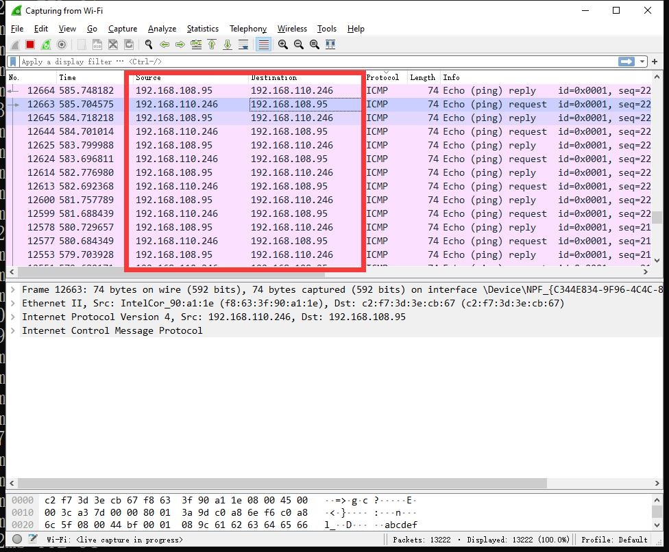
ICMP — how does a ping complete its round trip?
① Echo Request: the query message
② Echo Reply: the answer message
③ Source / Destination: direction of the exchange
④ Sequence Number: the clue that matches reply to request
Ping normally uses an ICMP Echo Request to test whether a target host responds.
When the target receives the request, it returns an ICMP Echo Reply if it is allowed and able to.
The source and destination IP addresses of the request and the reply point in opposite directions.
The Identifier and Sequence Number fields let us match each reply to its request.

Slide 20
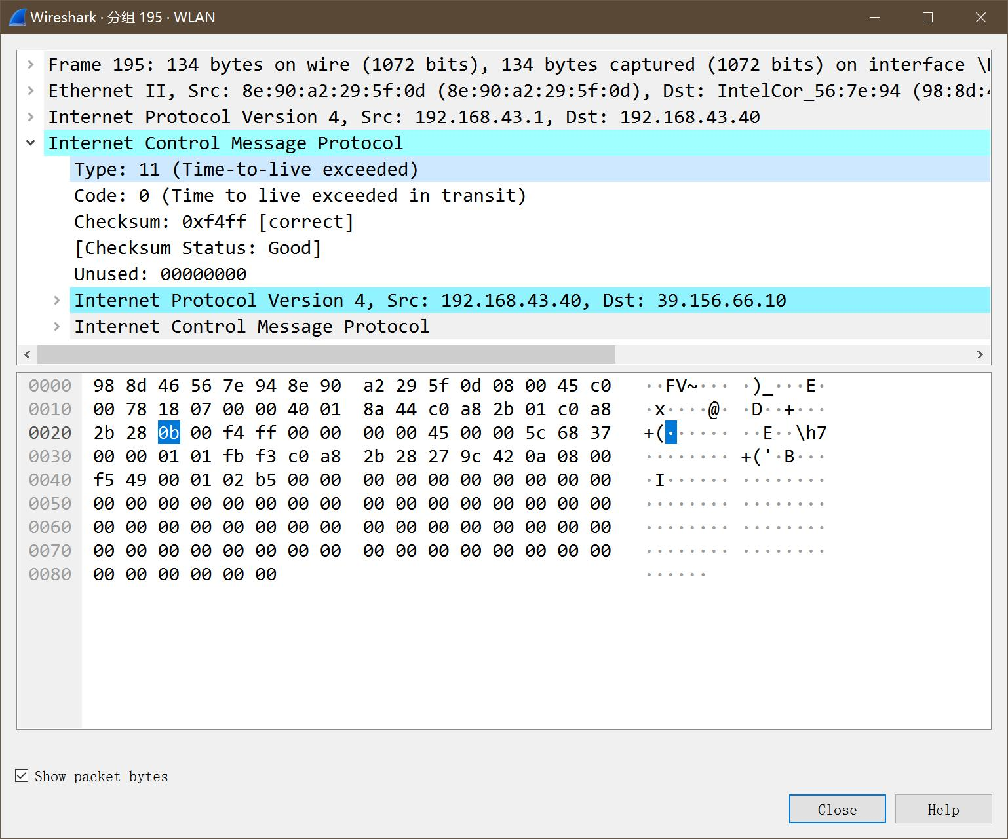
Opening a Packet — Reading the Protocol Fields
① Ethernet II: source and destination MAC addresses
② Internet Protocol: source and destination IP addresses
③ ICMP: Type, Code, Sequence Number
Wireshark's packet details pane expands the protocol fields layer by layer:
Ethernet layer: check the Layer 2 source and destination MAC.
IP layer: check the source IP, destination IP and TTL.
ICMP layer: check the message type and sequence number.

Slide 21
How does a Layer 2 switch forward Ethernet frames?
PC-A
PC-C
MAC-A
MAC-C
L2 Switch
PC-B
R1
MAC-B
MAC address table
Gateway MAC
MAC → port

Slide 22
Encapsulation and Hop-by-Hop Forwarding
Link segment | Source IP | Destination IP | Source MAC | Destination MAC
PC-A → R1 | 192.168.1.10 | 192.168.2.20 | PC-A MAC | R1 LAN MAC
R1 → next hop | 192.168.1.10 | 192.168.2.20 | R1 egress MAC | Next-hop MAC
Last hop → PC-B | 192.168.1.10 | 192.168.2.20 | Last router MAC | PC-B MAC
IP address: the end-to-end Layer 3 destination
MAC address: used to deliver the frame on the current link

Slide 23
TTL: why don't packets loop forever?
TTL = Time To Live
Field size: 8 bits in the IPv4 header.
Per hop: each router normally decrements the TTL by 1.
Loop prevention: once the TTL expires, the router drops the packet.
Common feedback: when the conditions are met, the router may return ICMP Time Exceeded.
64
63
62
61
Source host
after R1
after R2
after R3
TTL expires → packet dropped

Slide 24
04
Routing Decisions and Static Route Configuration

Slide 25
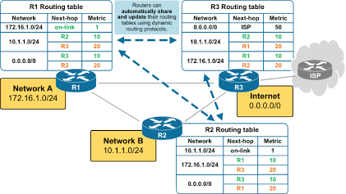
How a Routing Table Works
The routing table is what a router bases its decisions on.
It records which networks are reachable and how to forward toward them.
Destination network | Next hop | Exit interface | Meaning
192.168.1.0/24 | Directly connected | G0/0 | Locally attached network
192.168.2.0/24 | Directly connected | G0/1 | Another directly attached network
192.168.3.0/24 | 192.168.2.2 | G0/1 | Hand over to the next router
0.0.0.0/0 | 192.168.2.2 | G0/1 | Default route
When a router processes a packet it extracts the destination IP → finds the matching route → chooses the next hop / exit interface.

Slide 26
Route Selection: Longest Prefix Match
Destination IP: 192.168.1.10
192.168.0.0/16
broader coverage
Choose /24
Because the matching prefix is longer, the route is more specific.
192.168.1.0/24
more specific network

Slide 27
Static Routing
Static routing means routes are configured and maintained by hand by the network administrator.
Unlike dynamic routing protocols such as OSPF, RIP and BGP, which learn and compute paths automatically, static routes do not update themselves when the topology changes. If a path fails or the topology changes, the administrator must edit the routing table manually.
The core of a static route: name the destination network, then specify the next hop or the exit interface
Advantages
Limitations
Configuration is straightforward
Behaviour is predictable
Suits small or stable topologies
Topology changes usually require manual edits
A misconfiguration can cause unreachability
Higher maintenance cost in large networks

Slide 28
ACL: Who May Talk to Whom?
A list of permit and deny rules, read in order, applied to an interface
What it matches
How it is read
Where it is applied
Source and destination IP
Protocol: IP, TCP, UDP, ICMP
Port number (extended ACLs)
Checked top-down, one rule at a time
First match wins; later rules are skipped
An invisible deny any sits at the end
On one router interface
Inbound: before the routing decision
Outbound: after the routing decision
One rule reads like a sentence
deny ip host 192.168.10.50 host 192.168.20.10
→ block one host from reaching one server
Remember: if no rule matches, the packet is dropped. Every permitted flow needs an explicit permit.

Slide 29
One ACL in Practice
Block one host, keep every other flow working
The task
The rules, in order
Office VLAN 10: 192.168.10.0/24
Server in VLAN 20: 192.168.20.10
Block 192.168.10.50 from the server
Everything else must still work
10
deny ip host 192.168.10.50 host 192.168.20.10
20
permit ip any any
(everything else keeps working)
R1 — applied inbound on the VLAN 10 interface
Check and remember
R1(config)# access-list 100 deny ip host 192.168.10.50 host 192.168.20.10
R1(config)# access-list 100 permit ip any any
R1(config)# interface gi0/0
R1(config-if)# ip access-group 100 in
R1(config-if)# end
R1# show access-lists
R1# write memory
show access-lists — order and hit counts
No match means the packet is dropped
Place it on the interface facing the source
A new rule is added at the end of the list
Change the order, change the result
Order matters: a permit placed first would let the blocked host straight through.

Slide 30
Class Exercise
Mixed Practice: who should the next hop be?
Q1
PC-A talks to PC-B on the same subnet — whose MAC is resolved?
PC-B's MAC
Q2
PC-A talks to a remote PC-C — whose MAC is resolved?
The default gateway's MAC
Q3
When reaching PC-C, what is the destination IP of the packet?
PC-C's IP
Q4
After a packet passes one router, how does the TTL normally change?
Decremented by 1

Slide 31
Class Summary
1
Determine the destination network
IP + subnet mask
2
Determine the next hop
Destination host or default gateway
3
Resolve the next-hop MAC
Use ARP when needed
4
Consult the routing table
Choose the next hop and exit interface
5
Re-encapsulate and forward
MAC changes, TTL normally decreases

