Slide 1


Slide 2



CODE VERSE HACKATHON 2025
Problem Statement Title:
Lack of Real-Time KPI Visibility: Campaign performance insights were scattered across multiple tools, resulting in fragmented reporting and delays indecision-making due to the absence of a centralized dashboard.
Team Name- Bit Beast
Team Members: Yash Deshpande
Aniket Bhujad
Khushi Roongta

Slide 3
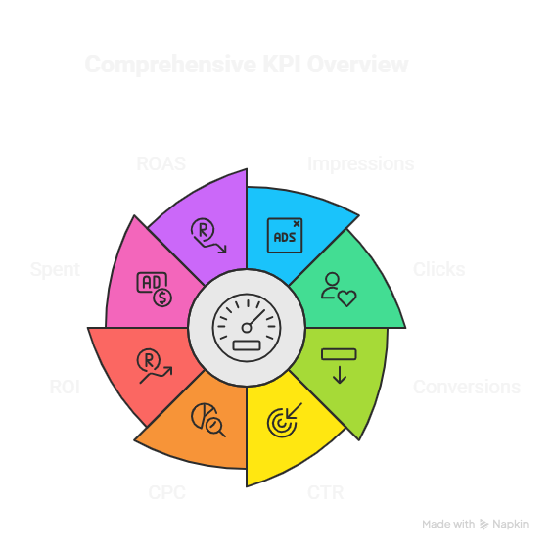
IDEA TITLE
💡 Centralized Real-Time KPI Dashboard
We propose a smart, unified platform that collects campaign performance data from multiple tools and displays it on a centralized dashboard.
Integrates data from ad platforms, analytics tools, and CRM systems.
Provides visualization of KPIs with automated reports.
Enables stakeholders to view campaign performance in one place and take faster actions.
KPI OVERVIEW
🛠️ How the Solution Helps
Eliminates the need for manually switching between multiple tools and reports.
Allows campaign managers to make faster, data-driven decisions.
KPI (Key Performance Indicators) are the measurable metrics that help track how well marketing campaigns are performing. In your centralized dashboard, KPIs are automatically calculated from Google Ads, Facebook Ads, and LinkedIn Ads data, then displayed to managers, finance teams, and clients.

Slide 4
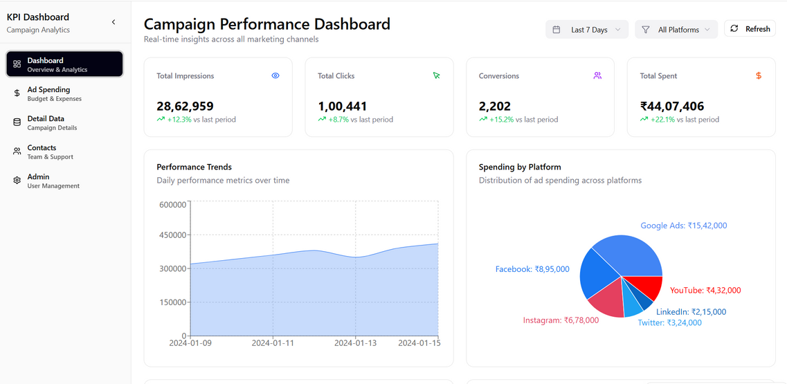
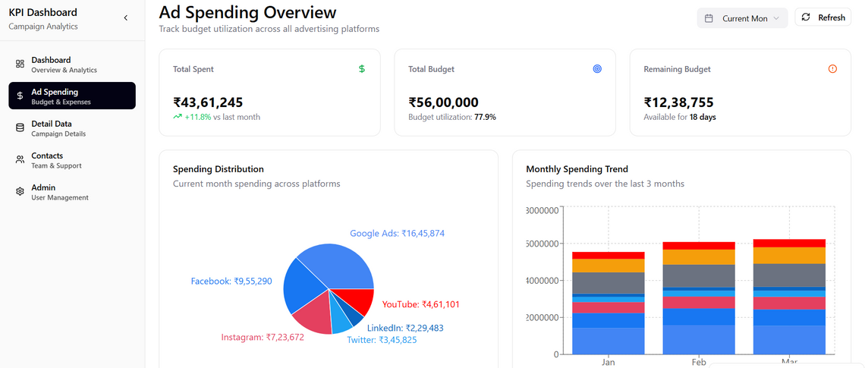
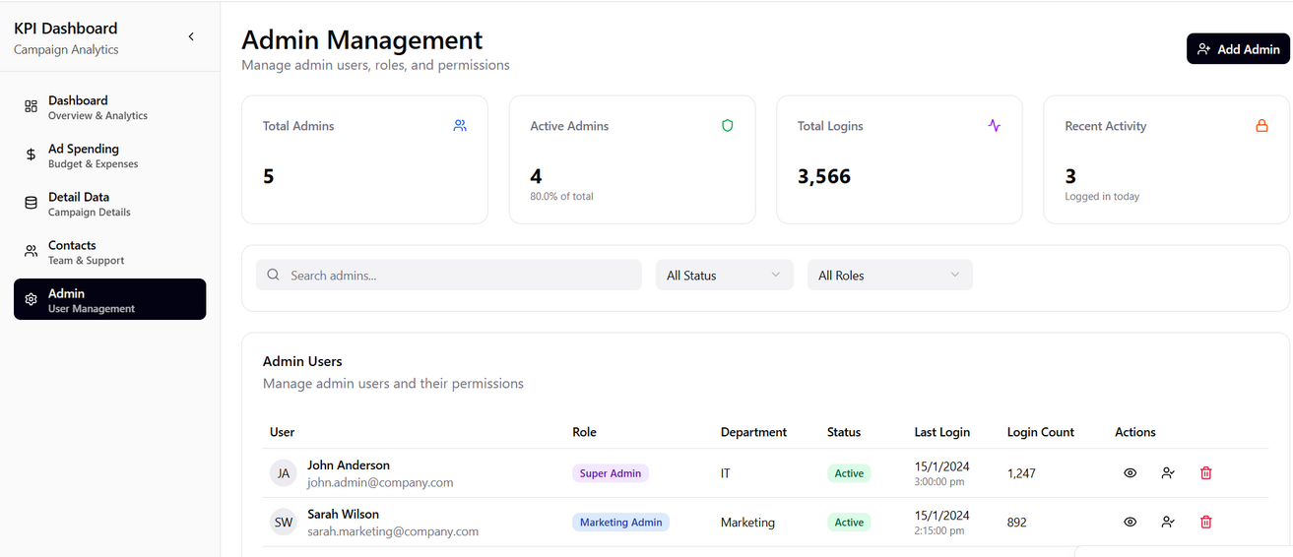
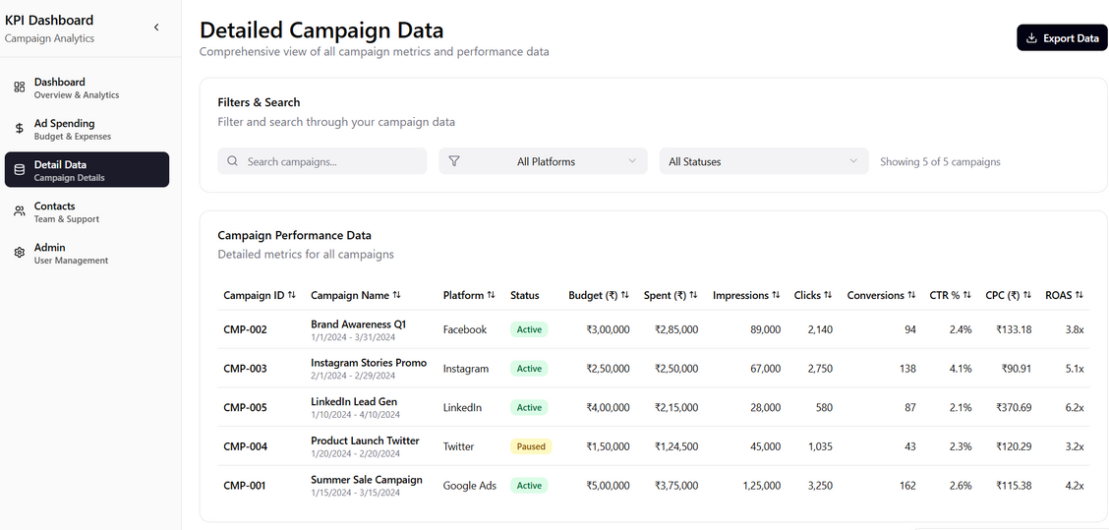
PROTOTYPE
PROTO-TYPE lINK :
KPI-Dashboard-Prototype.site

Slide 5
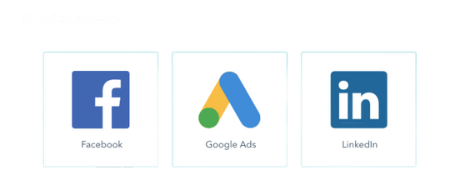
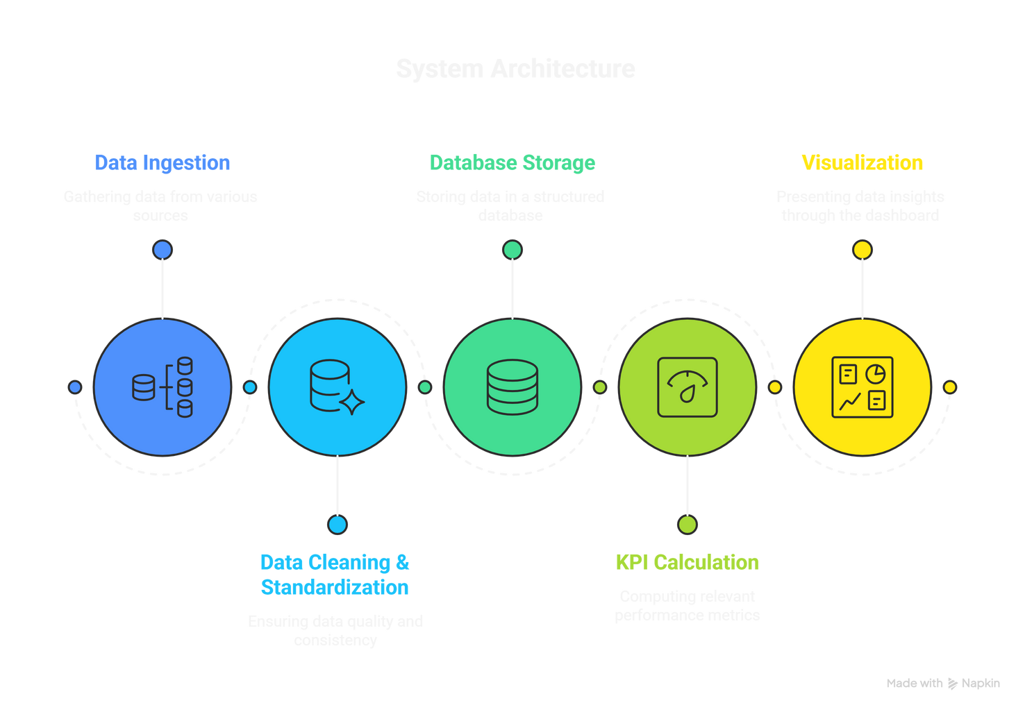


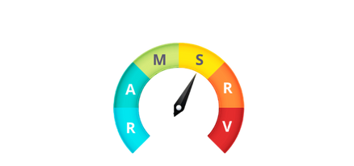
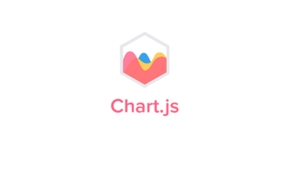
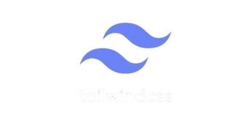
TECHNICAL APPROACH
TechStack
SYSTEM ARCHITECTURE
Sources
Database
ETL
Layer
Visualization
KPI
Algorithm
1️⃣ Data Ingestion (ETL Layer) : Backend scripts pull campaign data from Google Ads API.
2️⃣ Data Cleaning & Standardization : Align Google, Facebook, and LinkedIn metrics into a
common format.
3️⃣ Database Storage : Store cleaned data in structured tables for campaigns, performance,
and finance.
4️⃣ Processing & KPI Engine : Backend queries calculate KPIs like CTR, CPC, ROI, and
conversions.
5️⃣ Visualization : React.js dashboard displays real-time KPIs and reports for managers,
Finance, and clients.
Data is collected from multiple sources like Facebook, Google Ads, and LinkedIn.
This data is stored in a centralized database for easy access.
An ETL layer (Python + Node.js) processes and cleans the data.
A KPI algorithm analyzes the data to generate meaningful insights.
Insights are displayed through visualization tools (TailwindCSS + Chart.js) in a user-friendly dashboard.
Used Figma for UI/UX design and VS code as coding tool.

Slide 6
FEASIBILITY AND VIABILITY
Different platforms data:
Google Ads, Facebook, and LinkedIn sometimes calculate things differently (like clicks, conversions, or ROI).
This can confuse users when comparing campaigns side by side.
Too much data:
If we throw every single KPI onto the dashboard, it could feel messy and hard to read. We need to highlight the most important metrics first, let users drill down if they want more.
✅ Analysis of the Feasibility of the Idea
🔍 Potential Challenges and Risks
Financial:
Built with api and flexible cloud hosting , keeps costs low.
Long-term savings by automating tasks and cutting down on too many tools.
Market:
High demand across industries struggling with scattered marketing insights.
Provides competitive advantage by enabling real time visibility of performance.
🔧 Strategies for Overcoming These Challenges
Keep data feeling fresh
Use smart refresh timings and caching so numbers look almost live without delays.
One definition for everyone.
Standardize KPI rules so Google, Facebook, and LinkedIn all speak the same language.
Operational:
Everything sits in one place, making it easier to track campaigns and work together as a team.
Say goodbye to juggling spreadsheets and scattered reports. The system keeps it clean and simple.

Slide 7
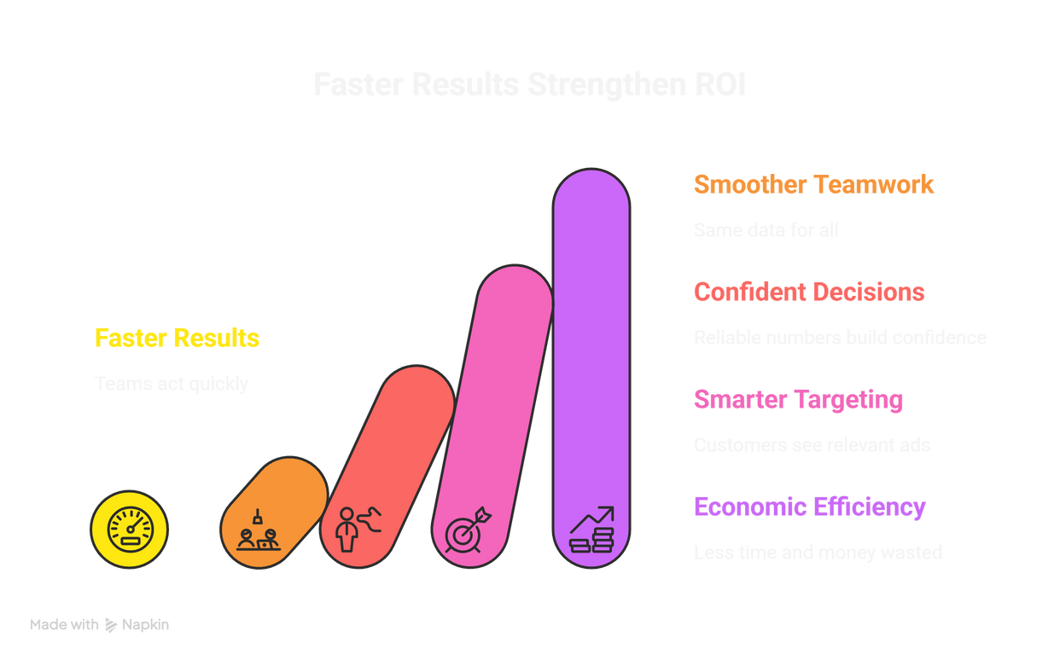
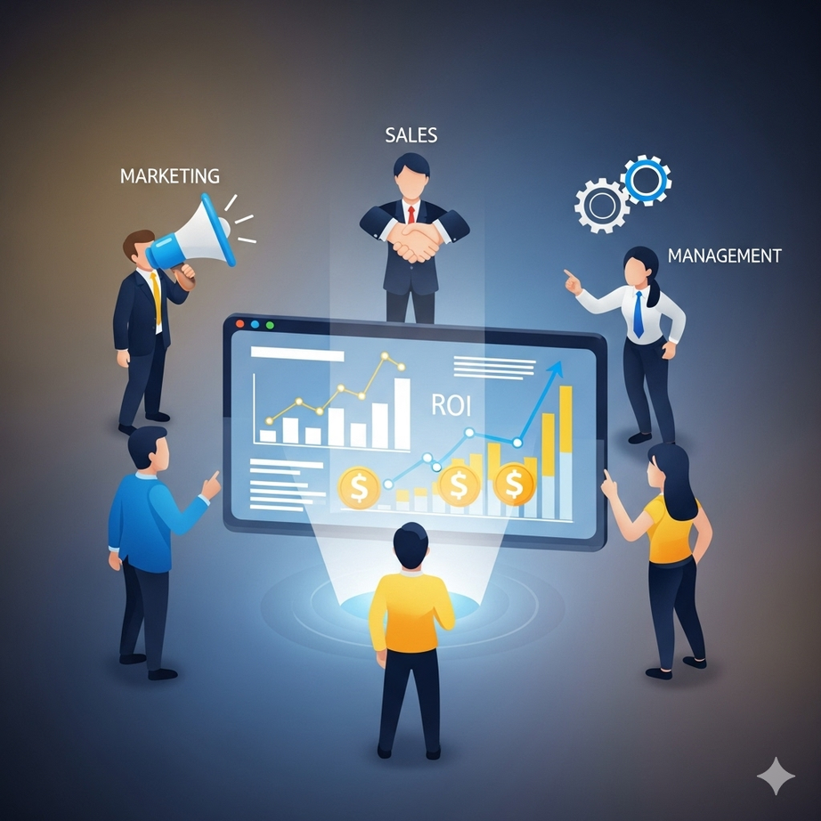
IMPACTS AND BENEFITS
📈 Potential Impact
As team get faster result,Teams can act fast and get stronger ROI.
Marketing, sales, and management all see the same data. That means fewer mix-ups and smoother teamwork.
Reliable numbers give confidence. It’s easier to convince clients or managers and make bold, smart decisions.
Social :
Smarter targeting means customers see ads that actually matter to them, creating a smoother and more positive experience.
Economic :
Less time and money wasted on manual reporting, more efficiency, and better returns from every campaign.
🎯 Benefits

