Slide 1
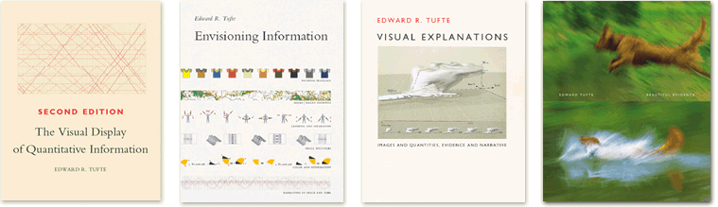
LESSONS FROM
EDWARD TUFTE
Slides adapted from presentation by Mika Aldaba, Graphic Designer

Slide 2
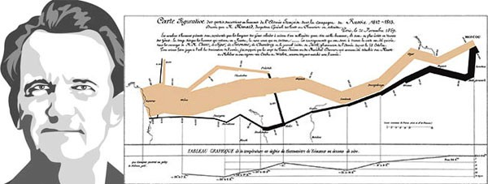
WHO IS EDWARD TUFTE?
an analytical design theorist, educator, and landscape sculptor best known for his
self-published books on analytical design
Illustrated by Merchant for the Brunswick Review

Slide 3
STRIVE FOR
GRAPHICAL INTEGRITY
Visual representations of data must tell the truth.

Slide 4
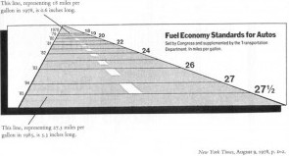
1
GRAPHICAL INTEGRITY
THE LIE FACTOR
Calculated by dividing the size of the effect shown in the graphic by the size of the effect in the data.
If the Lie Factor is greater than 1 the graph overstates the effect.
According to Tufte the Lie Factor of this graph is 14.8. A numerical change of 53% is represented by a graphical change (size of horizontal lines) of 783%.

Slide 5
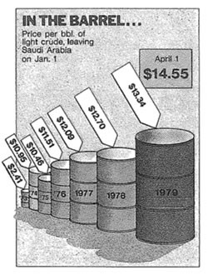
1
GRAPHICAL INTEGRITY
1ST PRINCIPLE
The representation of numbers, as physically measured on the surface of the graph itself, should be directly proportional to the numerical quantities represented

Slide 6
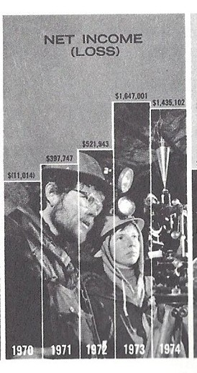
1
GRAPHICAL INTEGRITY
2ND PRINCIPLE
Clear, detailed and thorough labeling should be used to defeat graphical distortion and ambiguity. Write out explanations of the data on the graph itself. Label important events in the data.

Slide 7
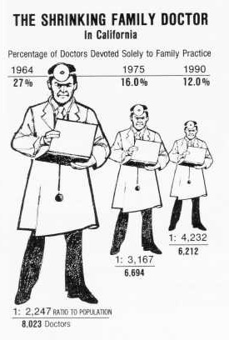
1
GRAPHICAL INTEGRITY
3RD PRINCIPLE
Show data variation, not design variation.

Slide 8
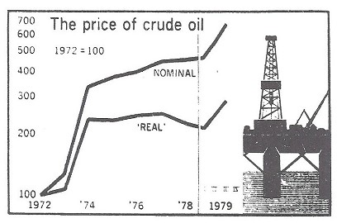
1
GRAPHICAL INTEGRITY
4TH PRINCIPLE
In time-series displays of money, deflated and standardized units of monetary measurement are nearly always better than nominal units.

Slide 9
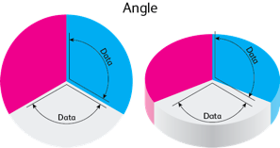
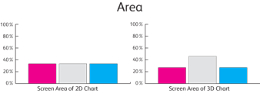
1
GRAPHICAL INTEGRITY
5TH PRINCIPLE
The number of information carrying (variable) dimensions depicted should not exceed the number of dimensions in the data.
Graphics must not quote data out of context.

Slide 10
2
MAXIMIZE
DATA INK
The ink on a graph that represents data. Good graphical representations maximize data-ink and erase as much non-data-ink as possible.
The data-ink ratio is calculated by 1 minus the proportion of the graph that can be erased without loss of data-information.

Slide 11
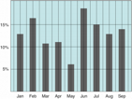
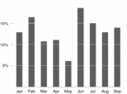
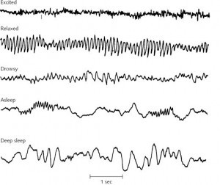
2 DATA INK
5 PRINCIPLES
Above all else show data.
Maximize the data-ink ratio.
Erase non-data-ink.
Erase redundant data-ink.
Revise and edit
It’s an electroencephalogram – a graph that records the electrical activity from the brain. This graph would have a very high data-ink ratio of 1.

Slide 12
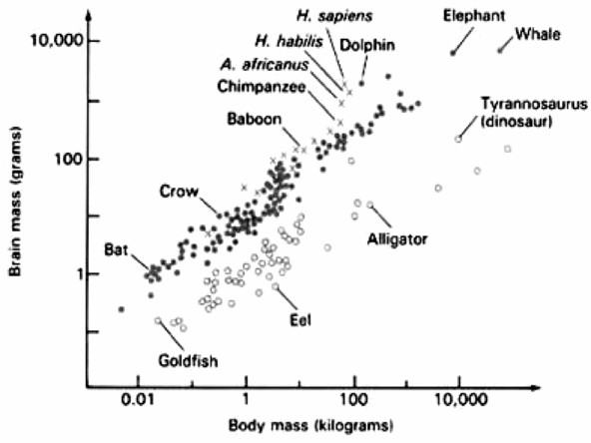
2 DATA INK
Graph from Carl Sagan’s The Dragons of Eden

Slide 13
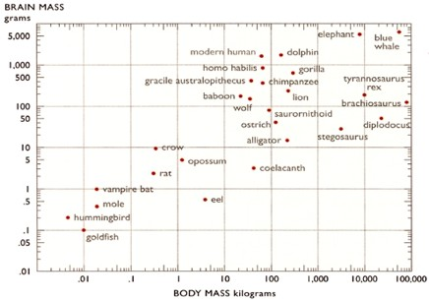
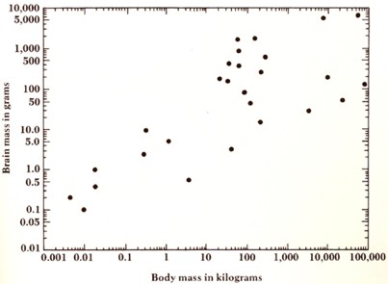
2 DATA INK
Tufte’s redesign

Slide 14
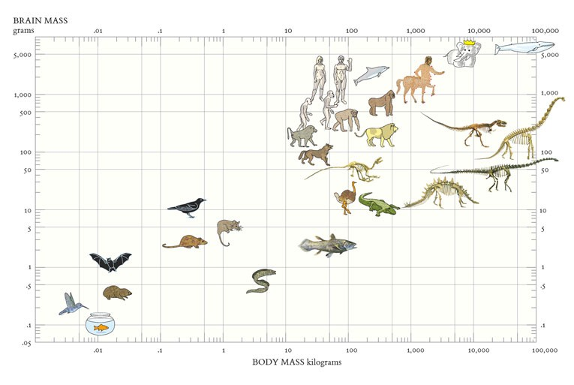
2 DATA INK
Tufte’s redesign from Beautiful Evidence

Slide 15
3
AVOID
CHART JUNK
The excessive and unnecessary use of graphical effects in graphs used to demonstrate the graphic ability of the designer rather than display the data.

Slide 16
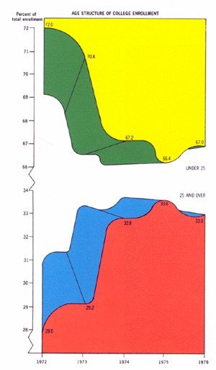
3 CHART JUNK
This is according to Tufte possibly the worst graph ever :
“A series of weird three-dimensional displays appearing in the magazine of American Education in the 1970’s delighted the connoisseurs of the graphically preposterous. Here five colors report, almost by happenstance, only 5 pieces of data (since the division within each adds to 100%). This may well be the worst graphic ever to find its way into print.”

Slide 17
4
AIM FOR HIGH
DATA DENSITY
The proportion of the total size of the graph that is dedicated displaying data.

Slide 18
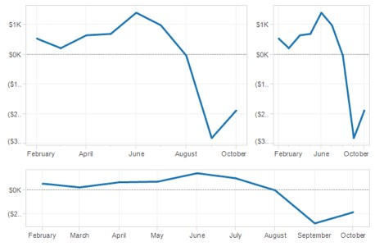
4DATA DENSITY
SHRINK PRINCIPLE
Maximize data density and the size of the data matrix within reason. One way of achieving this is through the Shrink Principle. Most graphs can be shrunk way down without losing legibility or information.

Slide 19
5
USE
CLASSIC DESIGN SOLUTIONS

Slide 20
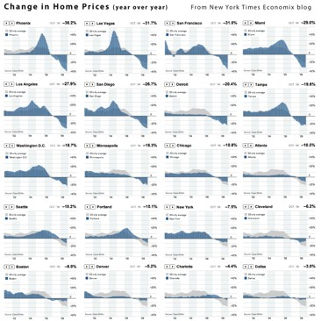
5 DESIGN SOLUTIONS
SMALL MULTIPLES
Series of the same small
graph repeated in one visual.

Slide 21
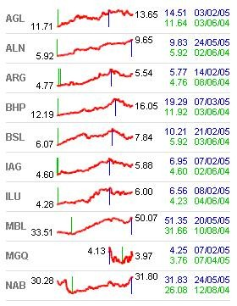
5 DESIGN SOLUTIONS
SPARKLINES
Small multiples are a great tool to visualize large quantities of data and with a high number of dimensions.
Sparklines are data-intense, design-simple, word-sized graphics.

Slide 22
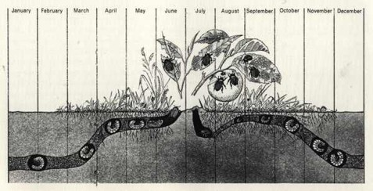
5 DESIGN SOLUTIONS
TIME SERIES
The most frequently used form of graphic design.
One dimension, usually the horizontal, is time, and the graphics march along showing variation as time proceeds. Most visualization time-series works are videos, which show time by changing the picture, requiring the user to remember what came before.

Slide 23
5 DESIGN SOLUTIONS
MICRO/MACRO COMPOSITION
Refers to an approach where a visualization contains enormous detail, but an overall pattern emerges. Panorama, vista, and prospect deliver to viewers the freedom of choice that derives from an overview, a capacity to compare and sift through detail. And that micro-information, like smaller texture in landscape perception, provides a credible refuge where the pace of visualization is condensed, slowed, and personalized.

Slide 24
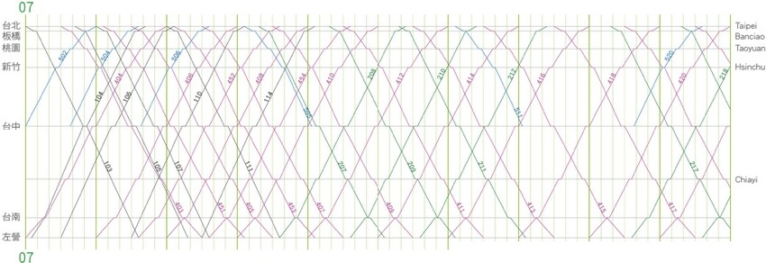
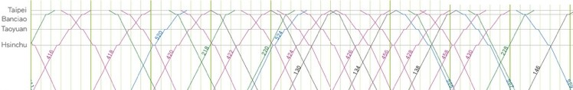
08
09
10
11
12
13
14
15
1 6
1 7
Ta
•
Ta11Nn
Zuoy.,.
1 7
08 09
gilf l!9Yilf1111
15 16
10 11
12 13
1 4
15
1 6
Train Operation Diagram of Taiwan High Speed Rail
2007 July 27
1 4
1 7 1 8 19 20
21
22
23
24
ttt
-!!ill
lltlll
Jlitl

Slide 25
6
APPLY
AESTHETICS & TECHNIQUE

Slide 26
6AESTHETICS & TECHNIQUE
have a properly chosen format and design use words, numbers, and drawing together
reflect a balance, a proportion, a sense of relevant scale display an accessible complexity of detail
have a narrative quality, a story to tell about the data draw elements in a professional manner, with the technical details of production done with care
avoid content-free decoration, including chartjunk

Slide 27
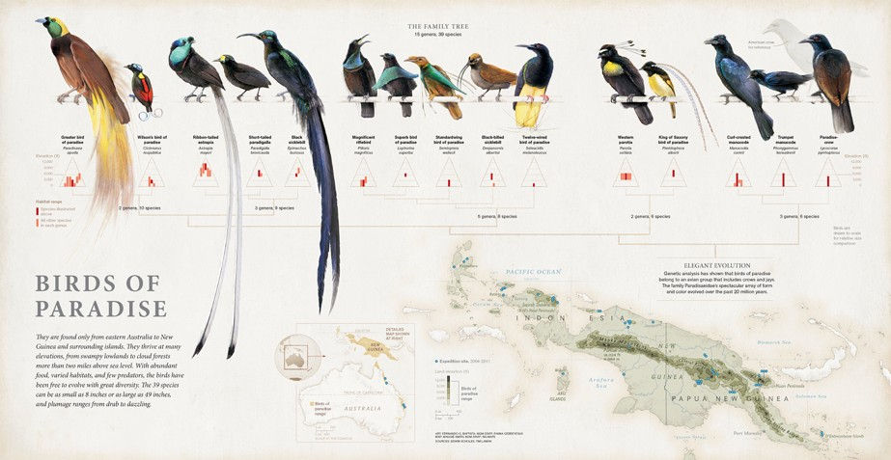
Juan Velasco
Cornell ornithologist Edwing Scholes and biologist/photographer Tim Laman
Senior Graphics Editor Fernando Baptista, Graphics Specialist Maggie Smith and freelance researcher Fanna Gebreyesus
National Geographic

Slide 28
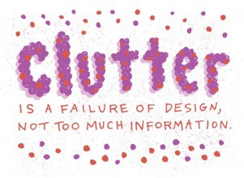
6AESTHETICS & TECHNIQUE
CLUTTER
If a visualization is too cluttered, don't remove data, change the design. Credibility comes from detail and in many cases one can clarify a design by adding detail.
High-density designs also allow viewers to select, to narrate, to recast and personalize data for their own uses.
Data-thin, forgetful displays move viewers toward ignorance and passivity, and at the same time diminish the credibility of the source.

Slide 29
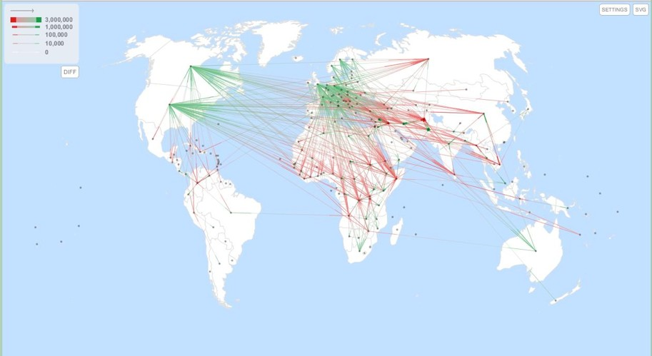
JFlowMap is a research prototype developed at the University of Fribourg that experiments various visualization techniques for spatial interactions, i.e. interactions between pairs of geographic locations. These can be migrations, movement of goods and people, network traffic, or any kind of entities “flowing” between locations.

Slide 30
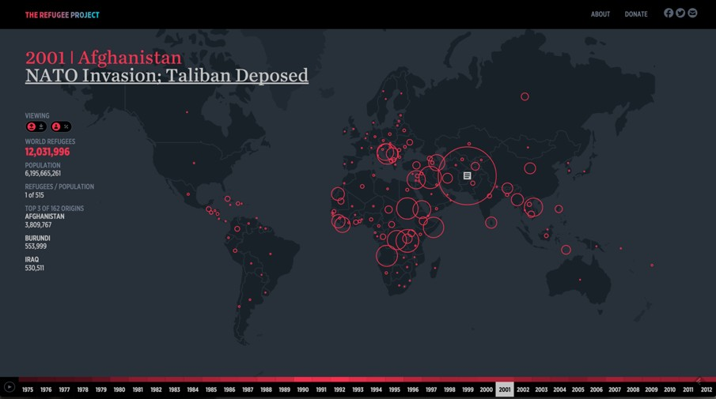
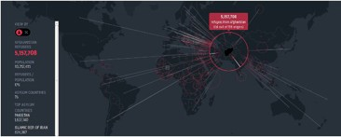
Hyperakt and Ekene Ijeoma visualized migrations over time and space in The Refugee Project http://www.therefugeeproject.org

Slide 31
6AESTHETICS & TECHNIQUE
CLUTTER
Empty space may reduce clutter, but it is not how much empty space there is, but rather how it is used. It is not how much information there is, but rather how effectively it is arranged.
Low density computer displays lead to spreading information out over many screens or dialog boxes. Place information adjacent in space, not stacked in time, to avoid the `Where am I?' problem.

Slide 32
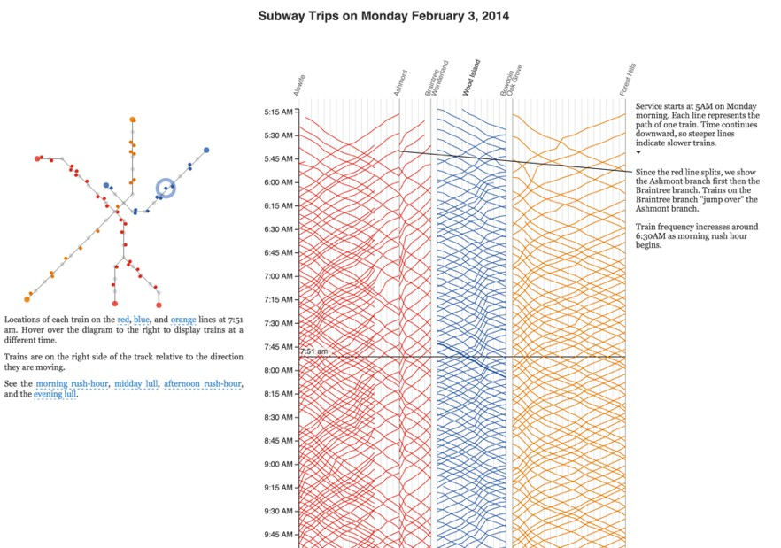
For a graduate project, Michael Barry and Brian Card explored the Boston subway system through a set of annotated interactives that show train routes, usage, and scheduling. http://mbtaviz.github.io/

Slide 33
6AESTHETICS & TECHNIQUE
LAYERING AND SEPARATION
Implies using color or other differentiation to separate important classes of information. Consider a colormapped surface that requires annotation. If the colormap uses all possible colors, positioning annotation will be difficult because of color clashes. A better approach might be to use intensity of a single hue for the colormap, leaving visual space for addition information; i.e., the annotation.

Slide 34
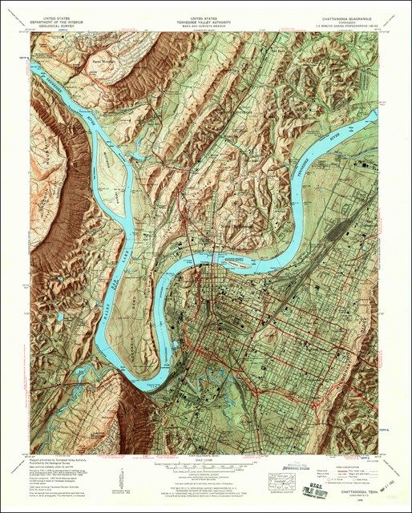
Muted colors, subtle shading and thin contour lines allow multiple types of data to be layered together in this 1958 topographic map of Chattanooga, Tennessee.

Slide 35
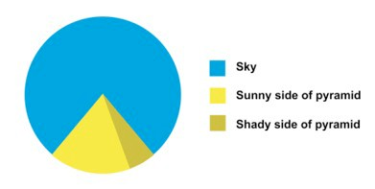
6AESTHETICS & TECHNIQUE
1 + 1 = 3 (or more)
Effective layering of information is often difficult because an omnipresent, yet subtle, design issue is involved: the various elements collected together interact, creating non-information patterns and texture.

Slide 36
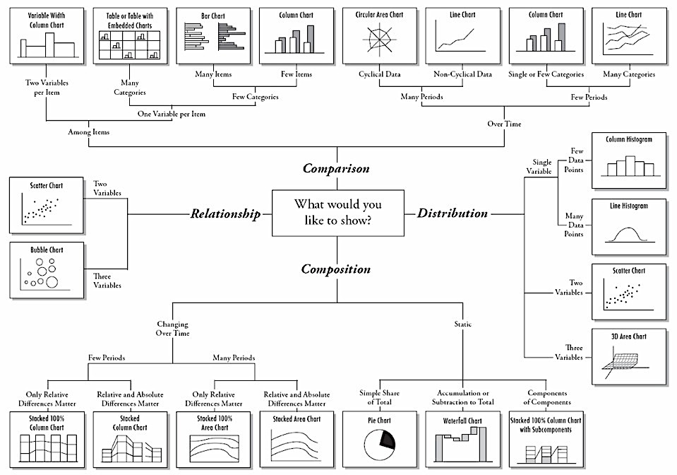
Chart by Andrew Abela

Slide 37
The final word…
The principles should not be applied rigidly or in a peevish spirit; they are not logically or mathematically certain; and it is better to violate any principle than to place graceless or inelegant marks on paper
--Tufte, Visual Display of Quantitative Information, page 191

Slide 38
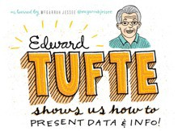
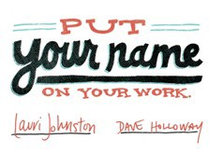
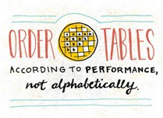
FOR MORE TIPS
HTTP://WWW.SLIDESHARE.NET/MCGARRAHJESSEE/MCJEDWARD-TUFTENOTES

