Slide 1
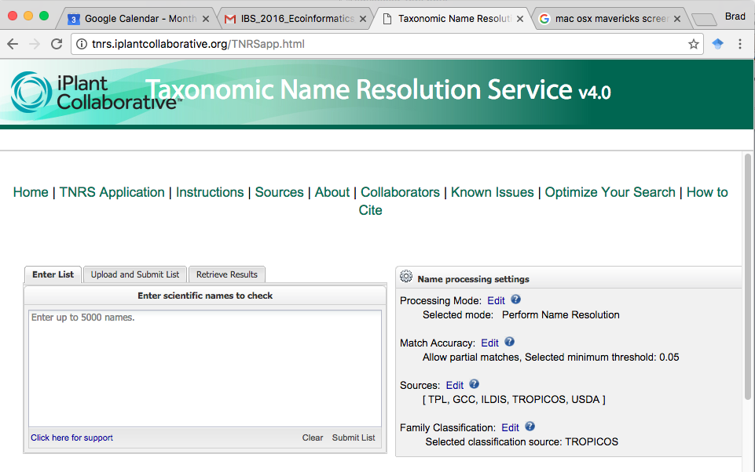
Tips for taxonomic cleaning with the TNRS
Brad Boyle
University of Arizona
9 January 2016

Slide 2
Taxonomic cleaning
Why bother?
Taxonomic scrubbing applications
General glitches and gotchas
TNRS glitches and gotchas
Pre-processing
Post-processing
Understanding the output

Slide 3
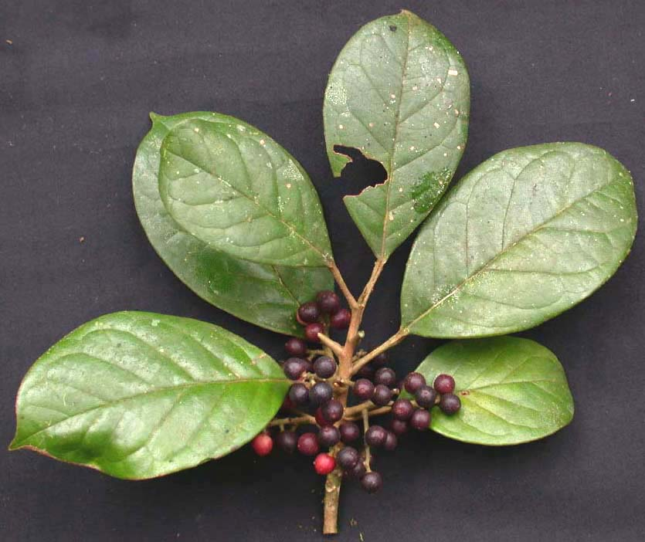
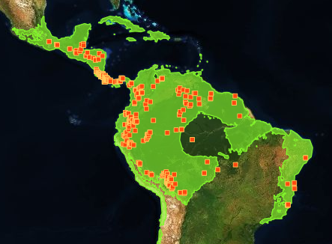
Taxonomic cleaning: why bother?
Widespread tropical tree
Hieronyma oblonga

Slide 4
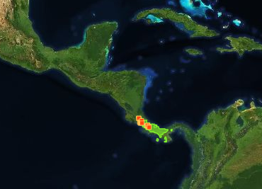
Taxonomic cleaning: why bother?
Widespread tropical tree
Hieronyma oblonga
Synonym of Hieronyma oblonga, once thought to be endemic to Costa Rica
Hieronyma poasana

Slide 5
Taxonomic cleaning: why bother?
Widespread tropical tree
Hieronyma oblonga
Common misspellings of Hieronyma oblonga
Hyeronima oblonga
Hieronima oblonga
Synonym of Hieronyma oblonga, once thought to be endemic to Costa Rica
Hieronyma poasana

Slide 6
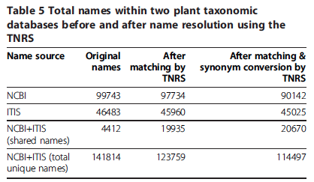
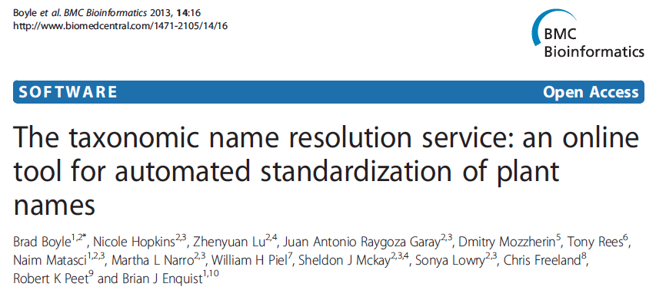
Why bother?
10% “bad” names

Slide 7
Why bother?
Overlap between databases only 3%!

Slide 8
Why bother?
400% increase in overlap

Slide 9
Taxonomic cleaning applications
TNRS
(http://tnrs.iplantcollaborative.org/index.html)
TaxonStand
http://onlinelibrary.wiley.com/doi/10.1111/j.2041-210X.2012.00232.x/full
Global Name Resolver
http://resolver.globalnames.org/
PlantMiner
http://www.plantminer.com/
Many others…

Slide 10
General architecture
Name parser
Breaks up and classifies name components
Hieronima poasana Standley
Genus
Authority
Specific epithet

Slide 11
General architecture
Name resolver
Matches the name to reference database
Tries fuzzy matching if exact match fails
Hieronima poasana Standley
Hieronyma poasana Standl.
Misspelled
Correct spelling (as published)

Slide 12
General architecture
Taxonomic status & synonym conversion
Some applications do no do this last step
Hieronyma poasana Standl.
Hieronyma oblonga (Tul.) Müll. Arg.
Synonym
Currently accepted name

Slide 13
Example workflow with TNRS API
Script: tnrs_api_example.R
Steps:
Extract the names
Turn into a string separated by commas
URL-encode and send to the TNRS API
Convert the returned JSON to data frame
Update your names

Slide 14
Pros and Cons of TNRS API
Advantages
Fast, simple, fully automated
Disadvantages
Can’t adjust all settings available in web interface
Uses Tropicos as only source
Can’t take advantage of web interface to inspect results, choose alternative matches and research names
Can’t access download options available in web interface
Parse-only option not available

Slide 15
Example basic workflow with TNRS web interface
Script: tnrs_gui_example.R
Steps:
Extract names to CSV file with two columns: Unique ID & names
Upload to TNRS using bulk “Upload and Submit List” tab, checking box “My file contains an identifier as first column”
Adjust name processing settings and submit
Inspect results online, selecting alternate matches if appropriate
Download results, using options: Best matches only, Detailed results, UTF-8 format
Import TNRS results as tab-delimitted file
Remaining processing as for API

Slide 16
Pros and Cons of TNRS Web Interface
Disadvantages
Not fully automated
Advantages
Can adjust name resolution settings
More name resolution sources
Use web interface to inspect results, choose alternative matches and research names
Select and download alternative matches on the fly
More download options, including “All matches” (useful if you don’t like how TNRS chooses best match and want to script it yourself)
Parse-only more (useful for comparing part of original name to matched name)

Slide 17
TNRS Tips & Gotchas
Tip: Pre-pend family to name to prevent matching similar names in different families
Gotcha: If you want to use The Plant List, *always* select TPL + ILDIS + GCC together
Tip: Research any name where Taxonomic Status <> Accepted or Synonym
Gotcha: Even accepted names can be wrong!

Slide 18
Taxonomic Status
Taxonomic Status refers to the Matched Name
Accepted: Good to go!
Synonym: Good to go, as long as accepted name supplied
No opinion: Could be good or bad name. RESEARCH IT
Invalid: Never validly published. DON’T USE
Illegitimate: Violates nomenclatural rules. DON’T USE
Rejected name: Rejected by nomenclatural committee. DON’T USE
Misapplied name: Commonly misapplied to the the wrong species. May or may not be correct. RESEARCH IT

Slide 19
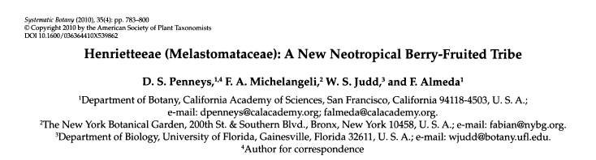
Even accepted names can be wrong!
Name submitted | Tropicos | The Plant List
Henriettea fascicularis | =Henriettella fascicularis | =Henriettella fascicularis
Henriettea ramiflora | Accepted | Accepted
Henriettea succosa | Accepted | Accepted
Henriettella fascicularis | Accepted | Accepted
Henriettella tuberculosa | Accepted | =Henriettea tuberculosa
Actually, all belong in
Henriettea

