Slide 1
Animation
Adam M. Wilson

Slide 2
Lead Author
Yihui Xie ~
Author of knitr package…

Slide 3
Animation package
Make animations
probability theory
mathematical statistics
multivariate statistics
nonparametric statistics
sampling survey
linear models
time series
computational statistics
data mining
machine learning
Save to Flash, GIF, HTML pages, PDF and videos

Slide 4
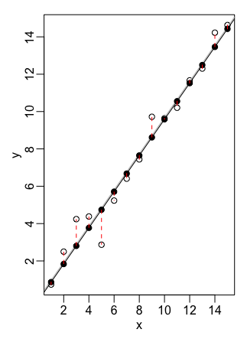
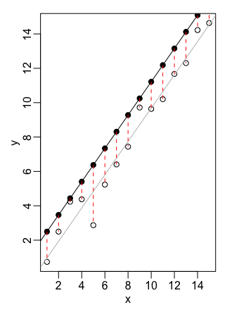
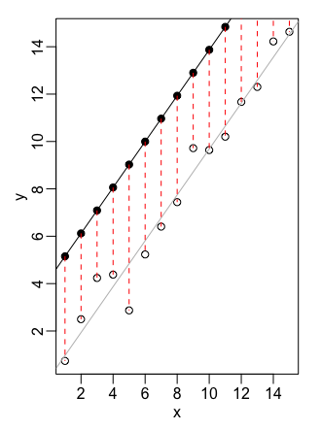
Basic steps…
Uses a ’loop’ to make a series of plots
1
2
3
Then the package facilitates ‘combining’ them into an animation

Slide 5
Example Code: Linear Regression
saveGIF({
ani.options(interval = 0.3, nmax = 50) par( mar = c(4, 4, 0.5, 0.1), mgp = c(2, 0.5, 0), tcl = -0.3)
least.squares() }, img.name = "least.squares", htmlfile = "least.squares.gif", ani.height = 600, ani.width = 1000, title = "Demonstration of Least Squares")
Set visual parameters plot
Run the visualization
Set the output parameters

Slide 6
Example Output

