Slide 1
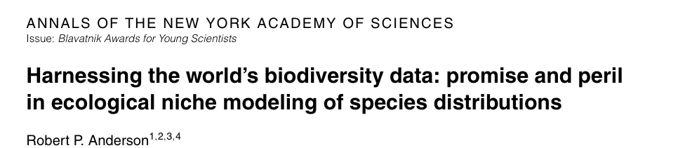
Applied biodiversity informatics
Anderson (2012)
Agenda: Making data and modeling ready to address critical environmental issues of the 21st century

Slide 2
Agenda: applied biodiversity informatics
1. High-quality data, ready to be accessed when the particular problem presents itself
2. Software that achieves an appropriate balance between automation and supervision
3. Scientists capable of building, applying, and appraising high-quality models

Slide 3






THANK YOU
NSF DEB-1119915 and DBI-1650241
http://www.andersonlab.ccny.cuny.edu/

