Slide 1
Integrating and Cleaning Biodiversity Data
A bunch of ecoinformaticians (see next)
9 Jan 2017 IBS Meeting

Slide 2
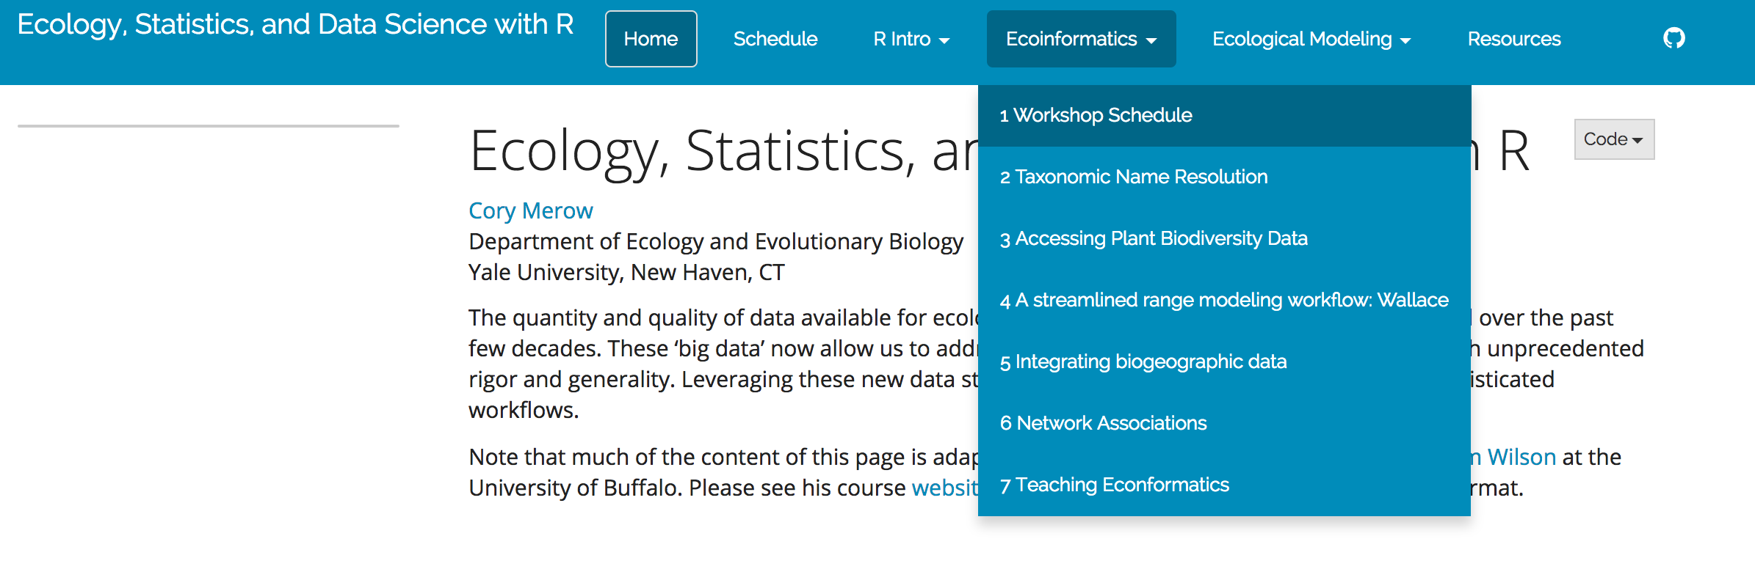
Install some packages while I’m talking…
cmerow.github.io/RDataScience/

Slide 3
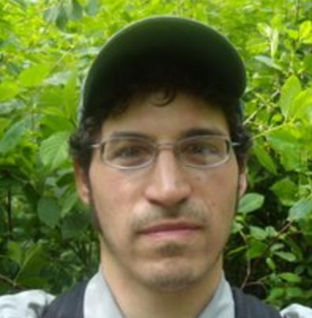
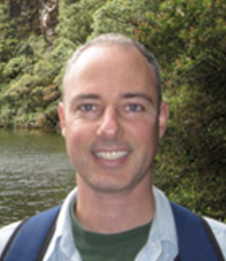
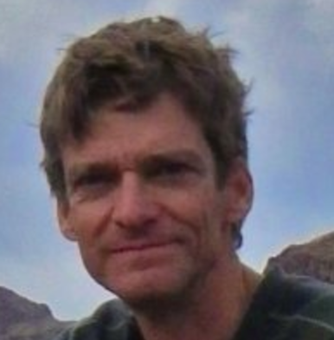
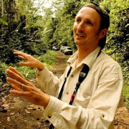
Matt Aiello-Lammens
Rob Anderson
Brad Boyle
Brian Enquist
Jamie Kass
Drew Kerkhoff
Brian Maitner
Brian McGill
Cory Merow
Naia Morueta-Holme
Jens Christian Svenning

Slide 4
A case for informatics
Informatics – getting info from data
Large data sets
Computation
Statistics

Slide 5
A case for informatics
Combine data sets
Explore data sets
Get our data organized

